Slide 1


The UPC today,
2024 — 2025 academic year

Slide 2

The UPC,
the public university
of engineering, architecture, sciences and technology

Slide 3

About the UPC

Slide 4



About the UPC
31.400
67
101
9
bachelor’s and
master’s degree students
/ 31 % women
campuses
6.600
graduates of bachelor’s and master’s degrees
18
schools
bachelor’s degrees
master’s degrees
30
departaments
2.600
continuing education students
45
180
141
research groups
2.300
doctoral students
doctoral programmes
continuing education
programmes
3.700
2.200
100.700
411 M€
2025 budget in million euros
108 M€
income from RDI (2025)
teaching and research staff
technical, management,
administrative
and service staff
alumni

Slide 5
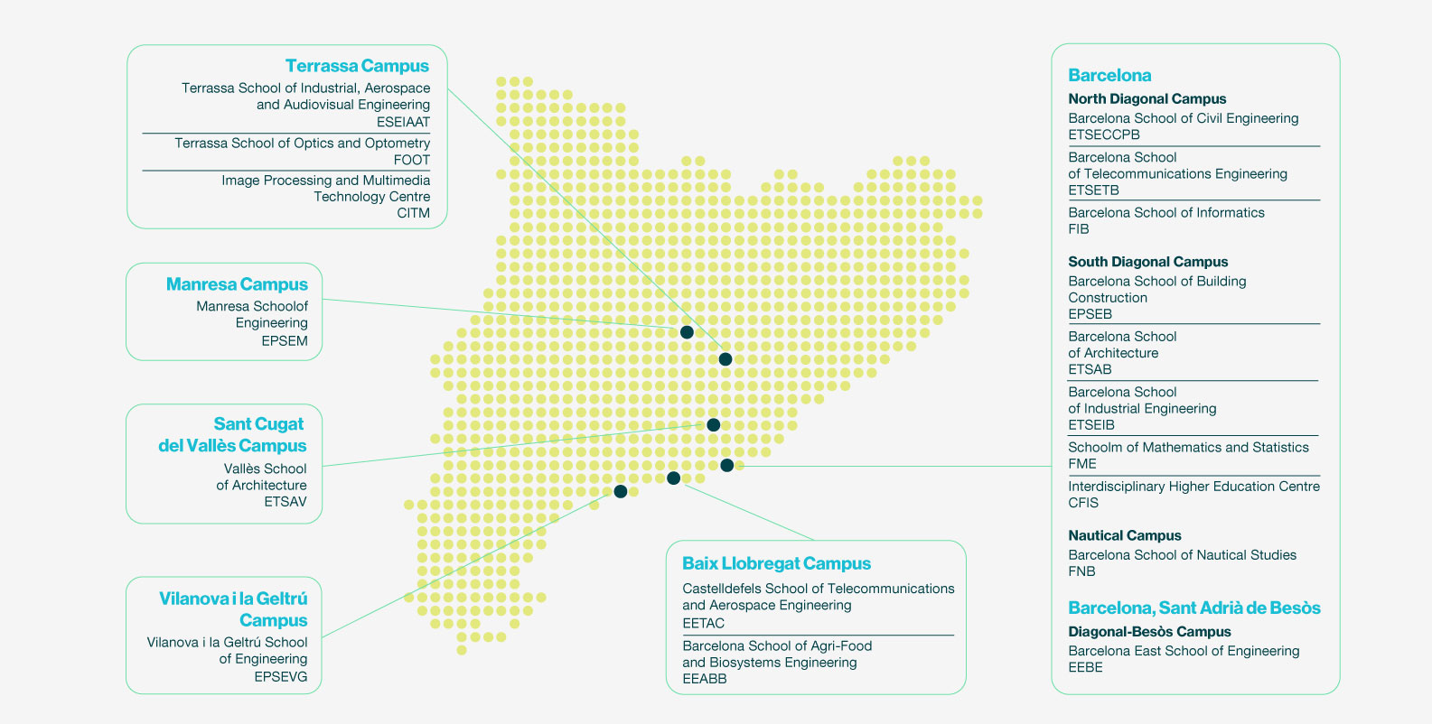
The UPC campuses

Slide 6
Schools and faculties
EEABB
Barcelona School
of Agri-Food and Biosystems Engineering
EEBE
Barcelona East School of Engineering
EETAC
Castelldefels School
of Telecommunications and Aerospace Engineering
EPSEB
Barcelona School
of Building Construction
EPSEM
Manresa School
of Engineering
EPSEVG
Vilanova i la Geltrú School of Engineering
ESEIAAT
Terrassa School
of Industrial, Aerospace
and Audiovisual Engineering
ETSAB
Barcelona School
of Architecture
ETSAV
Vallès School
of Architecture
ETSECCPB
Barcelona School
of Civil Engineering
ETSEIB
Barcelona School
of Industrial
Engineering
ETSETB
Barcelona School
of Telecommunications
Engineering
FIB
Barcelona School
of Informatics
FME
School
of Mathematics
and Statistics
FNB
Barcelona School
of Nautical Studies
FOOT
Terrassa School
of Optics and Optometry
CFIS
Interdisciplinary Higher Education Centre
CITM
Image Processing
and Multimedia Technology Centre

Slide 7

Teaching

Slide 8

Teaching
25.900
bachelor’s degrees
5.500
master’s degree students
2.300
doctoral students
2.600
continuing
education students
6.600
graduates of bachelor’s and master’s degrees
6.000
students on work placement
100.700
alumni
67
101
45
180
9
campuses
18
schools
bachelor’s degrees
master’s degrees
doctoral programmes
continuing education programmes

Slide 9
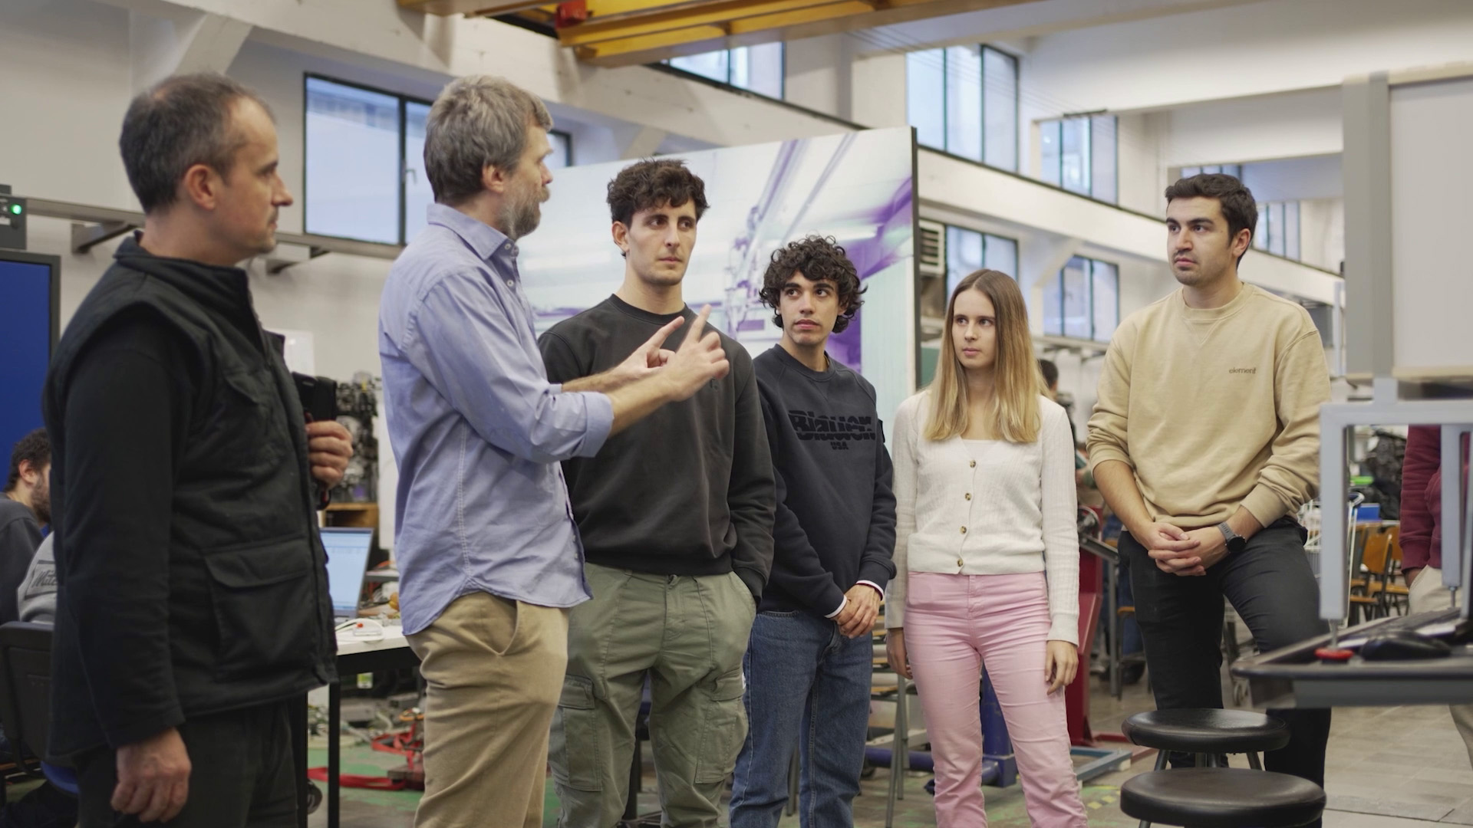

Slide 10
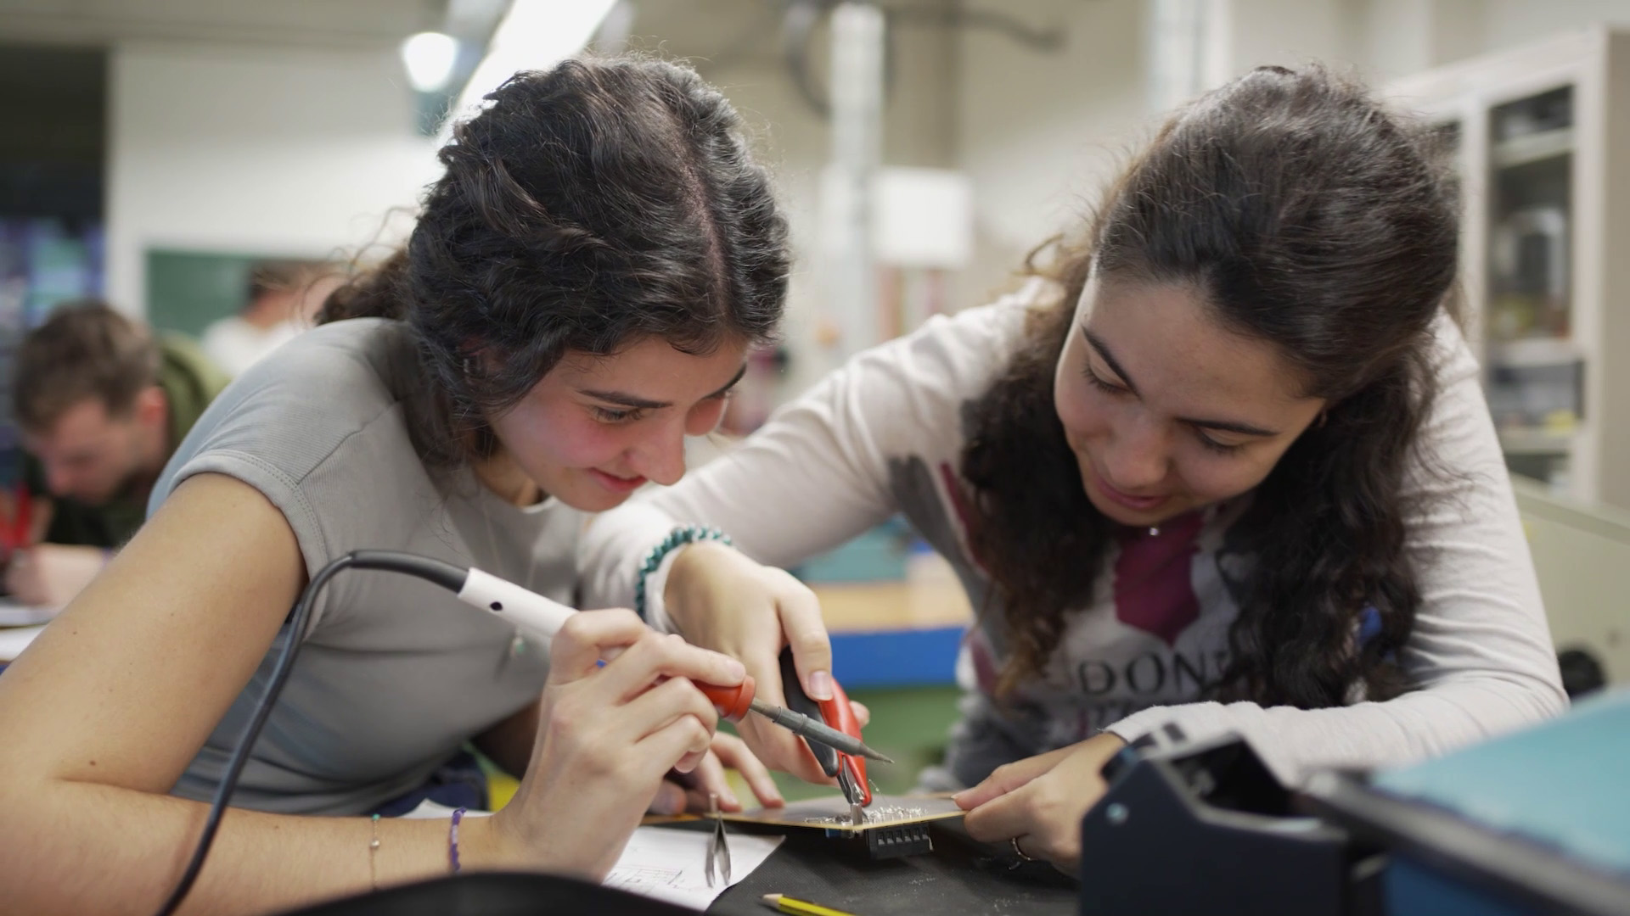

Slide 11
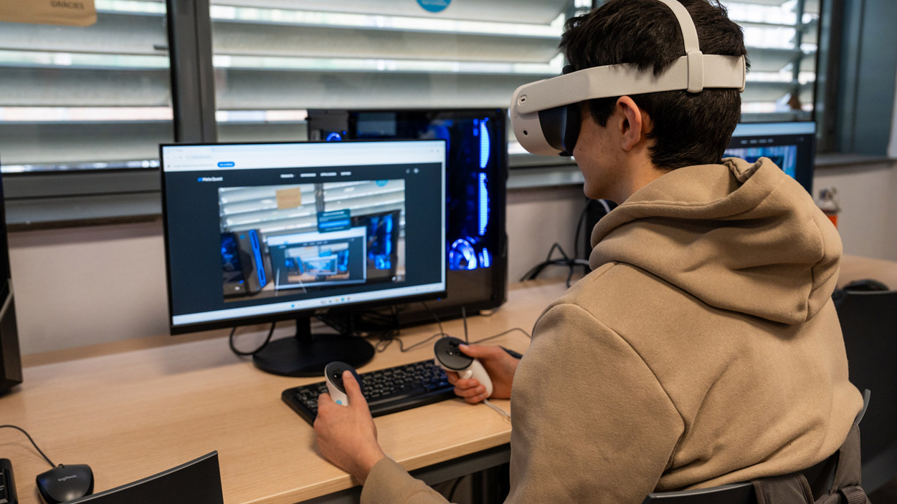

Slide 12
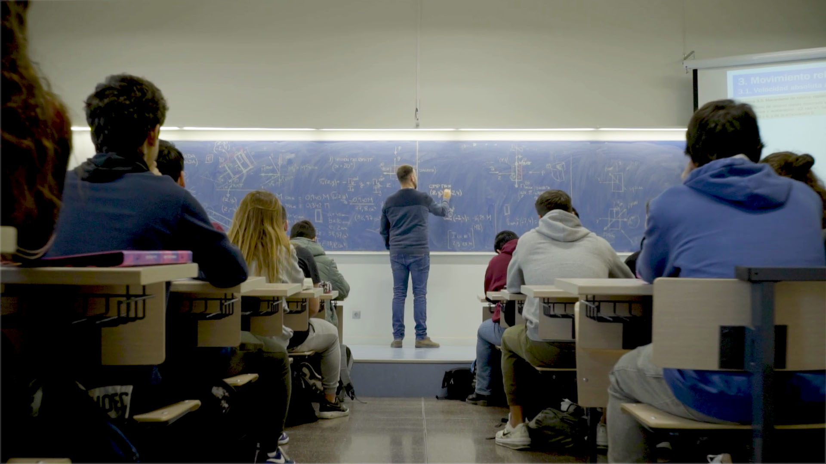

Slide 13

Research

Slide 14



Research
30
departments
141
research groups
5
research
institutes
21
specific
research centres
12
associated
research entitles
3.700
teaching
and research staff
2.579
scientific
publications (2024)
2.300
doctoral students
345
thesis
Areas
architecture
urbanism and building construction
sciences
civil and
environmental engineering
ICT engineering
industrial
engineering
46
doctoral programmes
(curs 2025-26)
43
industrial
doctorate projects
250
scientific and technical
distinctions
(2024)

Slide 15
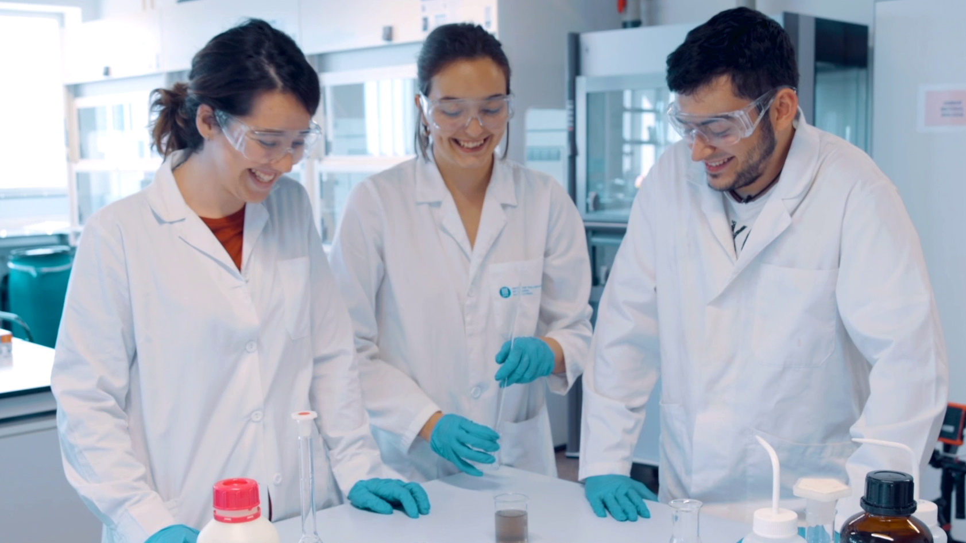

Slide 16
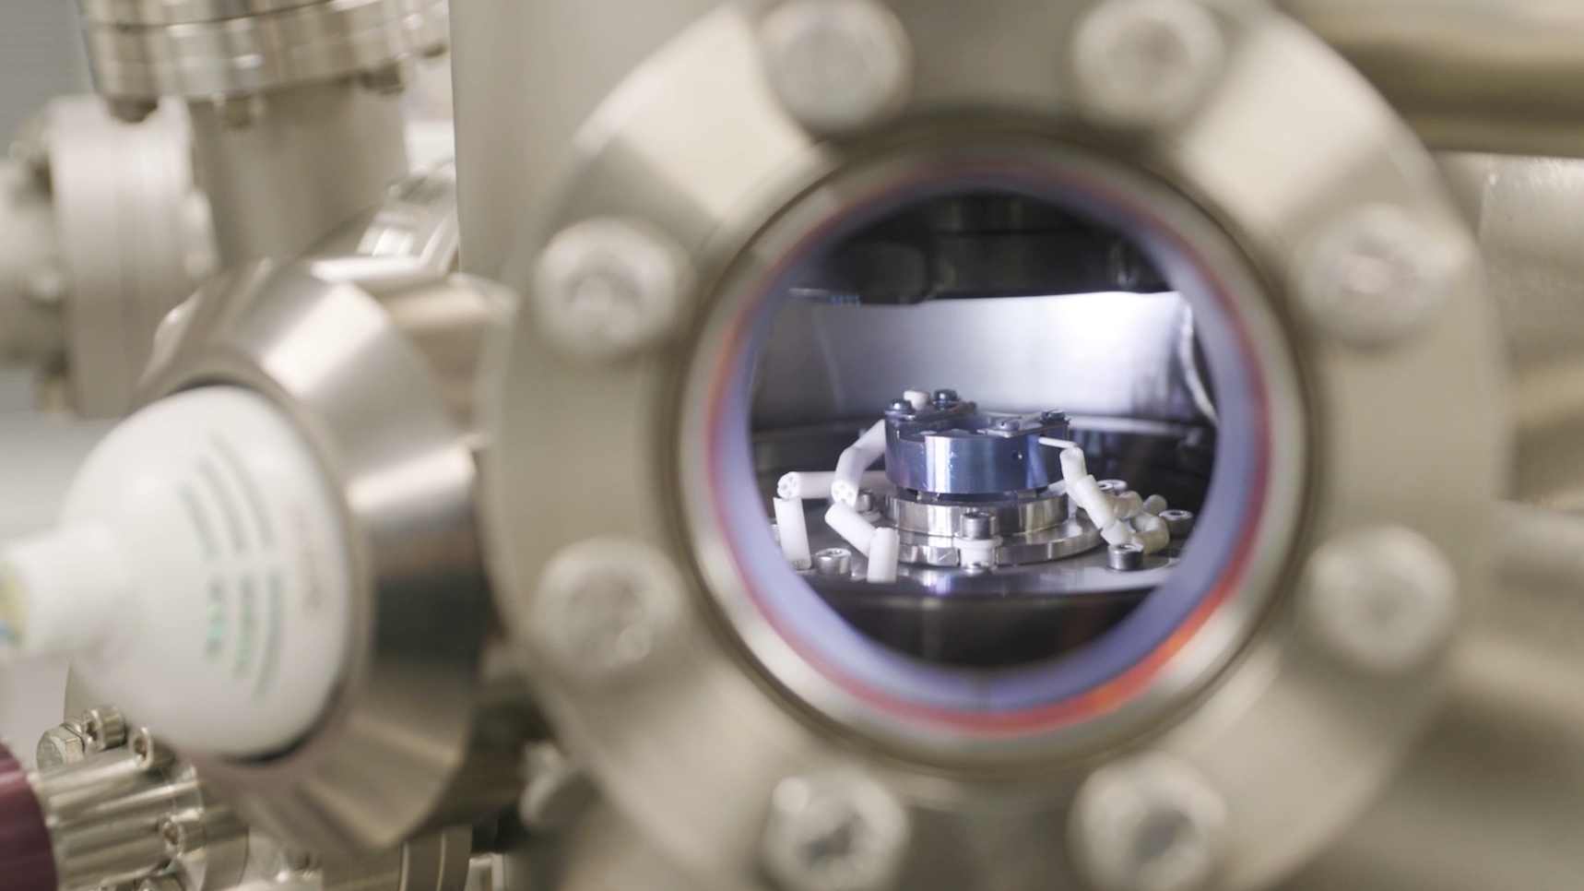

Slide 17
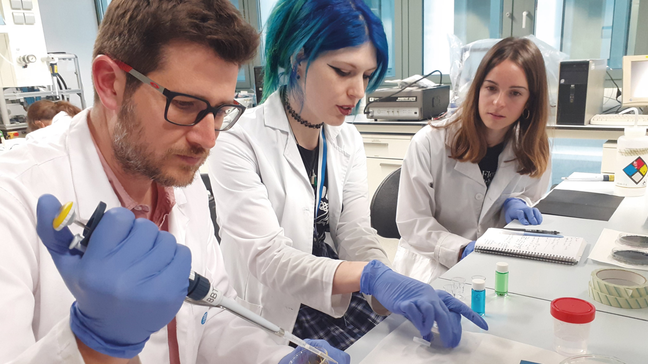

Slide 18
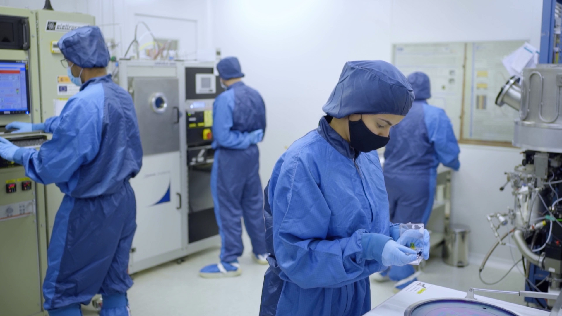

Slide 19
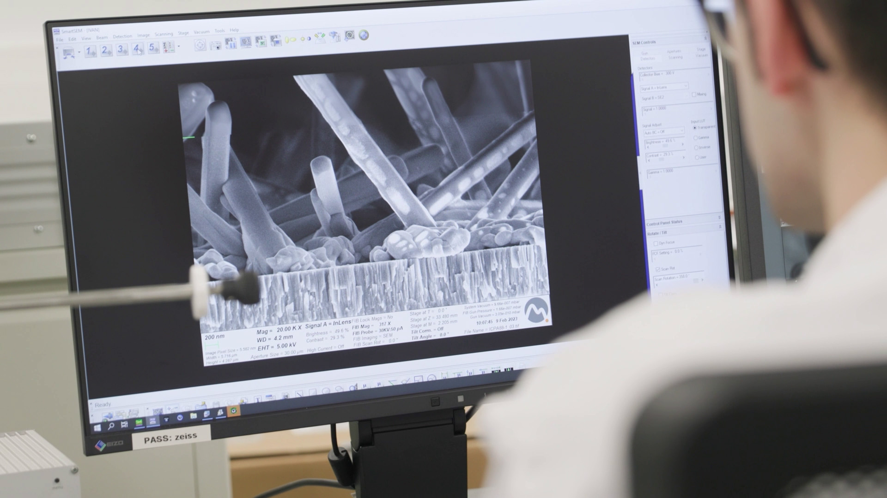

Slide 20

Transfer

Slide 21






Transfer
new patents
technology-based
companies
companies and organisations
with collaboration agreements
3.131
23
33
10
1.935
108 M€
income from RDI
new technological
start-ups
active agreements
and projects

Slide 22
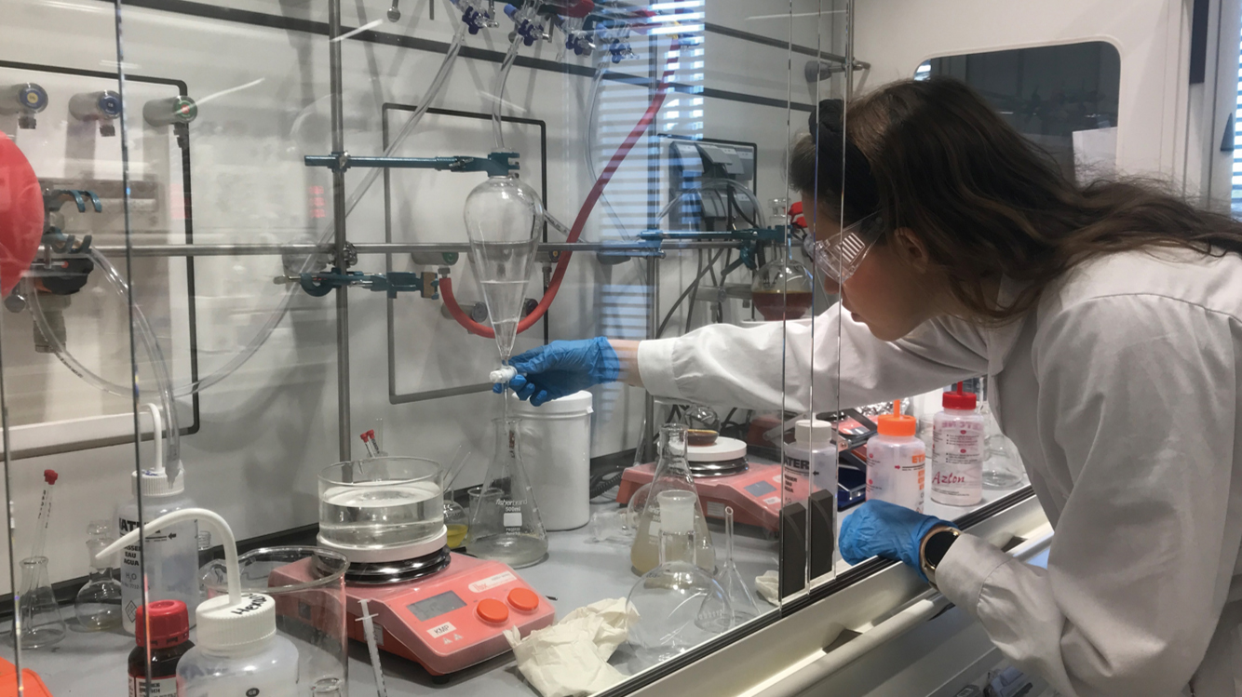

Slide 23
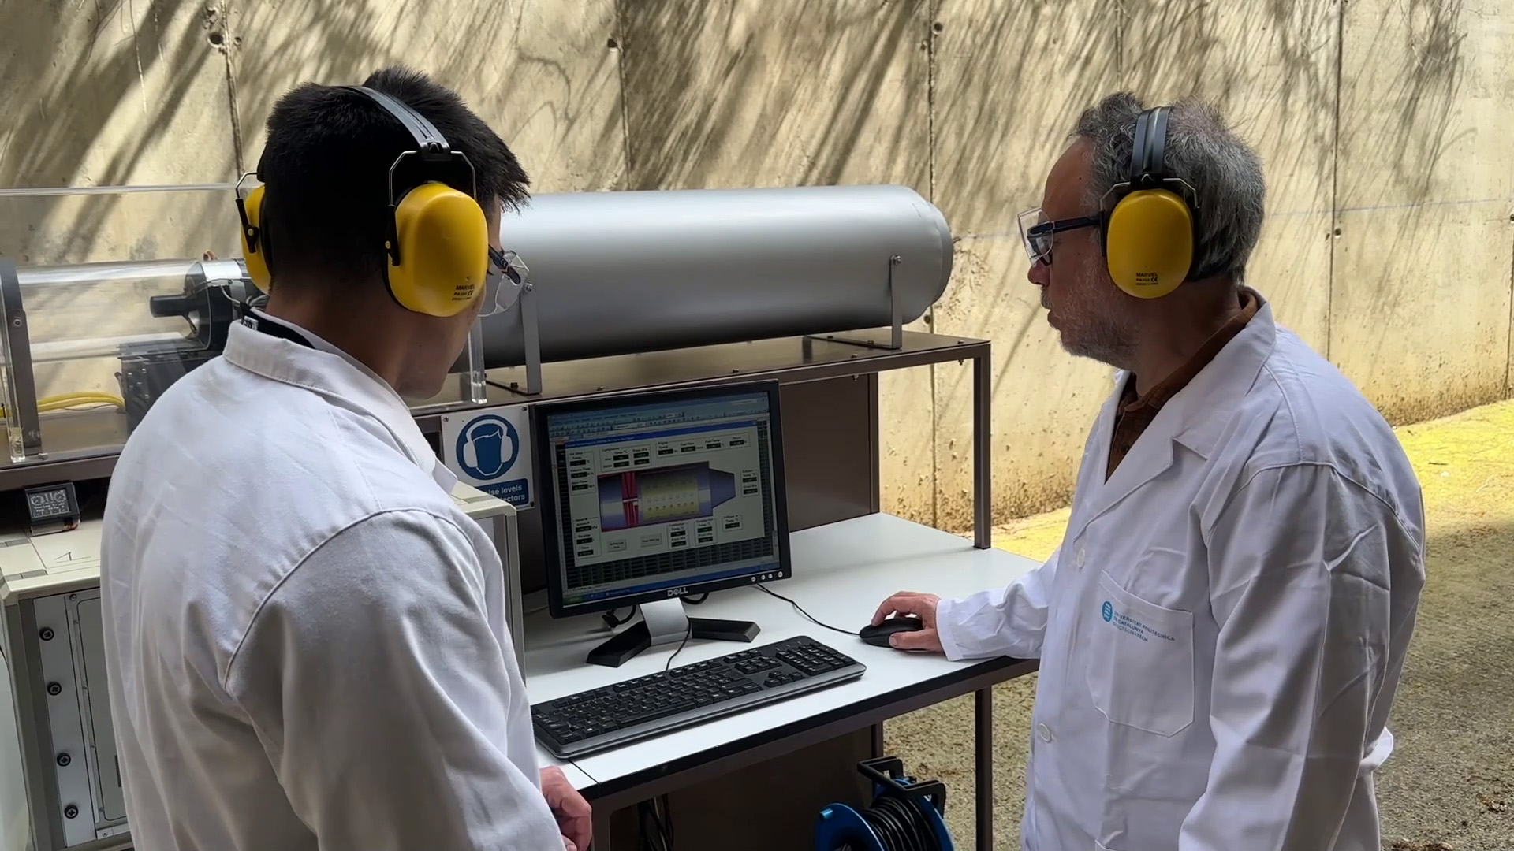

Slide 24
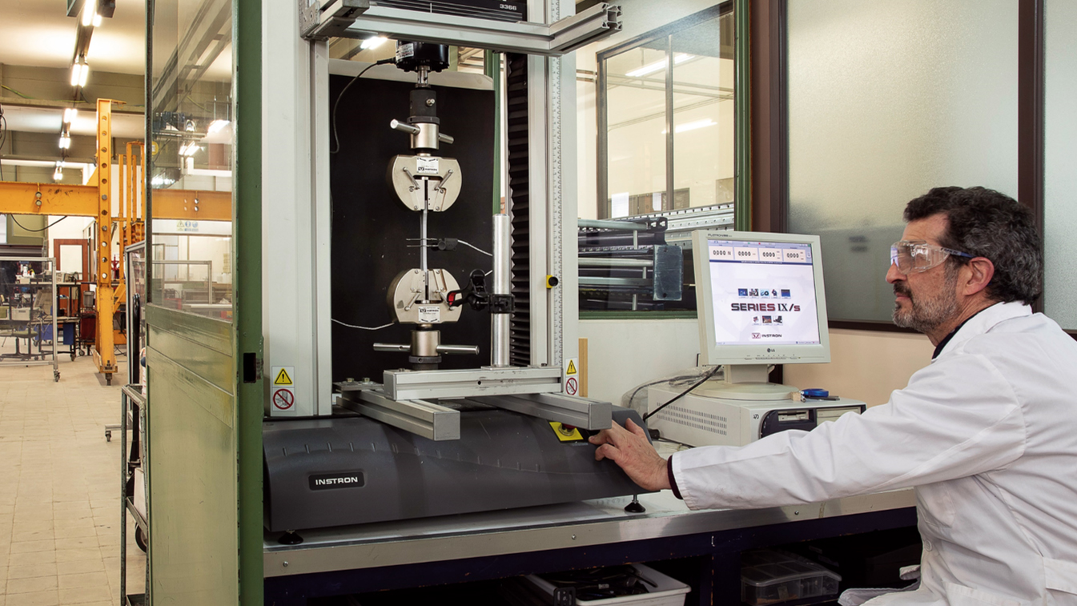

Slide 25

International

Slide 26
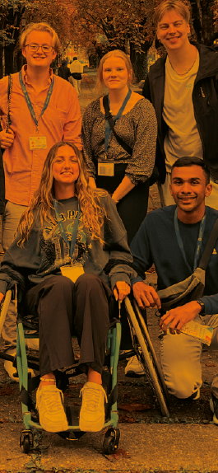


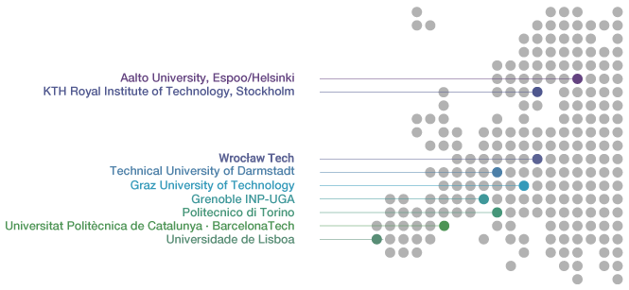


International
El 54%
dels estudiants
de doctorat i el
28%
dels estudiants de màster són internacionals
80
international double degree agreements with
1.600
student exchange
agreements with
3.200 mobility students
47
universities
12
countries
695
universities
57
countries
1.750
1.450
International exchange students at UPC
UPC students on mobility programmes
270
educational cooperation agreements with institutions
in over
1st
Spain’s university in projects funded through the Horizon Europe program
40
countries

Slide 27
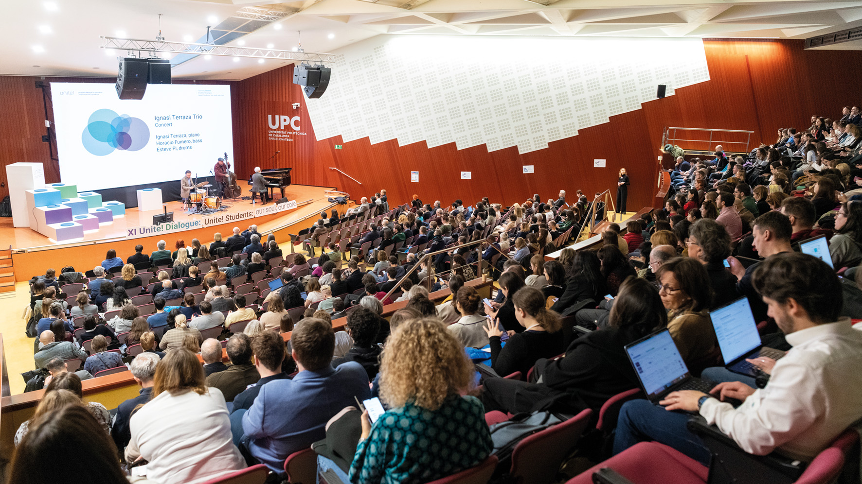

Slide 28
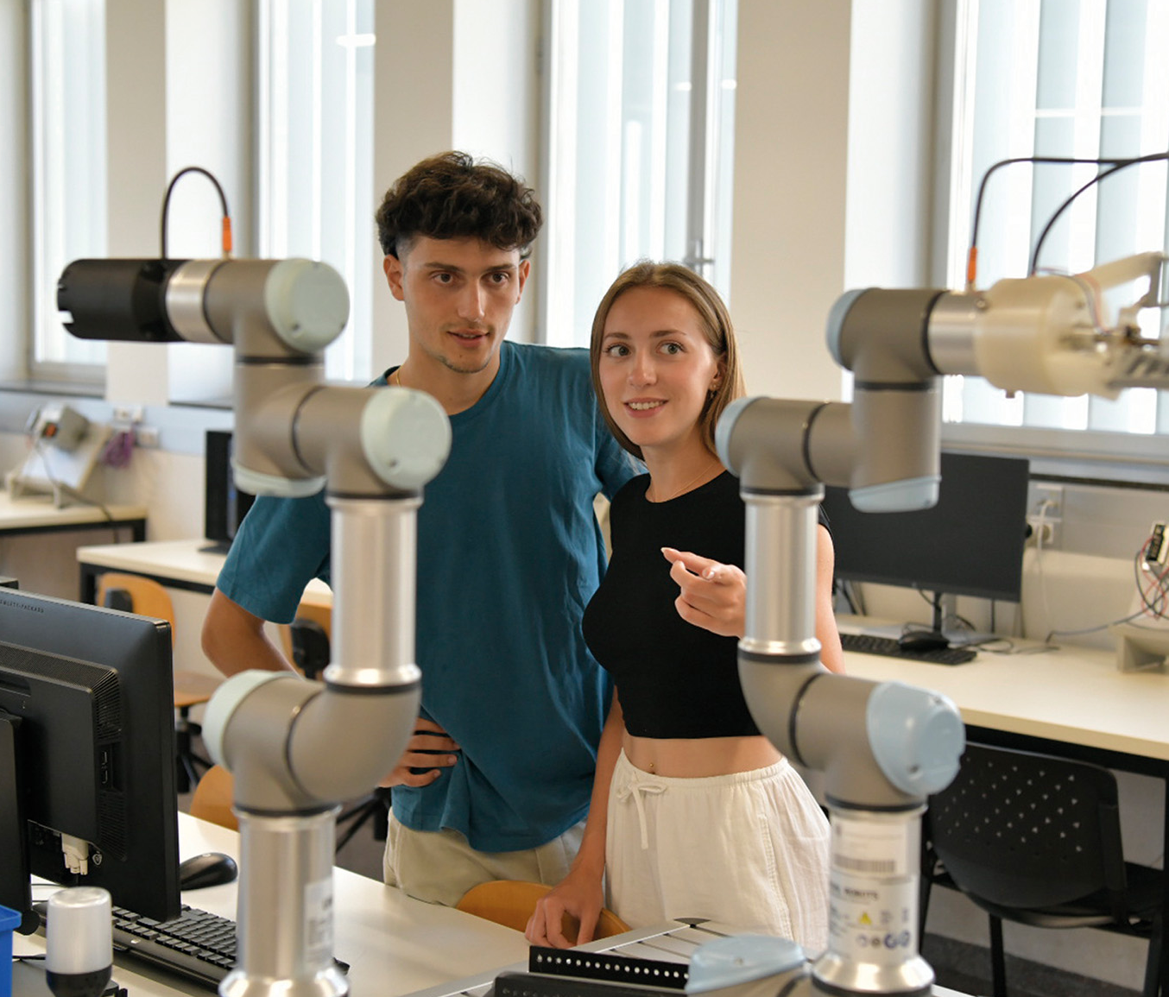
University studies
2024-2025
academic year
www.upc.edu/en
Bachelor’s degrees
www.upc.edu/en/bachelors/
Master’s
degrees
www.upc.edu/en/masters/
Doctoral programmes
doctorat.upc.edu/en/programmes/
Continuing education
www.talent.upc.edu/ing

Slide 29
The UPC,
the public university
of engineering, architecture, sciences and technology

Slide 30
The UPC today,
2024 — 2025 academic year

