Slide 1


The
today

Slide 2

2023-2024 ACADEMIC YEAR

Slide 3
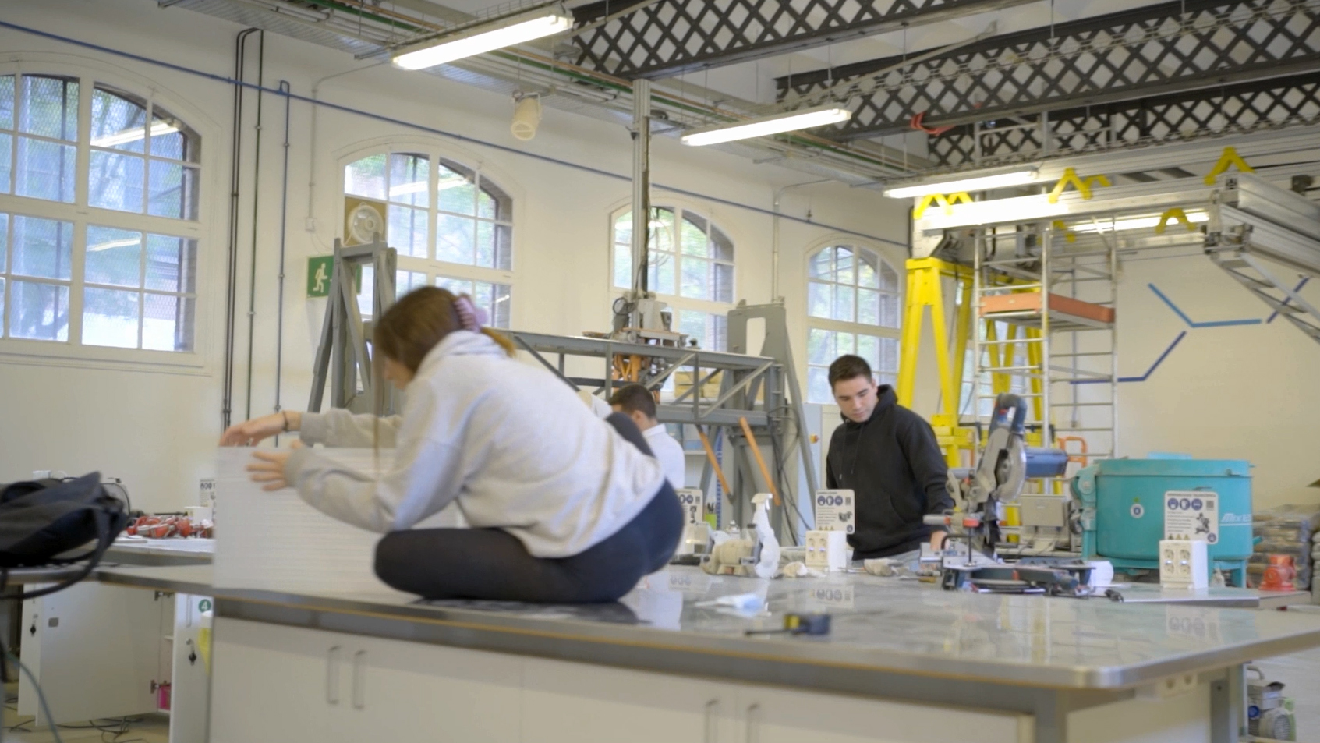
65
bachelor’s
degrees

Slide 4
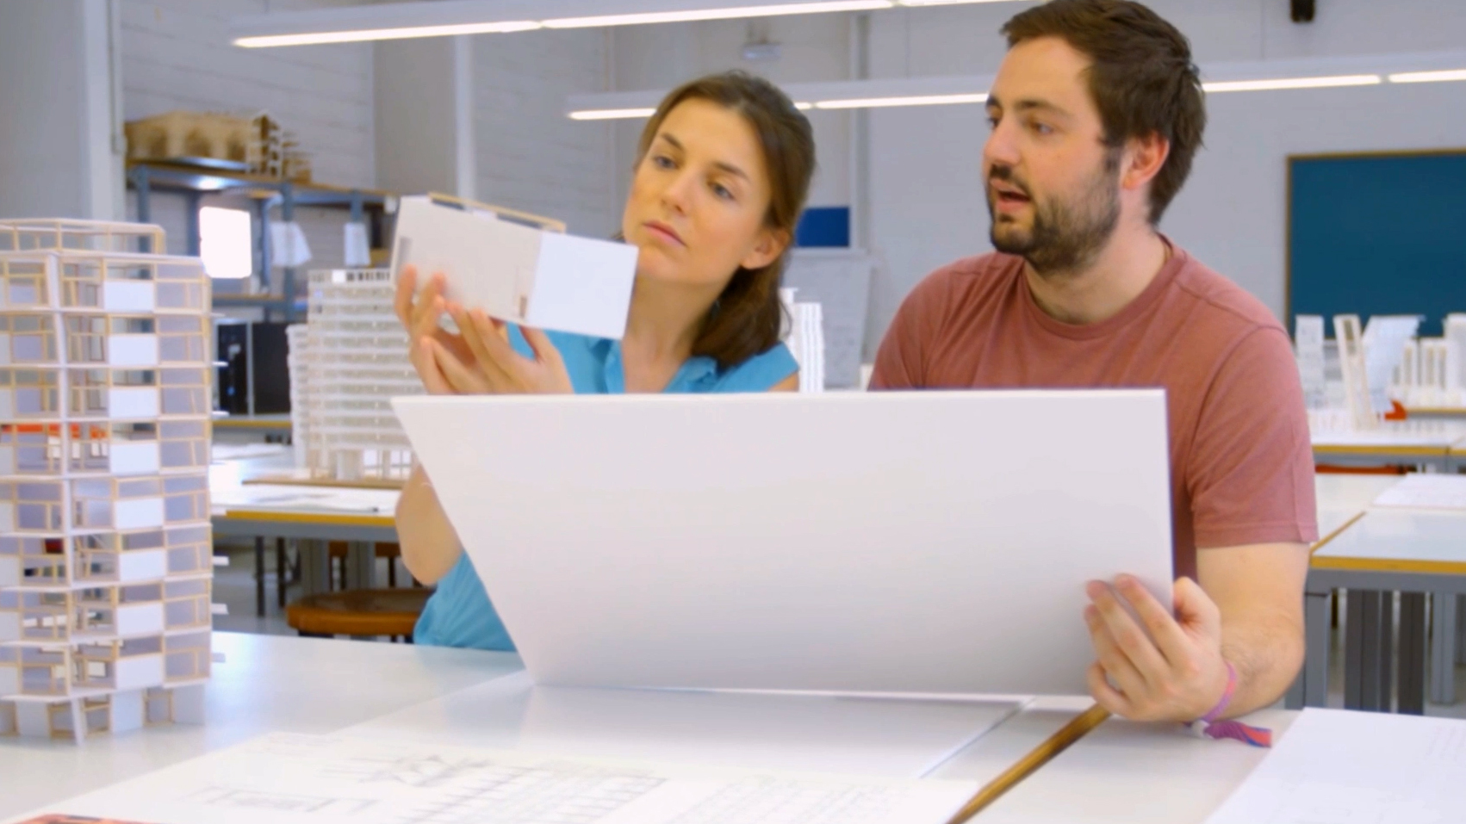
84
45
master’s
degrees
taught
in English

Slide 5
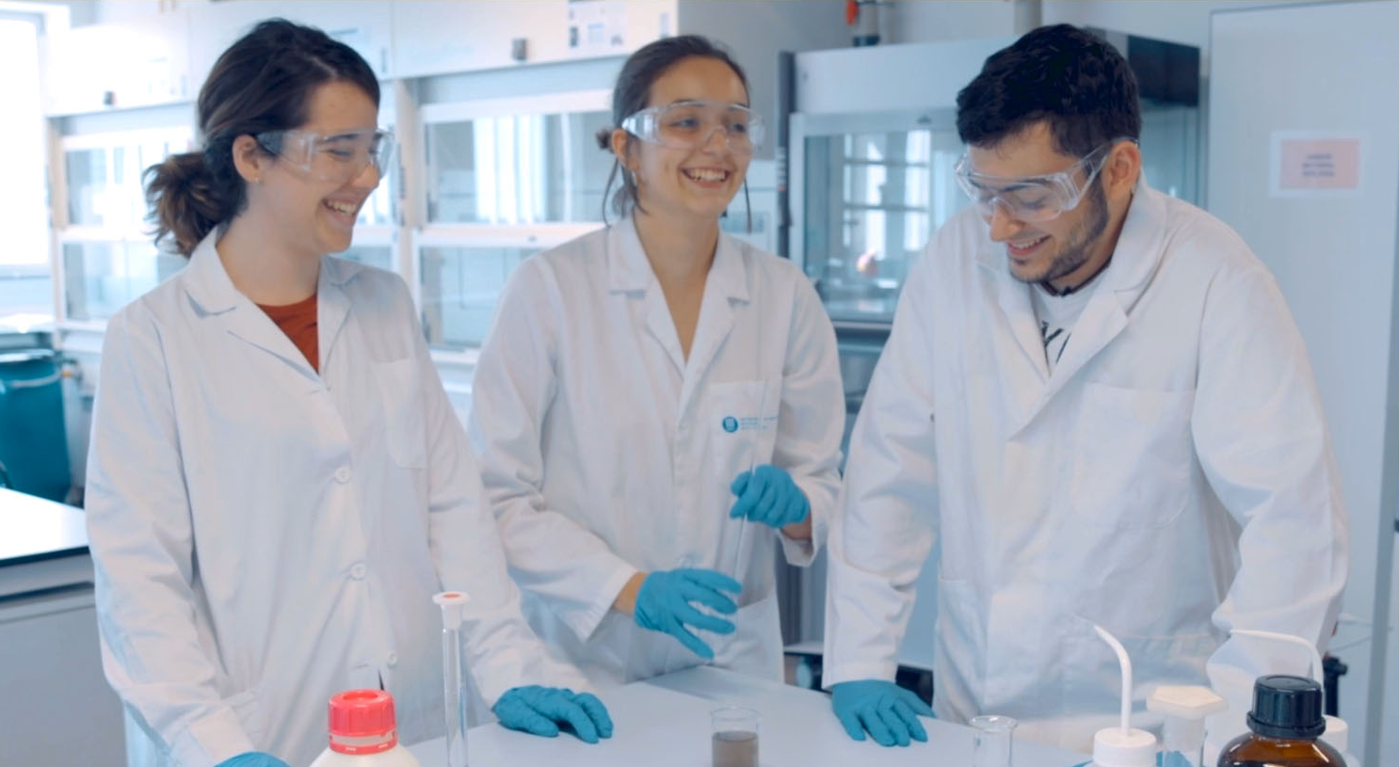
45
doctoral programmes

Slide 6

240
continuing education
programmes

Slide 7
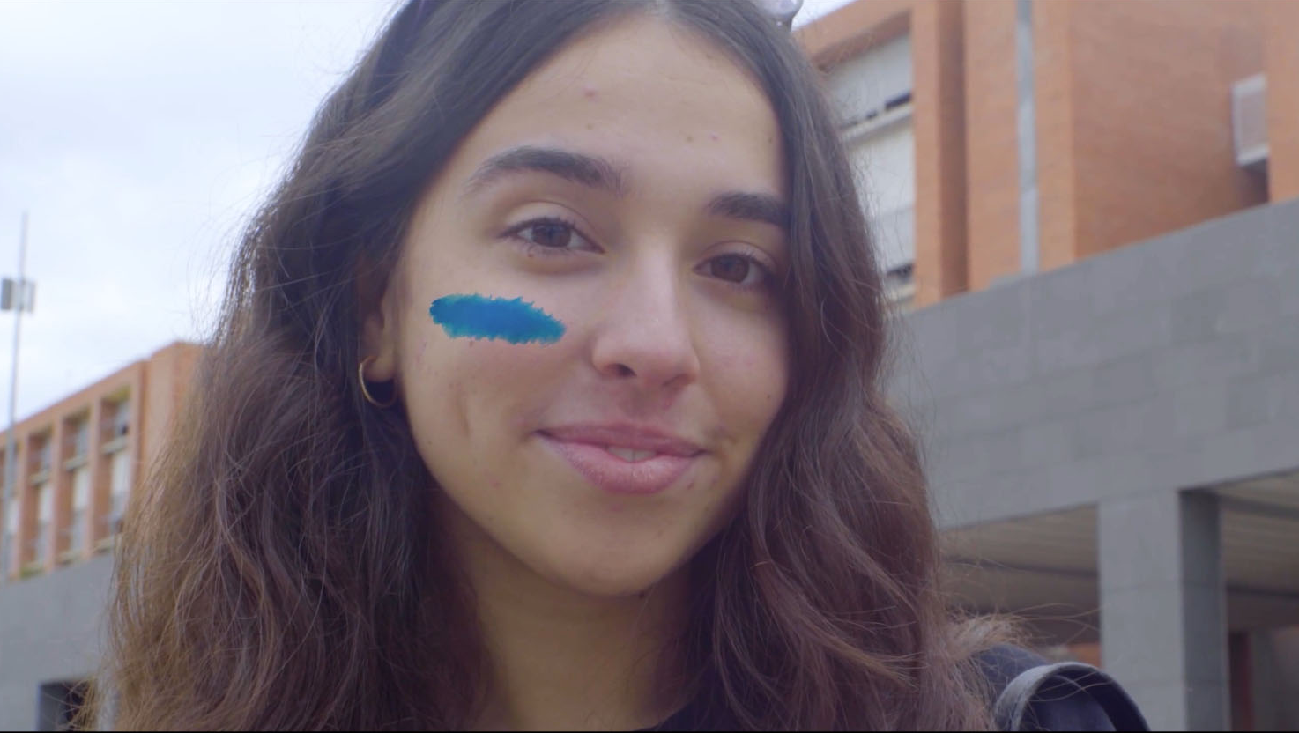

18
schools
7
in
Catalan cities

Slide 8
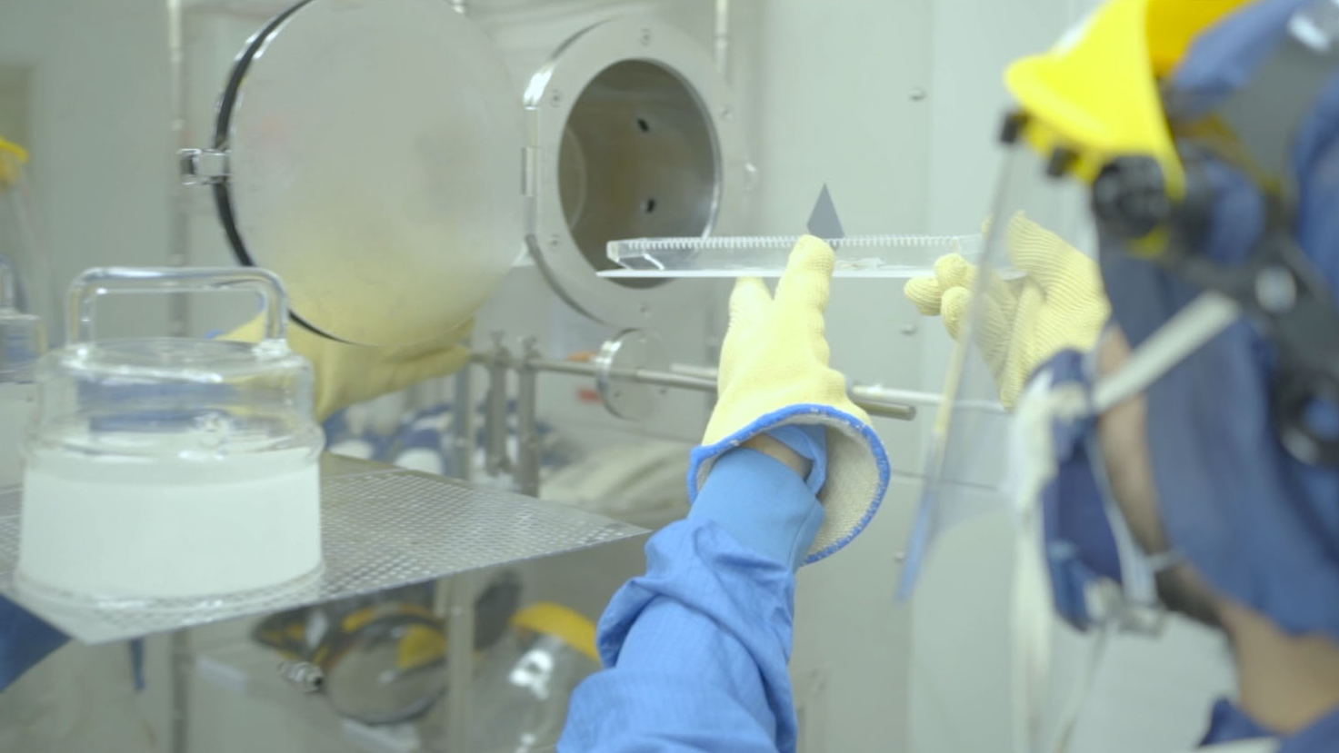
141
research
groups

Slide 9
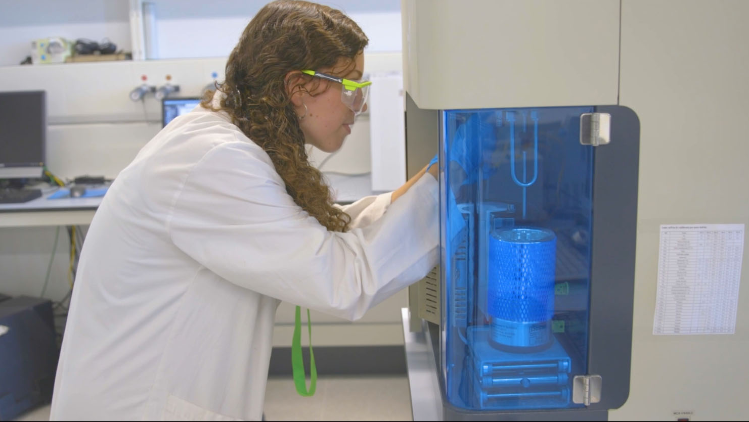
294
doctoral
theses
defended

Slide 10
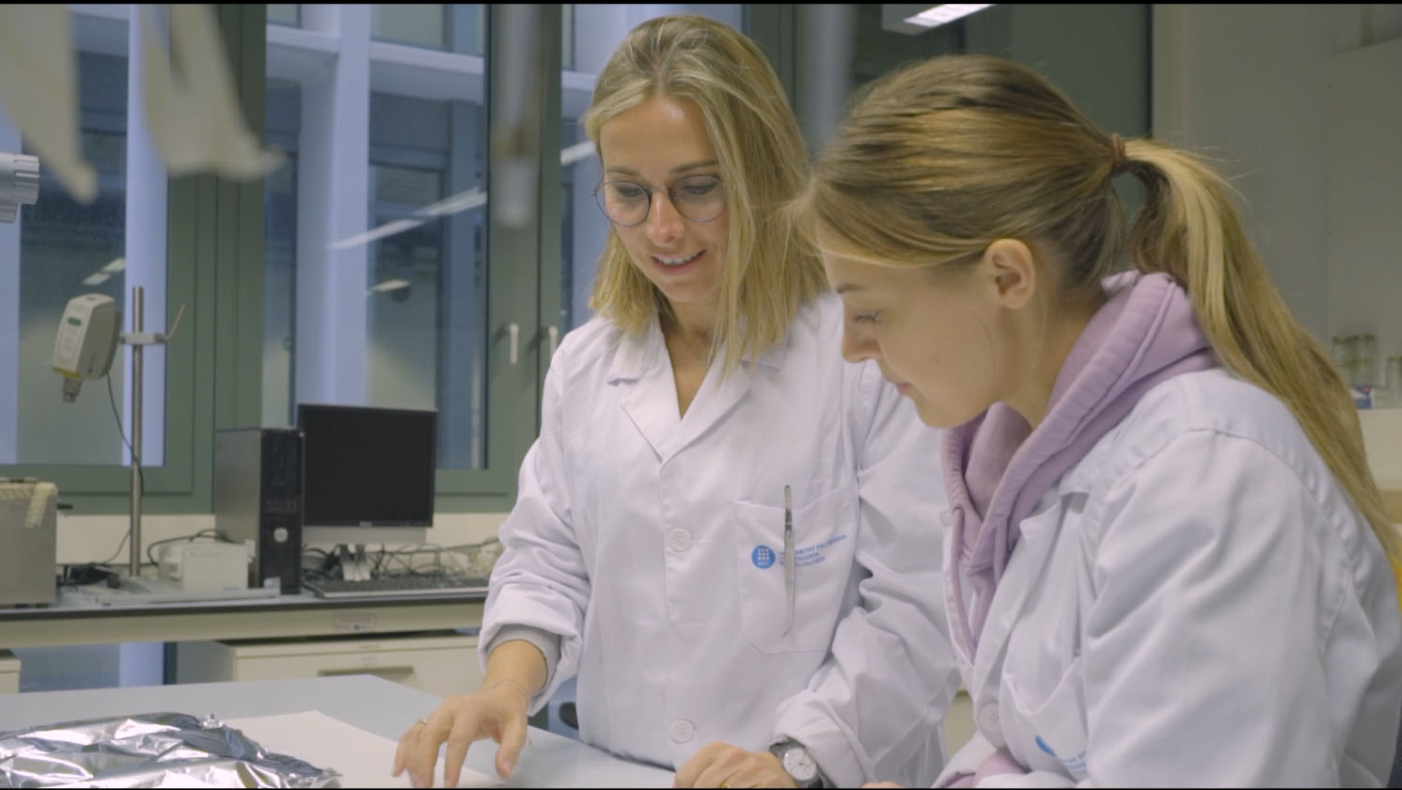
2,362
papers published
In scientific journals

Slide 11
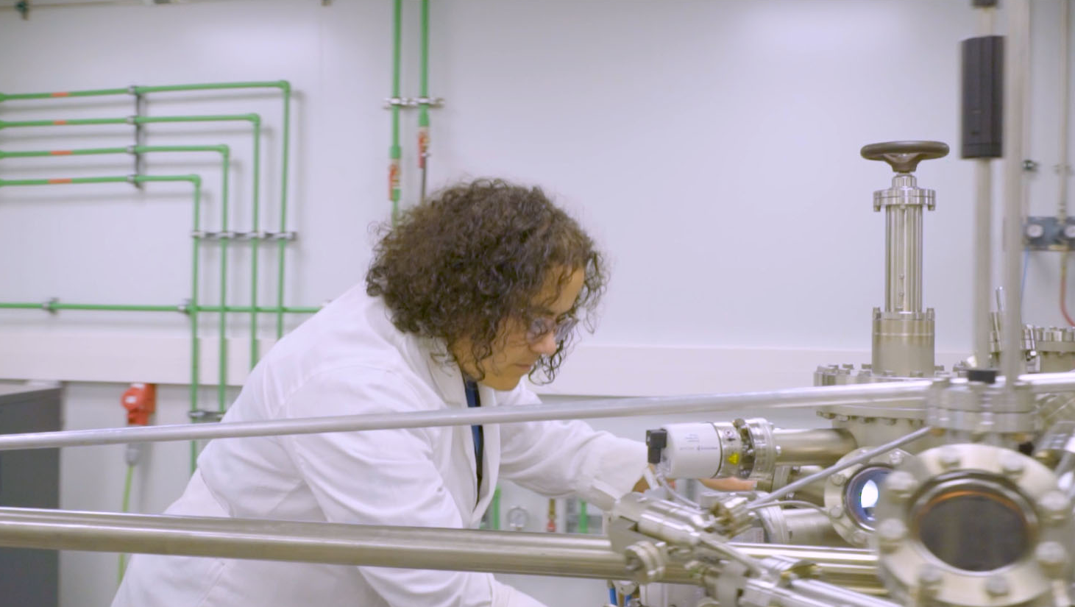
906
new research agreements and projects

Slide 12
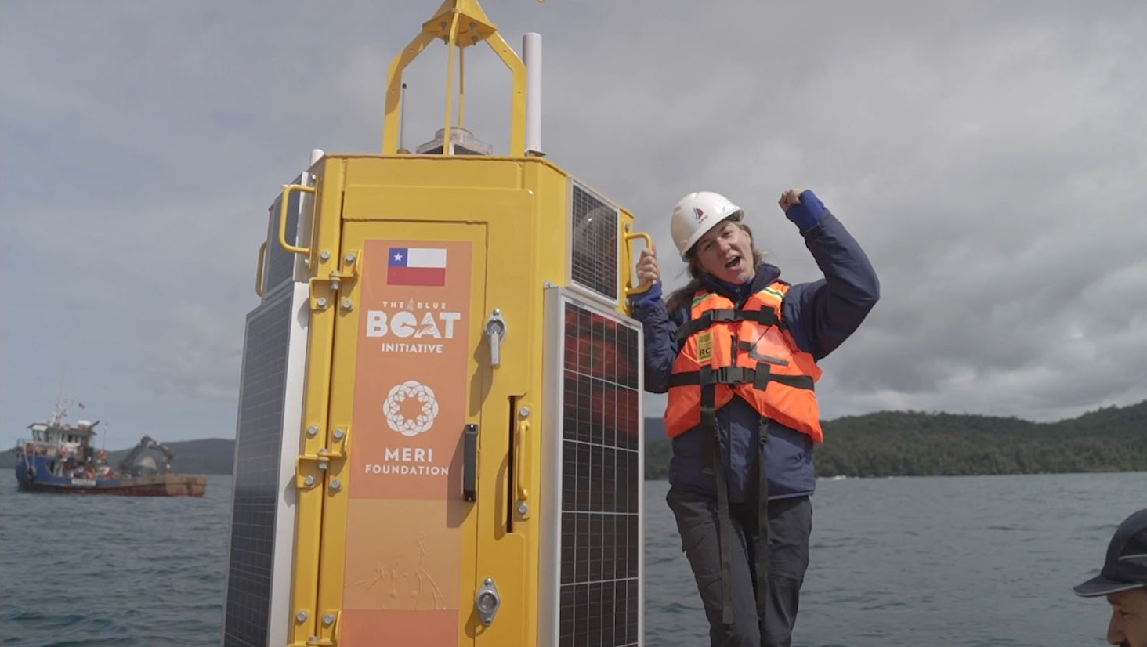
1,924
on-going
agreements
and projects

Slide 13
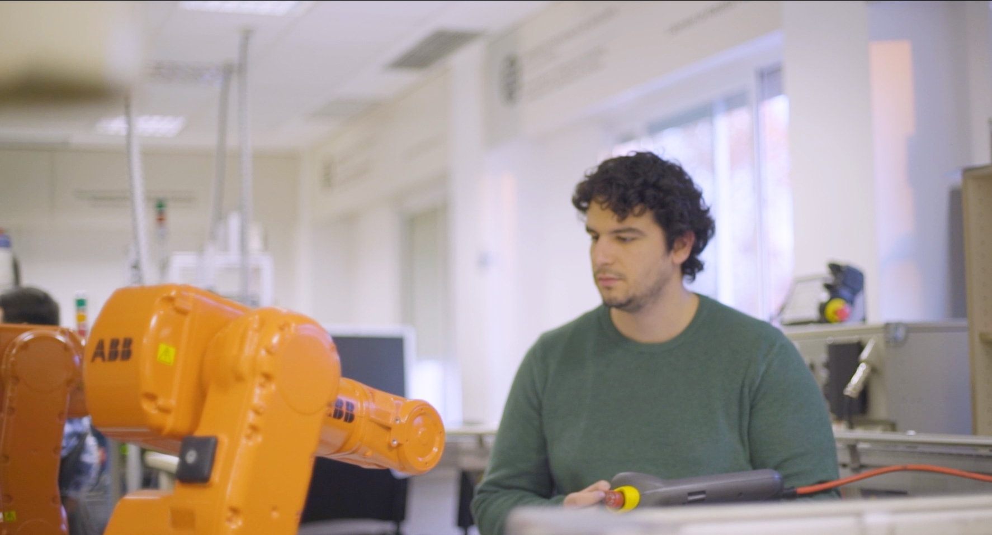
2,834
companies
and institutions
with collaboration
agreements

Slide 14
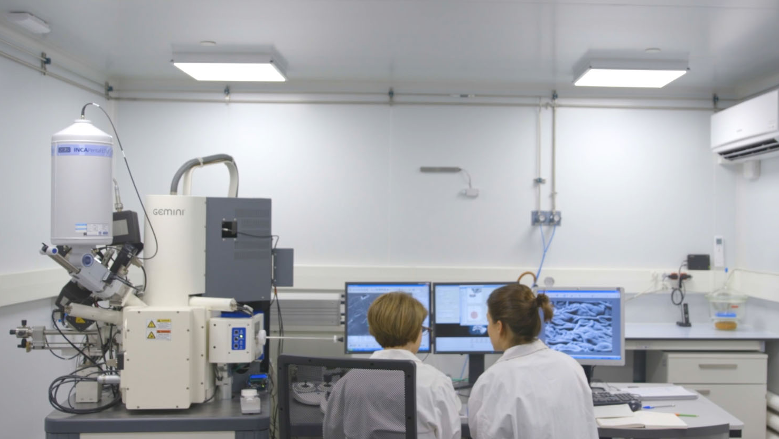
80,9 MEUR
income from
RDI projects
(2022)

Slide 15
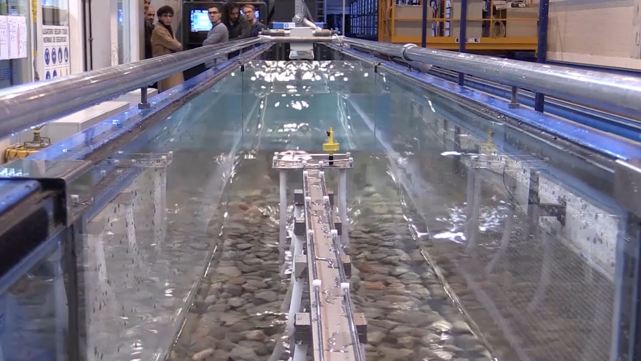
The UPC, the top university in Spain
in number of projects funded through
the Horizon Europe programme

Slide 16

13
patents
registered

Slide 17
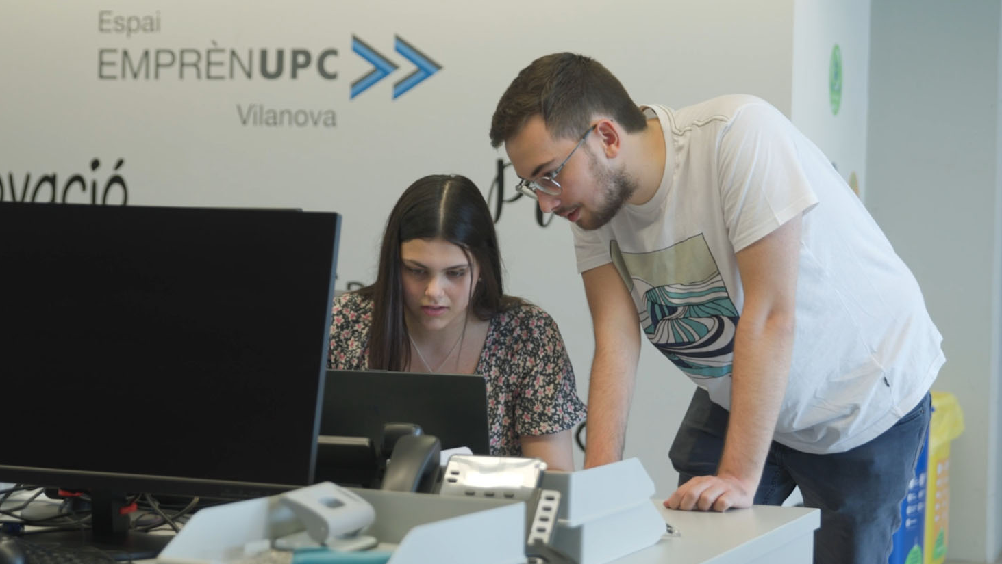
13
technology-based
start-ups

Slide 18
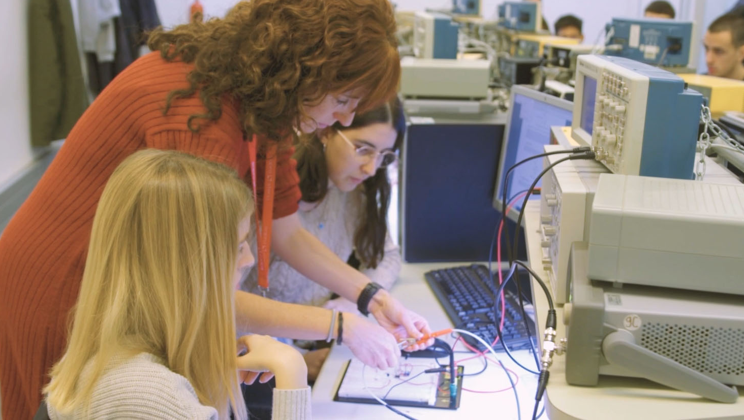
30,437
bachelor’s and master’s
degree students

Slide 19
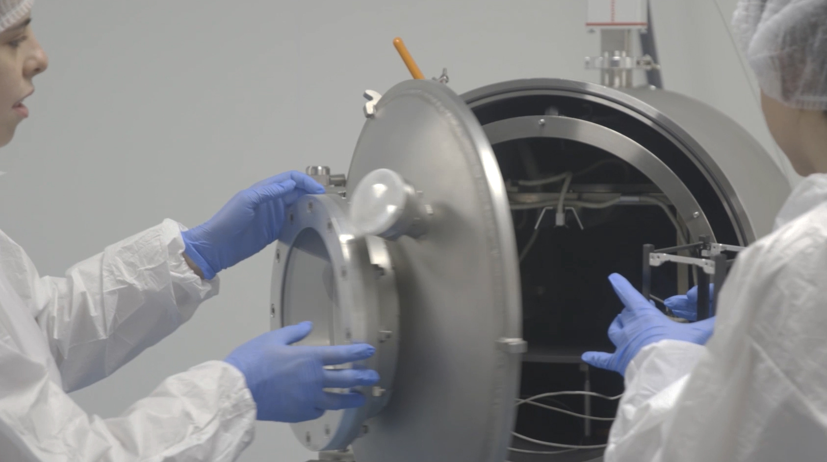
2,104
doctoral degree students

Slide 20
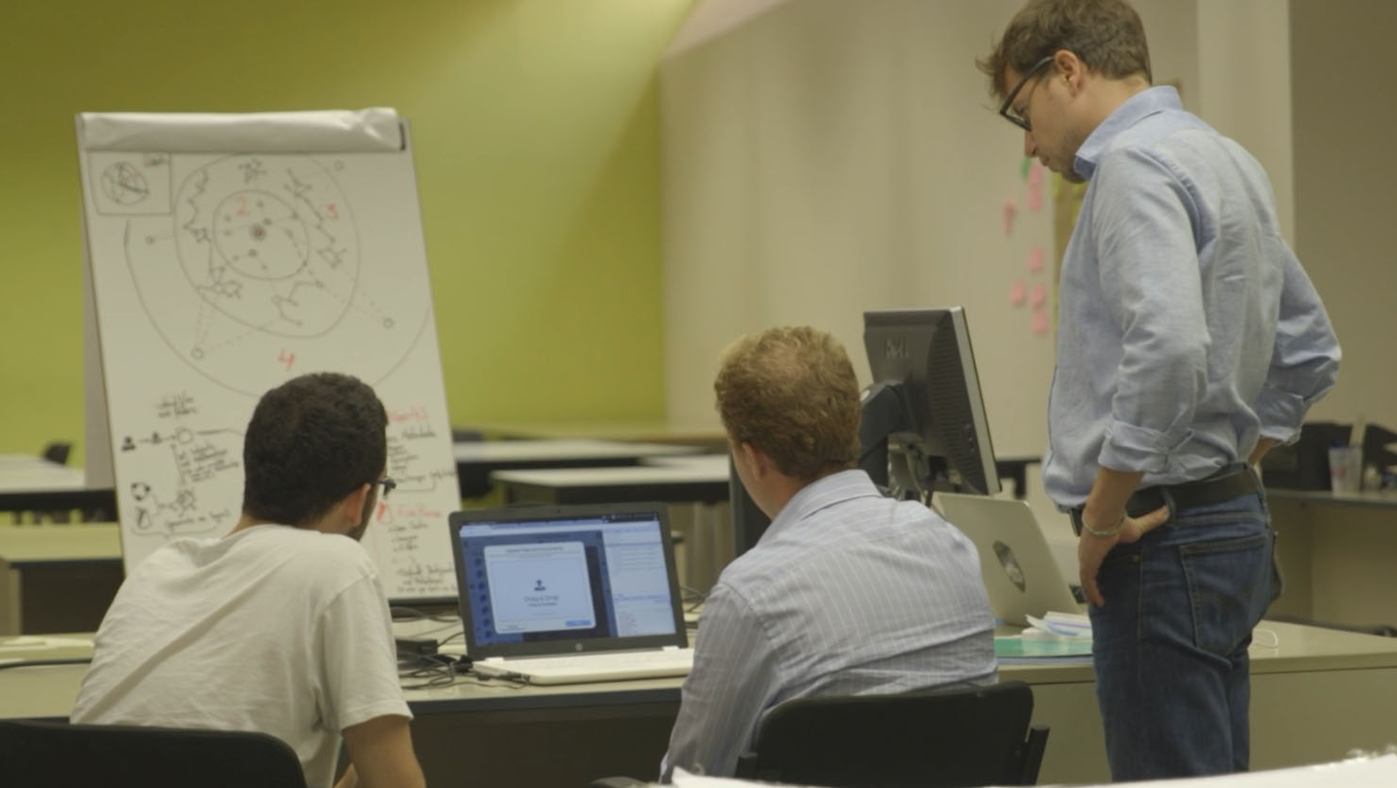
5,936
bachelor’s and master’s degree graduates

Slide 21
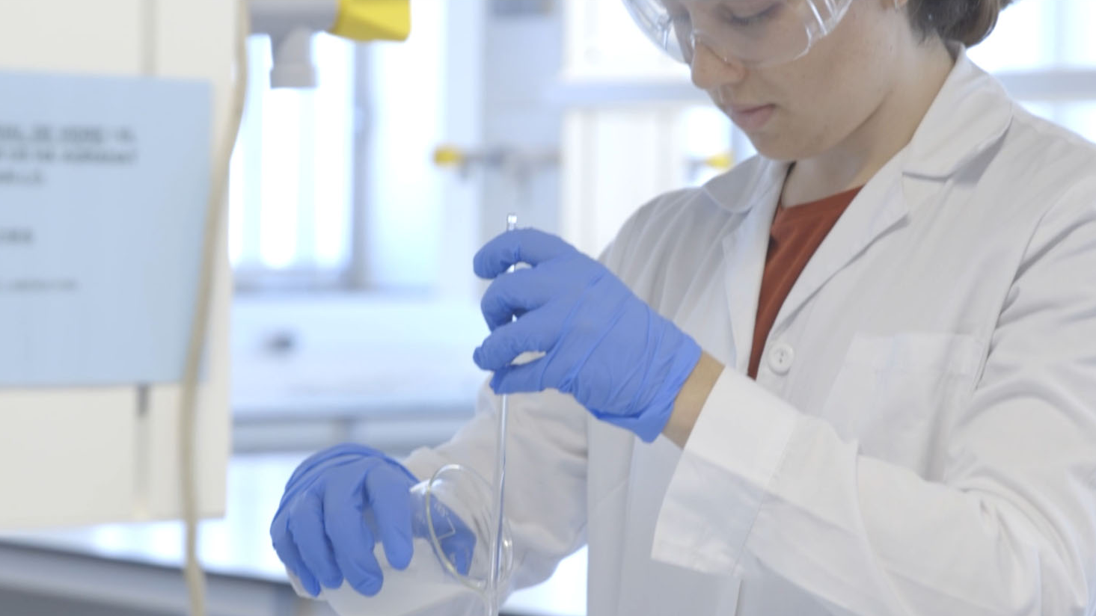

294
doctoral
graduates

Slide 22
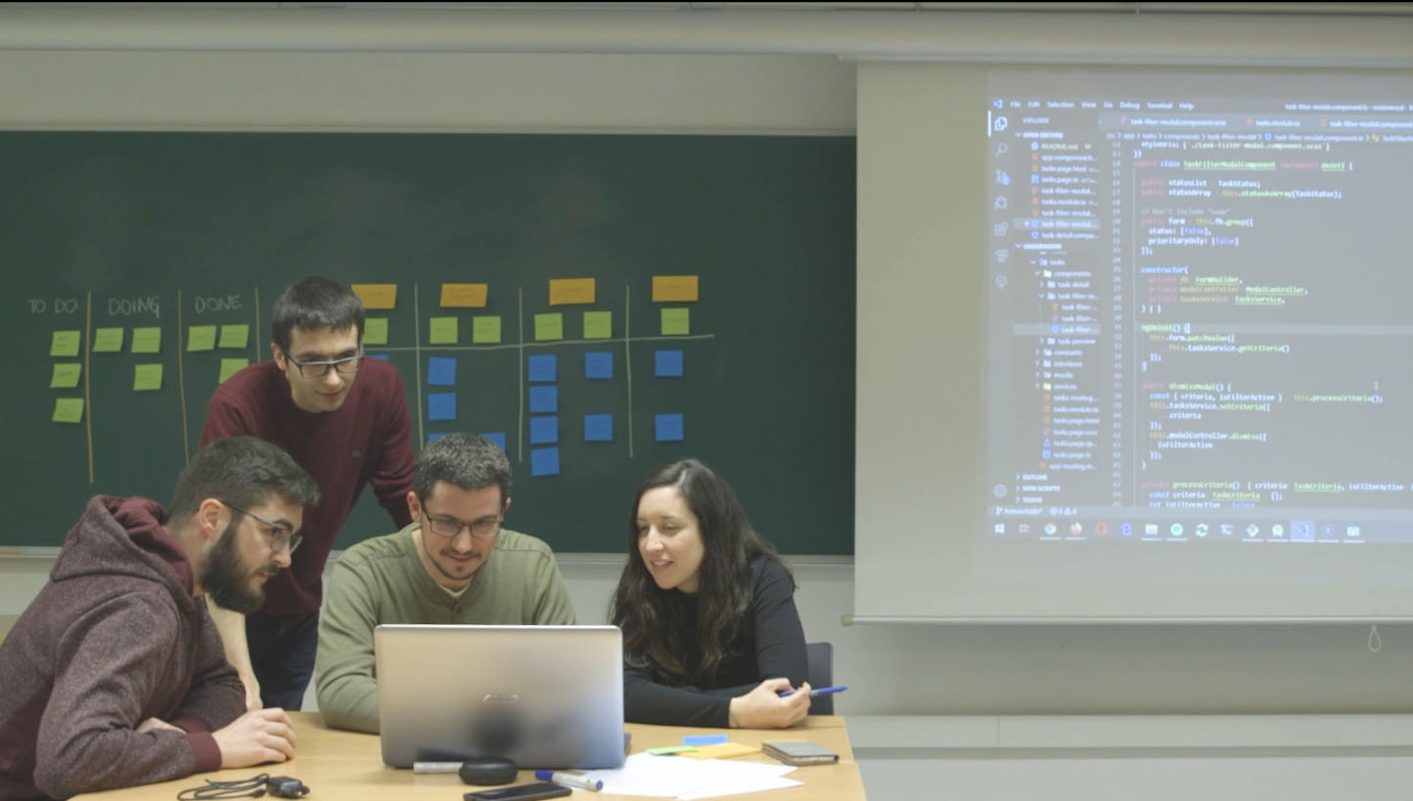
87,538
alumni

Slide 23
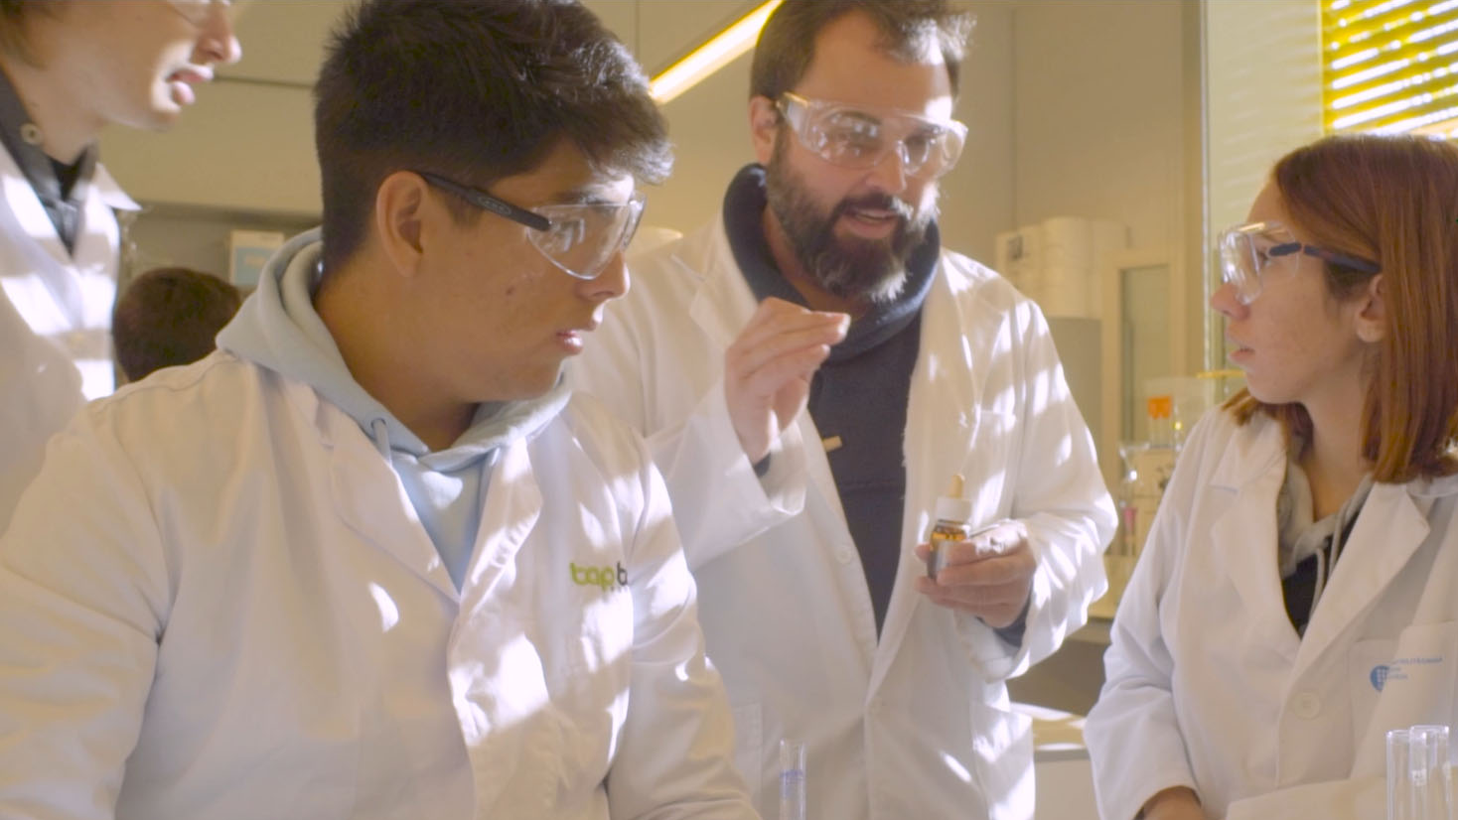
3,629
teaching
and research staff

Slide 24

1,989
administrative
and service staff

Slide 25
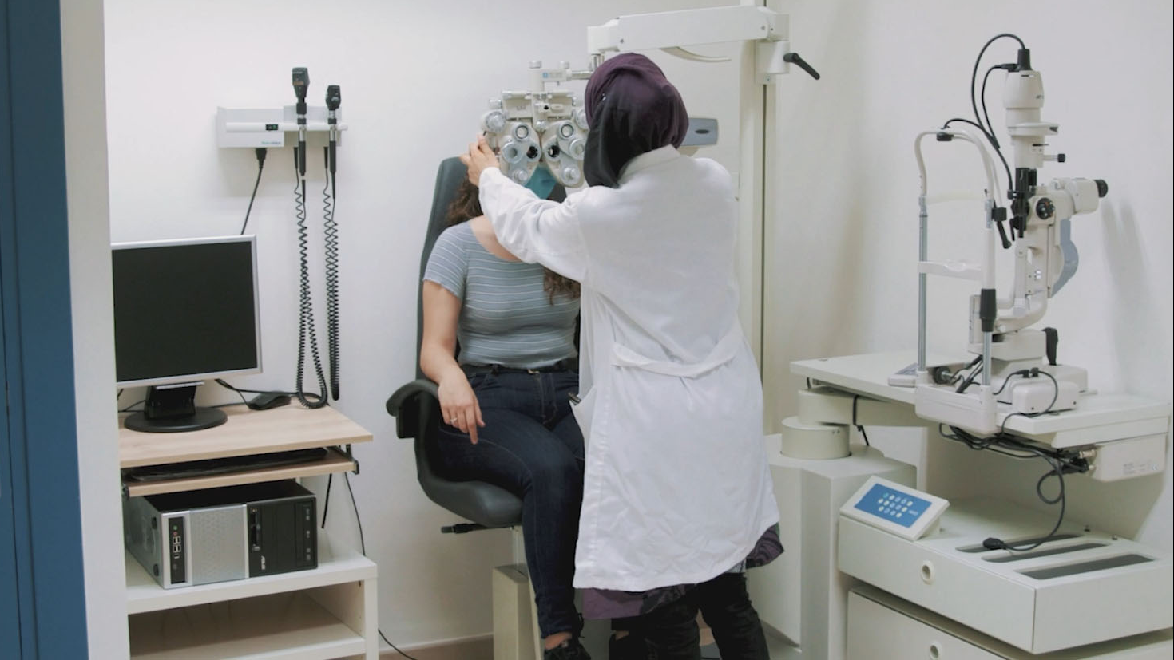
5,119
students
on work
placement

Slide 26
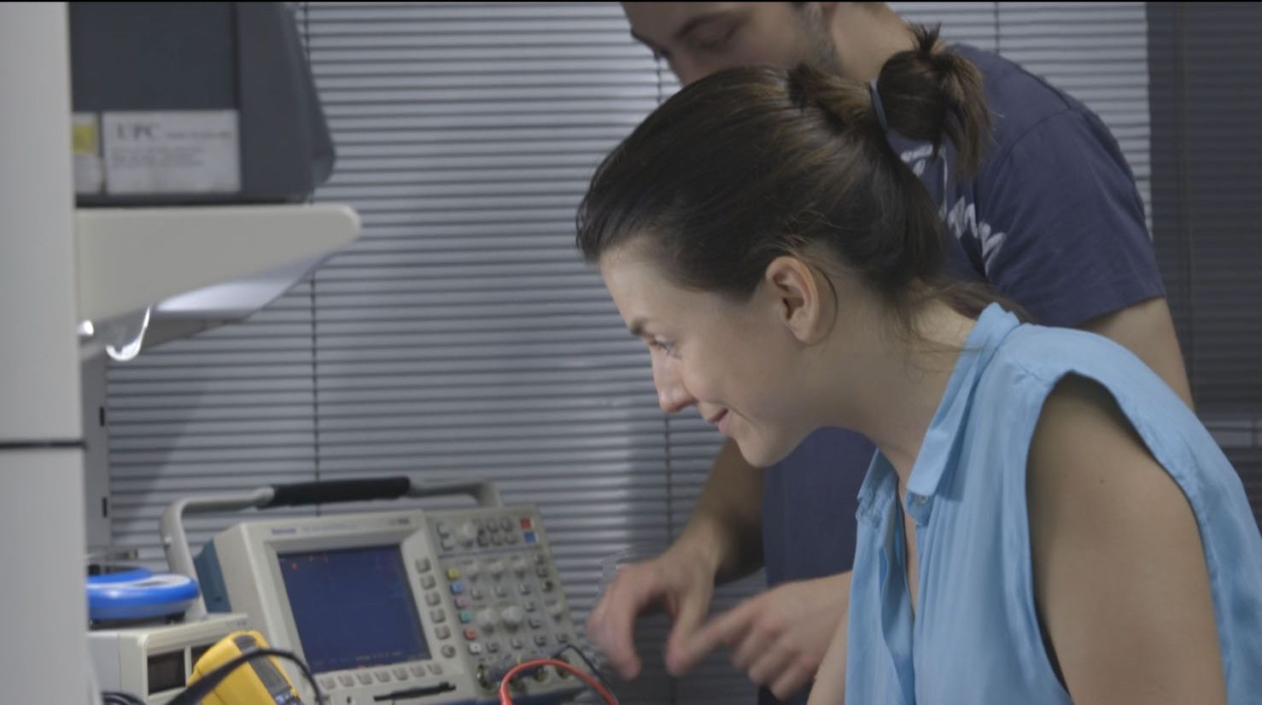
95%
graduate
employment
88%
of UPC
graduates
find a job
in less than
six months

Slide 27
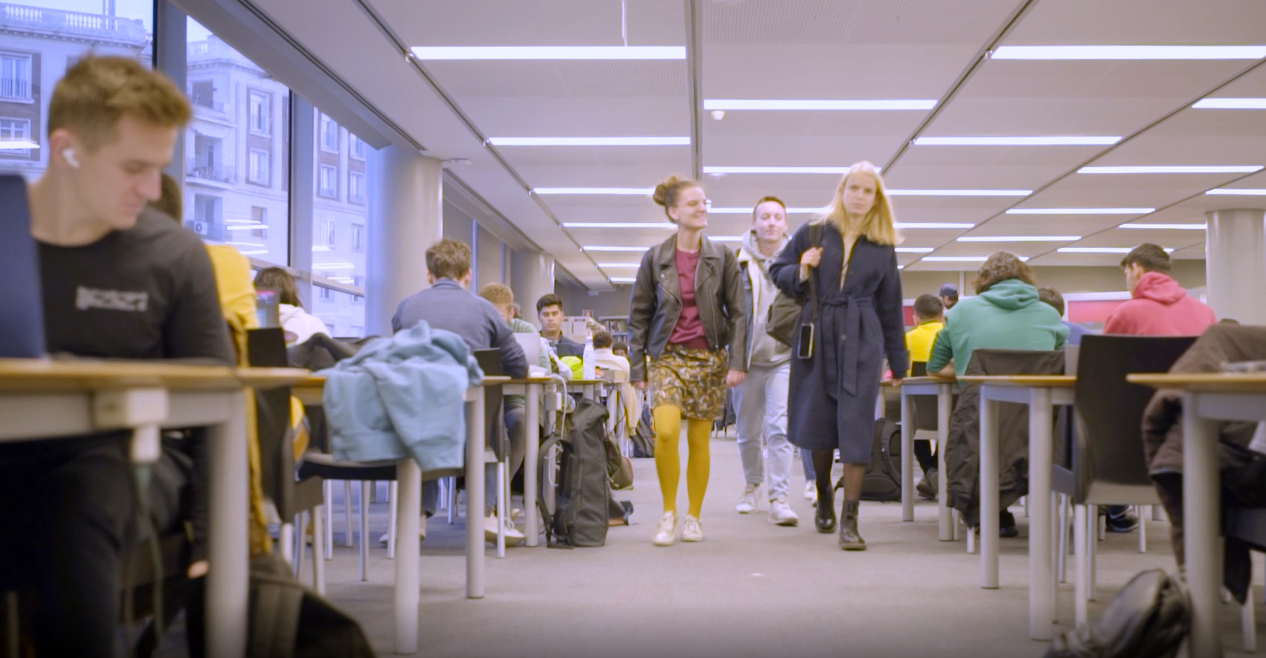
2,940
students
on mobility
programmes

Slide 28
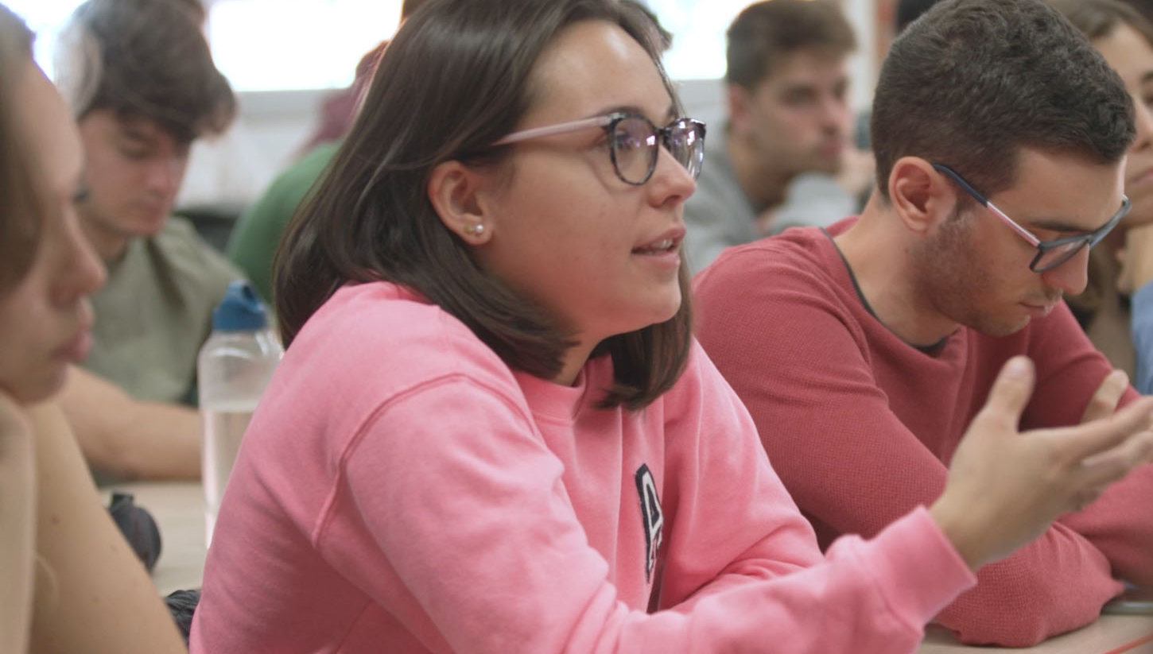
1,551
student exchange agreements
with higher education
institutions
716

Slide 29
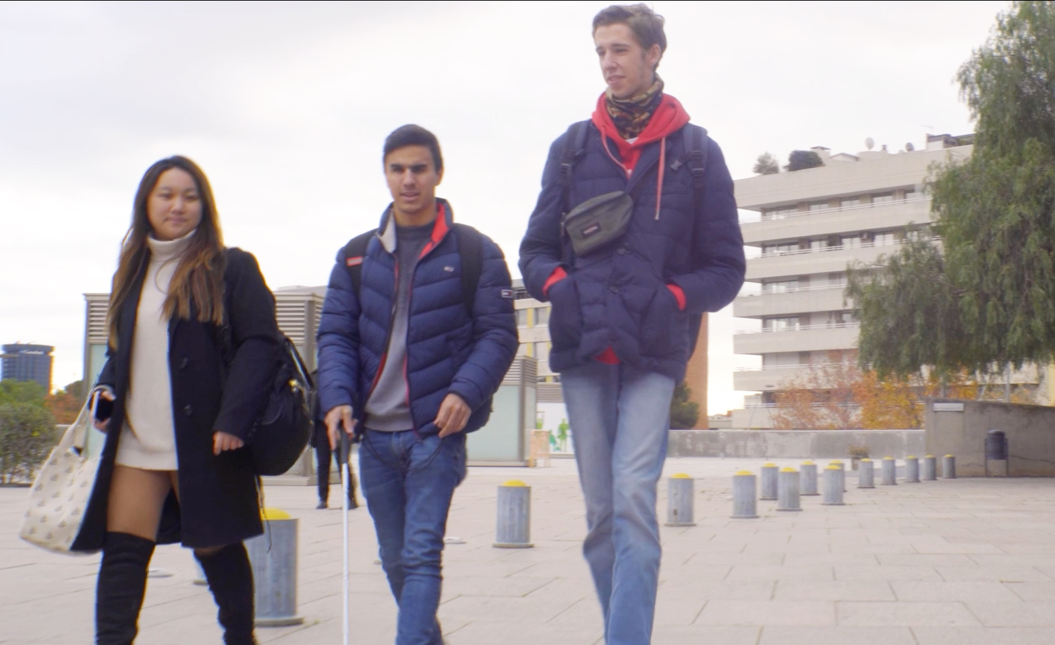
55%
of doctoral
degree student
and 27%
of master’s degree
students are
international
students

Slide 30
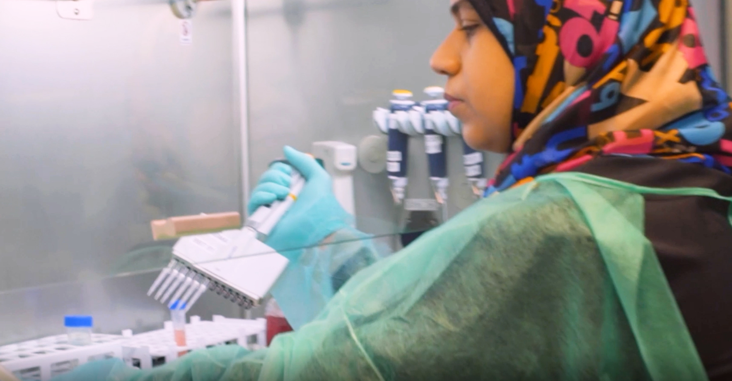
227
academic
cooperation
agreements
with international institutions

Slide 31
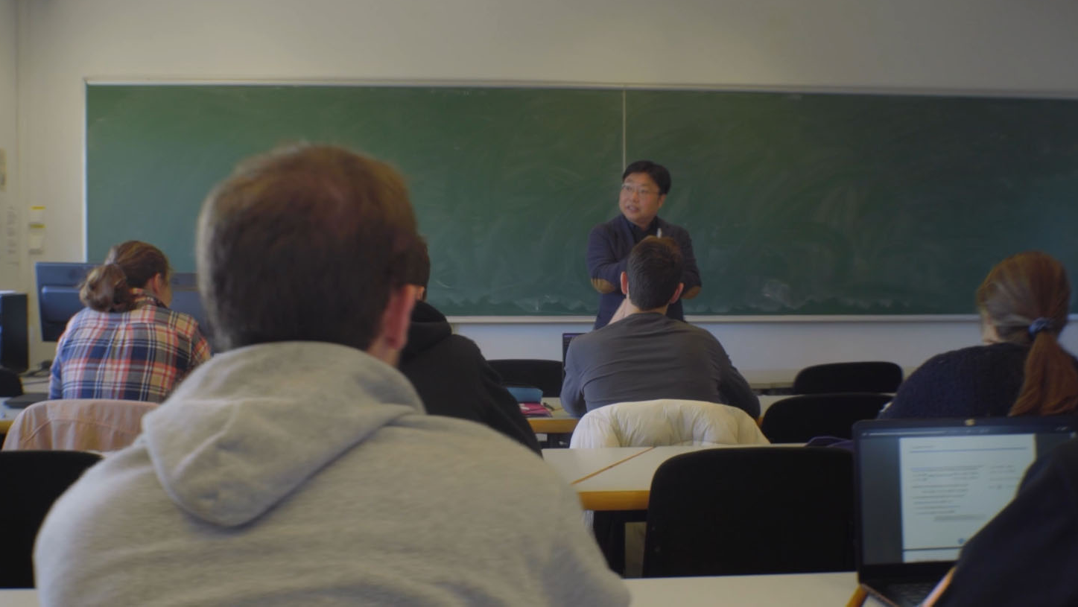
44
international double-degree programmes
with universities
30

Slide 32
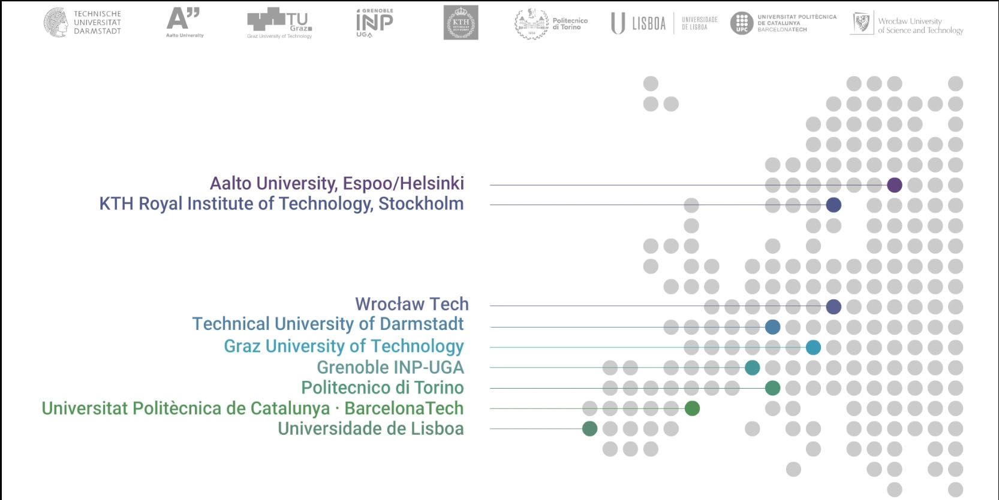
Building the Europe of the future with Unite!

Slide 33
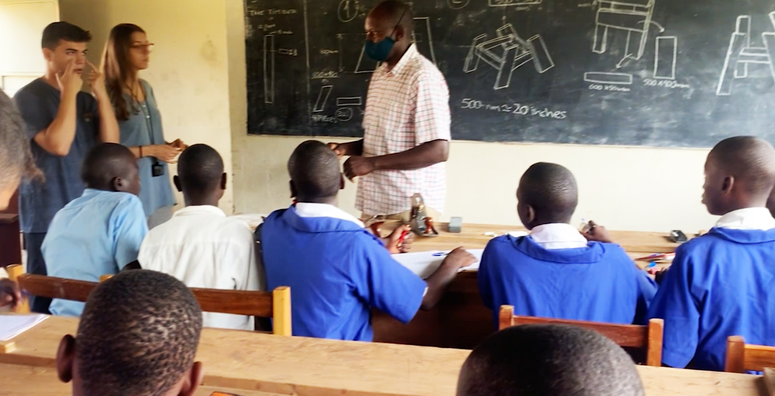
54
development
cooperation projects
in countries
25

Slide 34
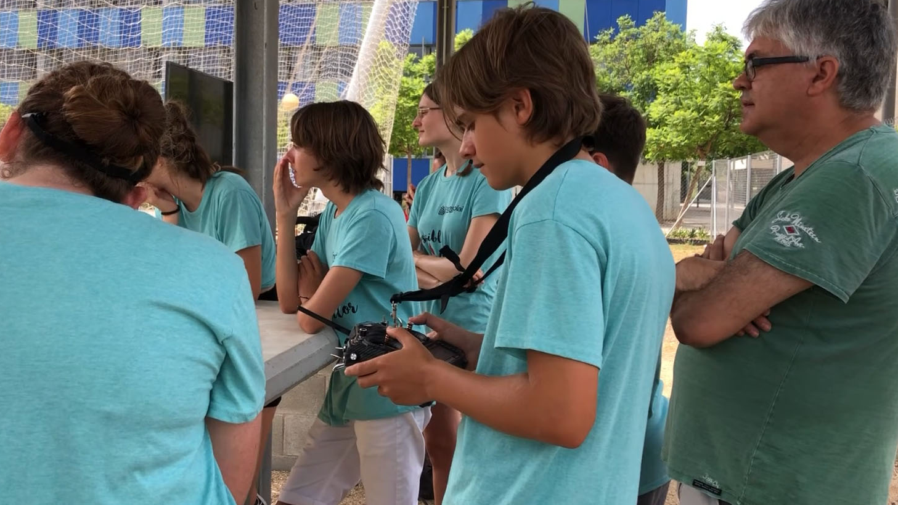
33,060
primary, secondary and upper secondary school students participating in STEAM activities at the UPC

Slide 35
ENGINEERING
ARCHITECTURE
SCIENCES
TECHNOLOGY

Slide 36
2023-2024 ACADEMIC YEAR

