Slide 1
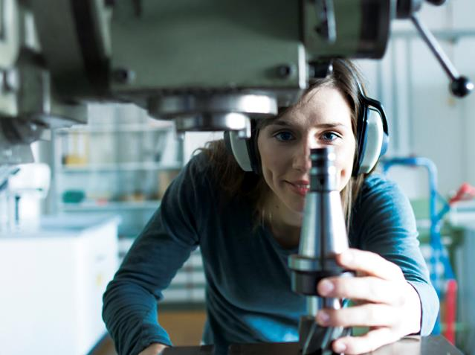



Slide 2

28,000
2,200
2,000
6,700
58,000
bachelor's and master's students
doctoral students
administrative
and service
staff
bachelor's and master's graduates
alumni
Leaders in high-quality graduate employment
UPC graduates often start their professional career thanks to
^{work placements during}
^{their studies.}
93% of UPC alumni find employment within a year of graduation.
3,100
teaching and
research staff
WE ARE THE UPC
€61 M
income from R&D
projects (2017)
20
207
46
3,000
€283 M
schools
research groups
doctoral
programmes
lifelong learning students
2018 budget
64
67
234
800
bachelor's degrees
master's degrees
lifelong learning programmes
new research agreements
and projects

Slide 3
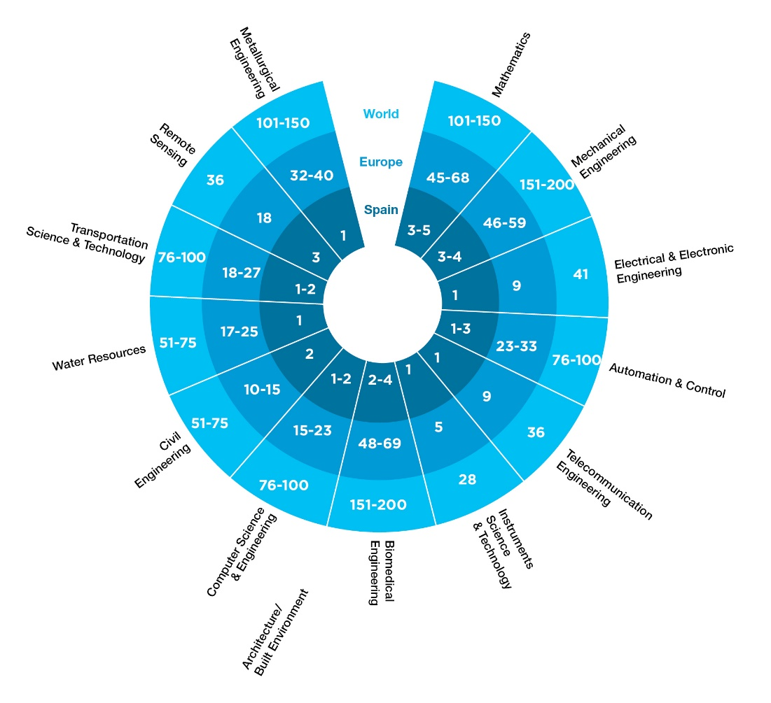
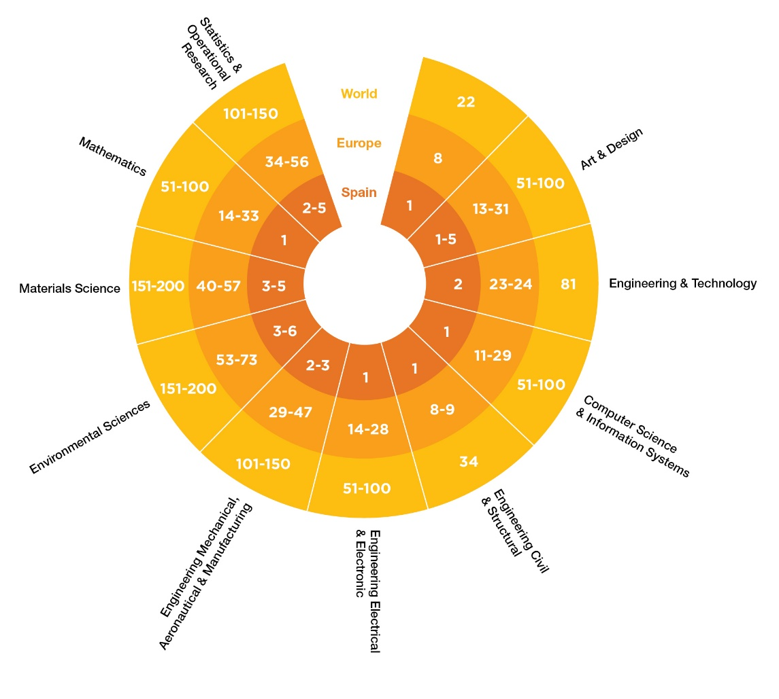
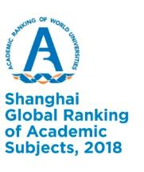
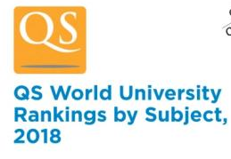
THE UPC IN INTERNATIONAL RANKINGS

Slide 4
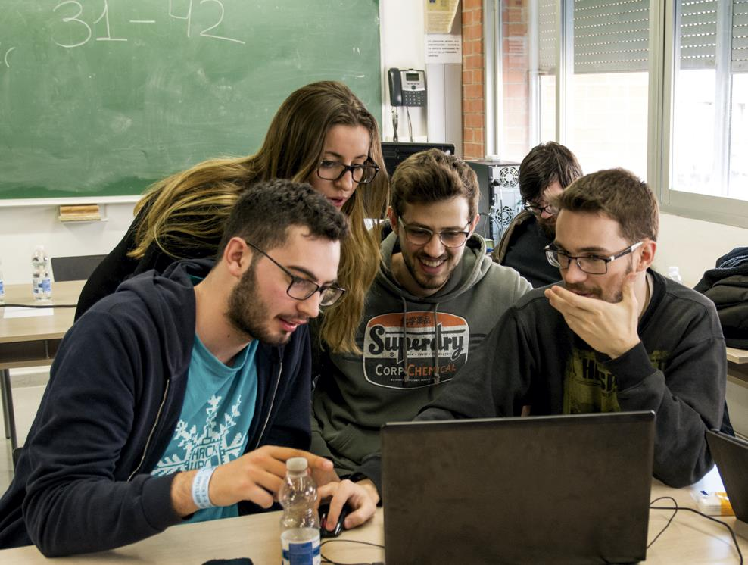
OUR GRADUATES BECOME VALUED PROFESSIONALS
Students at HackUPC, Spain’s most important hackathon

Slide 5

83% of UPC graduates say they would enrol again
This is the result of the UPC's approach to teaching, which puts students at the core. Solid theoretical training, participation in real projects and work placement are the defining traits of studying at the UPC.
UPC schools further refine this approach to teaching, which gives each of them a particular character.
58,000
alumni
30,200
bachelor's, master's and doctoral students
500
4,700
doctoral graduates
students on work
placement
6,700
#mésdonesUPC
The UPC community actively works
to give visibility and encouragement to women in STEAM fields (Science, Technology, Engineering, Art and Mathematics).
3,000
700
Female sailing crew of the Barcelona School of Nautical Studies
bachelor's and master's graduates
students on mobility programmes
higher education institutions with which the UPC has student exchange agreements

Slide 6
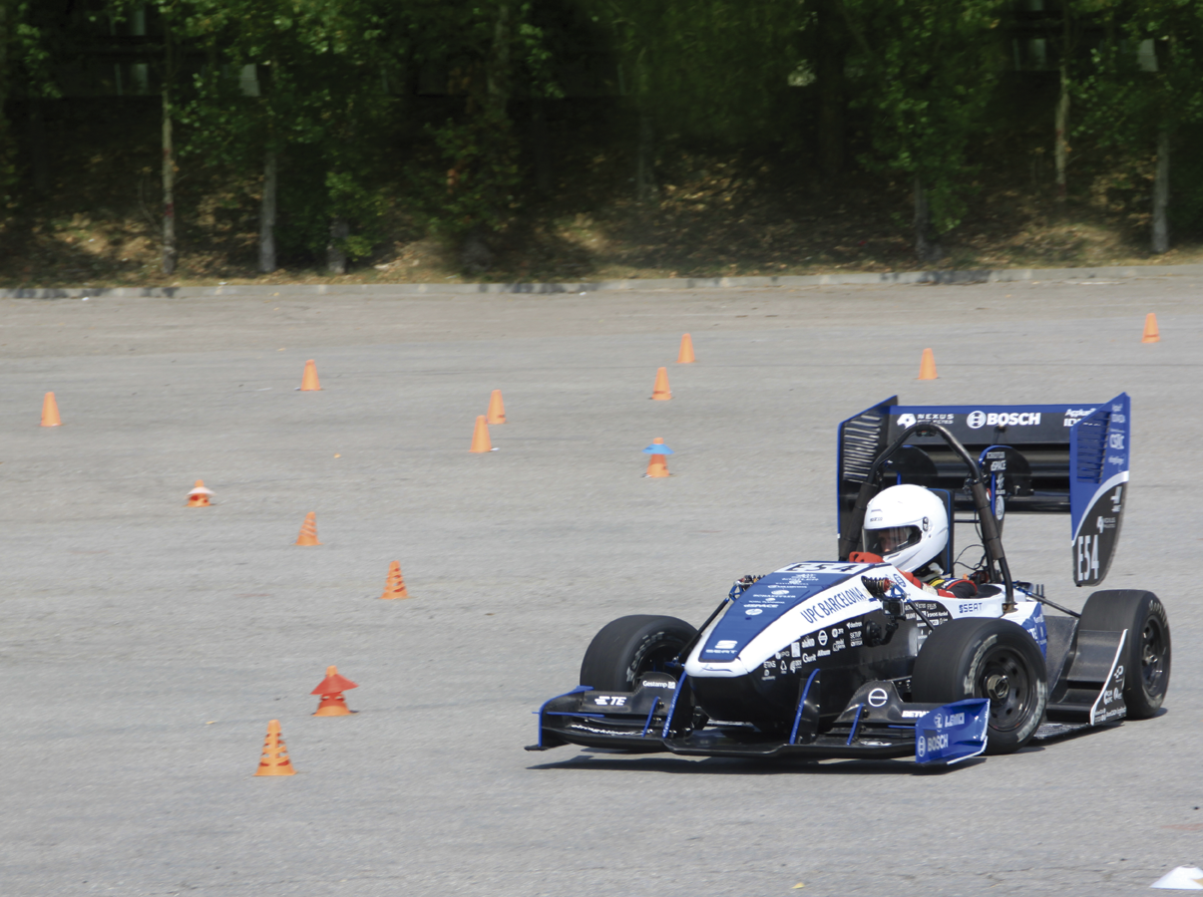
WE SEEK SOLUTIONS TO SOCIETY’S CHALLENGES
Dynamic tests at the Circuit de Barcelona-Catalunya of the ETSEIB Motorsport team single-seater racing car CAT11e.

Slide 7
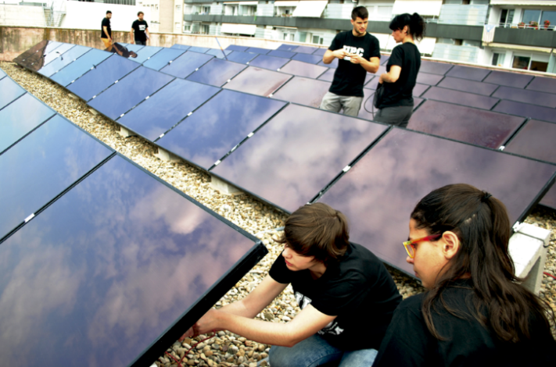
Leaders in research fundraising
The UPC is the leading university in research
fundraising within the framework of
the Horizon 2020 European project.
Approximately 800 new projects and agreements
are added to researchers' activity every year.
The talent of the research community, the network
of facilities and equipment, and the spirit of collaboration
in the alliances with other research centres all play key
roles in the UPC’s research strategy.
1,900
articles published in scientific journals
130
scientific and technical distinctions received
Students installing photovoltaic panels at the ESEIAAT
10
360
TECNIO network
research centres
doctoral theses defended
20
15
specific research centres
associated research entities

Slide 8
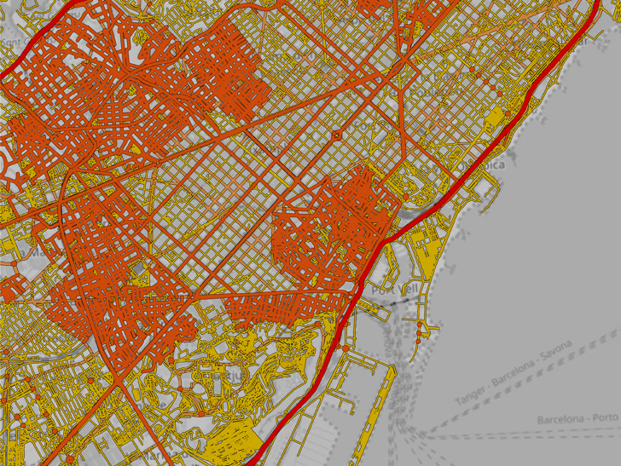
WE FUNCTION AS A NETWORK
CARNET, urban mobility of the future with Volkswagen and SEAT

Slide 9
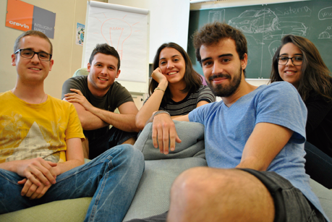
The University has consolidated its role as an agent of transformation for companies and has built up a network that is leading to projects with large corporations and small businesses that wish to move towards Industry 4.0 and the Internet of Things, for example.
It also seeks to collaborate with other prestigious universities, institutions and national and international consortia and is a member of 14 international networks.
Ideas that will become companies are developed
^{in the Emprèn facilities.}
2,800
52
companies
and institutions
with which the UPC has collaboration
agreements
patents registered
13
The Emprèn UPC formula
An entrepreneurial spirit is ever-present in the training provided by the UPC, which aims to provide knowledge and tools with which the community can generate new business projects. The Emprèn facilities offer students an ecosystem in which to develop future companies.
10
enterprise chairs
technology-based companies created

Slide 10
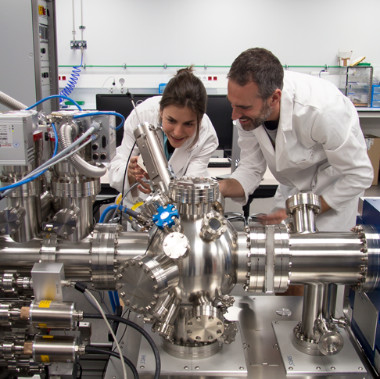
4
UNESCO chairs
UNESCO Chair of Higher Education Management (CUDU)
UNESCO Chair of Numerical Methods in Engineering
UNESCO Sustainability Chair
UNESCO Chair of Technology and Culture
400
academic cooperation agreements with international institutions
50
Barcelona Research Center in Multiscale Science and Engineering
international double degree agreements with 30 universities

Slide 11
The UPC in international networks
· AUIP. Asociación Universitaria Iberoamericana de Postgrado
· CASA. Consortium for Advanced Studies Abroad
· CESAER. Conference of European Schools for Advanced Engineering and Education Research
· CINDA. Centro Interuniversitario de Desarrollo
· CLUSTER. Consortium Linking Universities of Science and Technology for Education and Research
· EUA. European University Association
· GUNI. Global University Network for Innovation
^{· Magalhães}
^{· RedEmprendia}
· RMEI. Réseau Méditerranéen des Écoles d'Ingénieurs
· TELESCOPI. Red de Observatorios de Buenas Prácticas de Dirección Estratégica Universitaria
^{en Latinoamérica y Europa}
· T.I.M.E. Top Industrial Managers for Europe
· UNITECH International Society Network
^{· Universia}
^{INNOENERGY}
^{A Knowledge}
and Innovation Community (KIC) set
up by the European Institute of Innovation and Technology (EIT)
^{to promote innovation}
in the field of sustainable energy.
^{UP4}
An alliance of the four technical universities in Spain: the Universidad Politécnica de Madrid, the Universidad Politécnica de Cartagena, the Universitat Politècnica de València and the Universitat Politècnica de Catalunya.
The UPC has achieved a significant level of internationalisation in all its academic activities.
^{SINO-SPANISH CAMPUS}
A university campus set up with the Technical University of Madrid at Tongji University in China.

Slide 12
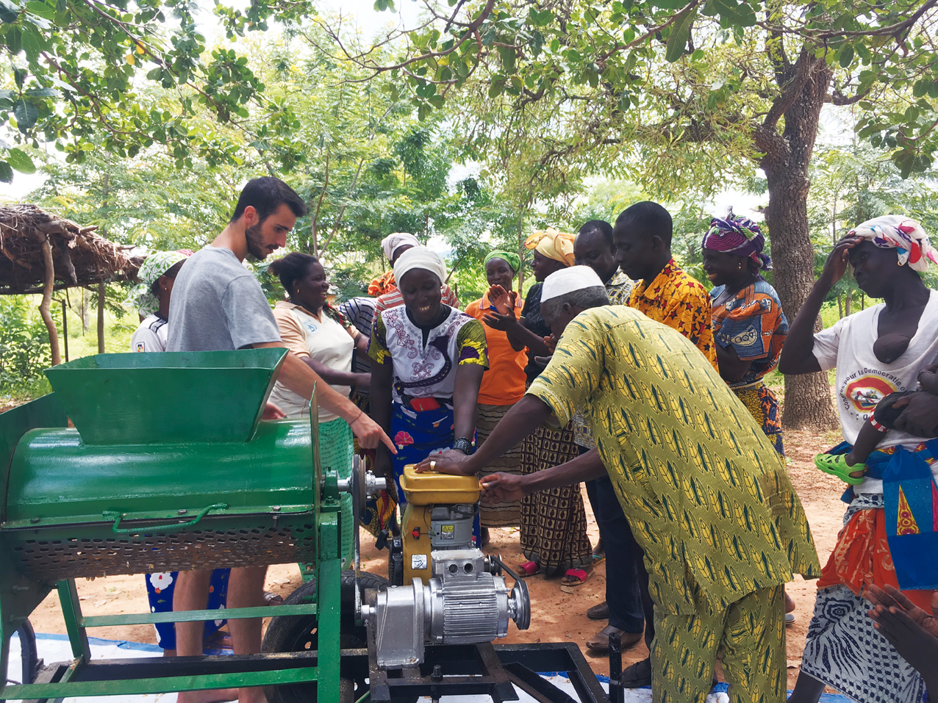
WE ARE COMMITTED TO OVERCOMING PLANETARY CHALLENGES
The Centre for Development
Cooperation promotes international volunteering projects.

Slide 13

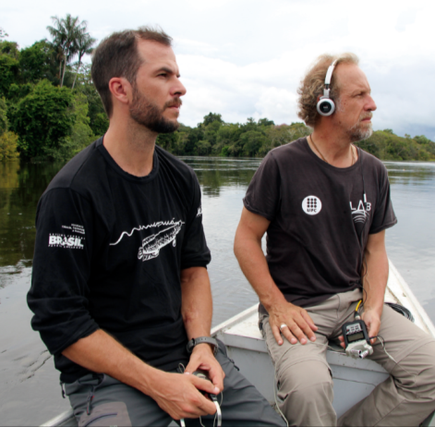
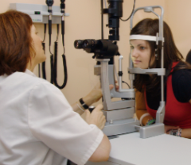
The UPC community maintains a high level of involvement in the resolution of planetary challenges. Each year, about 200 people contribute their knowledge to international cooperation projects.
The UPC also acts locally to meet local community needs.
59
Global commitment
Many of the UPC's activities
are aligned with the Sustainable Development Goals (SDG)
of the United Nations’ 2030 Agenda.
development
cooperation and awareness projects
in 29 countries
17,166
primary and secondary
students participate
in STEAM activities (Science, Technology, Engineering, Art and Mathematics)
organized
by the UPC
Local commitment
An example of the UPC’s local commitment is Mirades Solidàries, an initiative through which the University Vision Centre offers specialised visual health services
for vulnerable people.
Providence project: monitoring the Amazon
rainforest to preserve biodiversity
^{University Vision Centre}

Slide 14
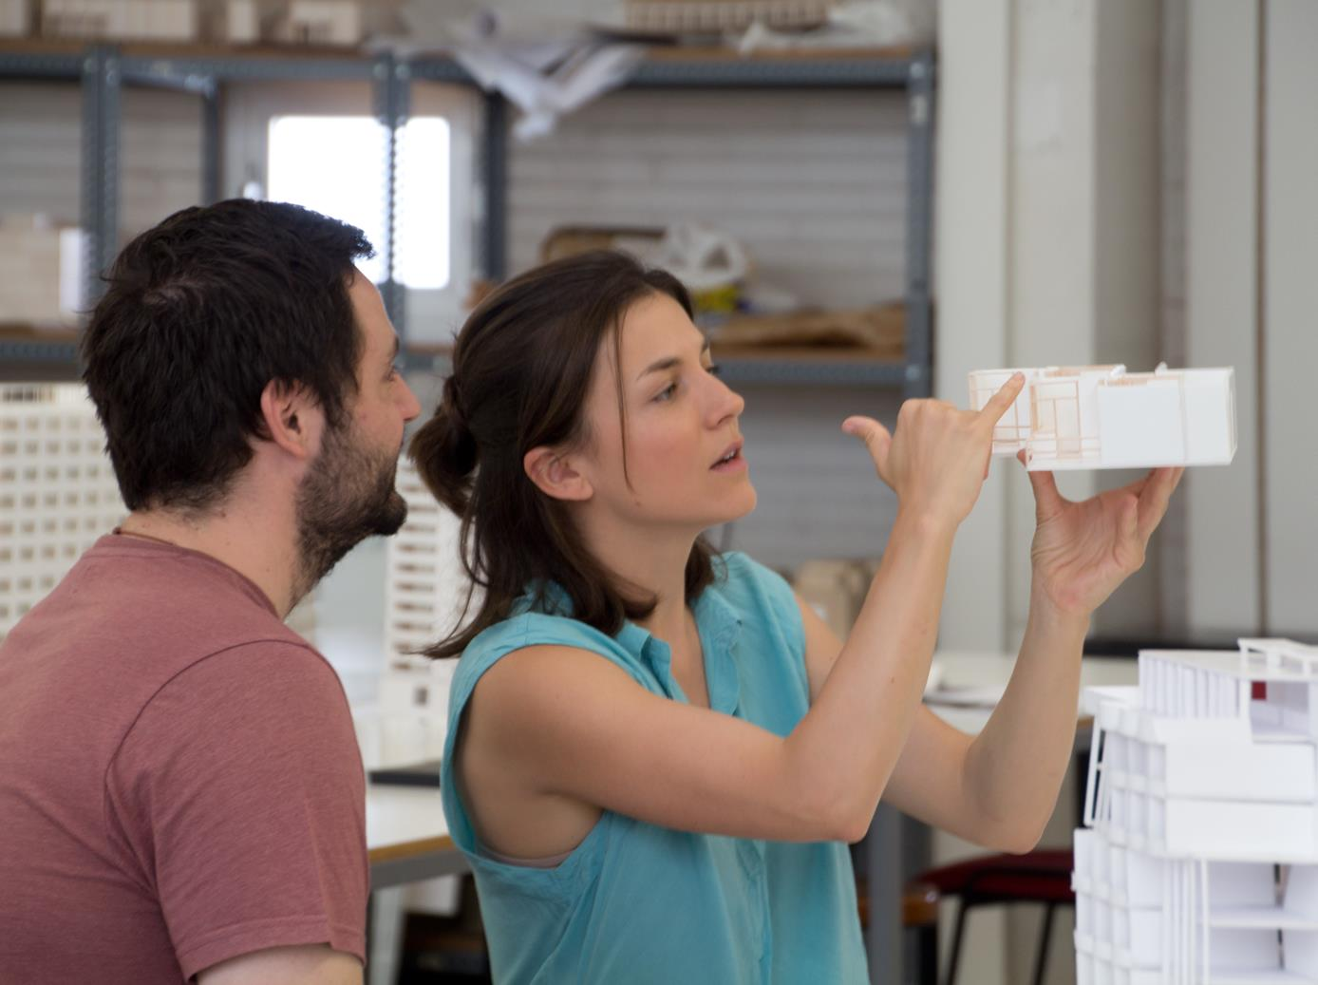
STUDIES
AND STRUCTURE
Modelling workshop at the Vallès School of Architecture (ETSAV)

Slide 15
^{2018-2019 BACHELOR'S DEGREES}
ARCHITECTURE, URBANISM AND BUILDING CONSTRUCTION
· Architectural Technology and Building Construction. EPSEB
· Architecture Studies. ETSAB, ETSAV
^{APPLIED SCIENCES}
· Data Science and Engineering. ETSETB-FIB-FME
· Economics and Statistics. FME (interuniversity UB-UPC double degree)
^{· Engineering Physics. ETSETB}
· Marine Sciences and Technologies, majors in Marine Sciences and Engineering / Marine Technologies. EPSEVG-ESAB-ETSECCPB
^{· Mathematics. FME}
· Statistics. FME (interuniversity UB-UPC degree)
·
^{HEALTH SCIENCES AND TECHNOLOGY}
^{· Biomedical Engineering. EEBE}
^{· Optics and Optometry. FOOT}
MULTIMEDIA DESIGN AND TECHNOLOGY
· Design, Animation and Digital Art. CITM
^{· Multimedia. CITM}
· Video Game Design and Development. CITM
^{AEROSPACE ENGINEERING}
· Aerospace Systems Engineering, majors in Air Navigation / Airports. EETAC
· Aerospace Systems Engineering + Telecommunications Systems
Engineering / Network Engineering. EETAC (double degree)
· Aerospace Technology Engineering. ESEIAAT
· Aerospace Vehicle Engineering. ESEIAAT
^{BIOSYSTEMS AND AGRI-FOOD}
^{ENGINEERING}
· Agronomic Science Engineering, majors in ^{Horticulture}
and Gardening / Crop and Livestock Production. ESAB
^{· Biosystems Engineering. ESAB}
· Culinary and Gastronomic Sciences. ESAB
(interuniversity UB-UPC degree)
^{· Food Engineering. ESAB}
^{CIVIL ENGINEERING}
^{· Civil Engineering. ETSECCPB}
· Geoinformation and Geomatics Engineering. EPSEB
· Geological and Environmental Engineering. ETSECCPB
^{(interuniversity} ^{UPC-UB degree)}
^{· Mining Engineering. EPSEM}
· Public Works Engineering. ETSECCPB

Slide 16
^{2018-2019 BACHELOR'S DEGREES}
^{INFORMATICS ENGINEERING}
^{· Bioinformatics.}
FIB (interuniversity UPF-UPC-UB degree)
· Data Science and Engineering. ETSETB-FIB-FME
· Geoinformation and Geomatics Engineering. EPSEB
· ICT Systems Engineering. EPSEM
· Informatics Engineering, majors in Computing / Computer Engineering / Software Engineering / Information Systems. FIB Information Technologies. EPSEVG-FIB
^{INDUSTRIAL ENGINEERING}
· Automotive Engineering. EPSEM
· Biomedical Engineering. EEBE
· Chemical Engineering. EEBE, EPSEM, ESEIAAT
· Electrical Engineering. EEBE, EPSEVG, ESEIAAT
^{· Energy Engineering. EEBE}
· Industrial Design and Product Development Engineering. EPSEVG, ESEIAAT
· Industrial Electronics and Automatic Control Engineering. EEBE, EPSEM, EPSEVG, ESEIAAT
· Industrial Technologies and Economic Analysis (taught in English). ETSEIB (interuniversity UPC-UPF degree)
· Industrial Technology Engineering. ESEIAAT, ETSEIB
^{· Materials Engineering. EEBE}
· Mechanical Engineering. EEBE, EPSEM, EPSEVG, ESEIAAT
· Textile Technology and Design Engineering. ESEIAAT
NAVAL, MARINE AND NAUTICAL ENGINEERING
^{· Marine Technologies. FNB}
· Nautical Science and Maritime Transport. FNB
· Naval Systems and Technology Engineering. FNB
^{TELECOMMUNICATIONS ENGINEERING}
· Audiovisual Systems Engineering. ESEIAAT
· Data Science and Engineering. ETSETB-FIB-FME
· Electronic Engineering and Telecommunications. ETSETB
· Geoinformation and Geomatics Engineering. EPSEB
· ICT Systems Engineering. EPSEM
^{· Network Engineering. EETAC}
· Telecommunications Systems Engineering. EETAC
· Telecommunications Systems Engineering / Network Engineering + Aerospace Systems Engineering. EETAC (double degree)
· Telecommunications Technologies and Services Engineering,
majors in: Audiovisual Systems / Telecommunications Systems / Network Systems. ETSETB
BUSINESS MANAGEMENT AND ORGANISATION
· Business Administration and Management. EAE, EUNCET*
· Industrial Technologies and Economic Analysis. ETSEIB (interuniversity UPC-UPF degree)
· Marketing and Digital Communication. EAE, EUNCET*
· Sport and Fitness Science and Technology. EUNCET*
^{* Affiliated schools}

Slide 17
^{2018-2019 MASTER'S DEGREES}
ARCHITECTURE, URBANISM AND BUILDING CONSTRUCTION
· Advanced Building Construction
· Advanced Studies in Architecture-Barcelona (MBArch)
· Advanced Studies in Design-Barcelona (MBDesign)
^{· Architecture}
· Building Construction Management
· Landscape Architecture-Barcelona (MBLandArch)
· Sustainable Intervention in the Built Environment (MISMeC)
^{APPLIED SCIENCES}
· Advanced Mathematics and Mathematical Engineering (MAMME)
^{· Computer Vision}
^{· Engineering Physics}
· Statistics and Operations Research (MESIO)
· Computational Modelling in Physics, Chemistry and Biochemistry
^{· Photonics}
^{· Pure and Applied Logic}
· Occupational Health and Safety
· Erasmus Mundus Photonics Engineering, Nanophotonics
and Biophotonics (Europhotonics)
^{HEALTH SCIENCES AND TECHNOLOGY}
^{· Biomedical Engineering}
· Optometry and Vision Sciences
^{AEROSPACE ENGINEERING}
^{· Aeronautical Engineering}
· Aerospace Science and Technology (MAST)
· Applications and Technologies for Unmanned Aircraft System
^{(Drones)}
· Space and Aeronautical Engineering
BIOSYSTEMS AND AGRI-FOOD ENGINEERING
^{· Aquaculture}
· Enabling Technologies for the Food and Bioprocessing Industry (KET4FOOD+BIO)
^{CIVIL ENGINEERING}
^{· Civil Engineering}
· Erasmus Mundus Coastal and Marine Engineering and Management (CoMEM)
· Erasmus Mundus Computational Mechanics
· Erasmus Mundus Hydroinformatics and Water Management (Euroaquae+)
^{· Geotechnical Engineering}
^{· Mining Engineering}
· Numerical Methods in Engineering
· Oceanography and Marine Management
· Structural Analysis of Monuments and Historical Constructions (SAHC)
· Structural and Construction Engineering
· Supply Chain, Transport and Mobility Management

Slide 18
^{2018-2019 MASTER'S DEGREES}
^{INDUSTRIAL ENGINEERING}
· Advanced Studies in Design-Barcelona (MBDesign)
· Automatic Control and Robotics
· Automatic Systems Engineering and Industrial Electronics (MUESAEI)
^{· Automotive Engineering}
^{· Biomedical Engineering}
^{· Chemical Engineering}
· Energy Engineering (linked to the InnoEnergy programme)
^{· Industrial Engineering}
· Erasmus Mundus Advanced Materials Science and Engineering (AMASE)
^{· Management Engineering}
· Materials Science and Engineering
· Nuclear Engineering (linked to the InnoEnergy programme)
· Supply Chain, Transport and Mobility Management
· Technology and Engineering Management
· Textile and Paper Engineering
^{INFORMATICS ENGINEERING}
^{· Artificial Intelligence}
· Erasmus Mundus Big Data Management and Analytics (BDMA)
^{· Informatics Engineering}
· Innovation and Research in Informatics (MIRI)
NAVAL, MARINE AND NAUTICAL ENGINEERING
· Management and Operation of Marine Energy Facilities
· Nautical Science and Maritime Transport Management
· Naval Architecture and Ocean Engineering
^{TELECOMMUNICATIONS ENGINEERING}
· Applications and Technologies for Unmanned Aircraft Systems (Drones)
· Applied Telecommunications and Engineering Management (MASTEAM)
^{· Electronic Engineering (MEE)}
· Telecommunications Engineering (MET)
TEACHER TRAINING AND GENDER STUDIES
· Secondary and Upper Secondary Education, Vocational Training
and Foreign Language Teaching. Specialisations: Vocational Training/ Technology / Mathematics
· Women’s, Gender and Citizenship Studies
ENVIRONMENT, SUSTAINABILITY AND NATURAL RESOURCES
^{· Environmental Engineering}
^{· Natural Resource Engineering}
· Sustainability Science and Technology
· Sustainable Intervention in the Built Environment (MISMeC)

Slide 19
^{2018-2019 DOCTORAL PROGRAMMES}
ARCHITECTURE, URBANISM AND BUILDING CONSTRUCTION
· Architectural, Building Construction and Urbanism ^{Technology}
· Architectural, Civil and Urban Heritage and Refurbishment
^{of Existing Buildings}
^{· Architectural Design}
· Architecture, Energy and Environment
· Theory and History of Architecture
· Urban and Architectural Management and Valuation
^{· Urbanism}
^{SCIENCES}
· Aerospace Science and Technology
· Agri-Food Technology and Biotechnology
^{· Applied Mathematics}
· Computational and Applied Physics
^{· Optical Engineering}
^{· Photonics}
· Statistics and Operations Research
^{CIVIL ENGINEERING}
^{· Civil Engineering}
^{· Construction Engineering}
· Earthquake Engineering and Structural Dynamics
^{· Environmental Engineering}
^{· Geotechnical Engineering}
^{· Marine Sciences}
· Nautical and Marine Engineering and Naval Radio-Electronics
^{· Structural Analysis}
^{INDUSTRIAL ENGINEERING}
· Automatic Control, Robotics and Vision
^{· Biomedical Engineering}
· Business Administration and Management
^{· Chemical Process Engineering}
^{· Electric Energy Systems}
^{· Electrical Engineering}
· Erasmus Mundus Environomical Pathways for Sustainable Energy Services (SELECT+)
· Materials Science and Engineering
· Mechanical, Fluids and Aerospace Engineering
· Natural Resources and Environment
· Nuclear and Ionising Radiation Engineering
^{· Polymers and Biopolymers}
· Supply Chain and Operations Management
^{· Sustainability}
· Textile and Paper Engineering
^{· Thermal Engineering}
^{ICT ENGINEERING}
^{· Artificial Intelligence}
^{· Bioinformatics}
^{· Computer Architecture}
^{· Computing}
^{· Electronic Engineering}
· Erasmus Mundus Information Technologies for Business Intelligence
^{(IT4BI-DC)}
^{· Network Engineering}
· Signal Theory and Communications

Slide 20
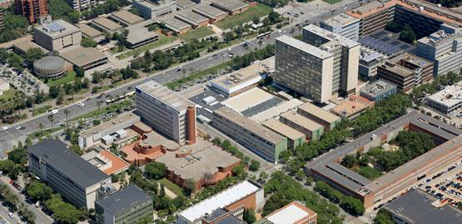
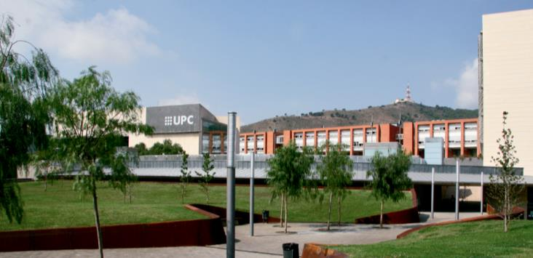
^{UPC Schools}
Barcelona
SOUTH DIAGONAL CAMPUS
. Barcelona School of Building Construction. EPSEB
. Barcelona School of Architecture. ETSAB
. Barcelona School of Industrial Engineering. ETSEIB
. School of Mathematics and Statistics. FME
. Interdisciplinary Higher Education Centre. CFIS
NORTH DIAGONAL CAMPUS
. Barcelona School of Civil Engineering. ETSECCPB
. Barcelona School of Telecommunications Engineering. ETSETB
. Barcelona School of Informatics. FIB

Slide 21
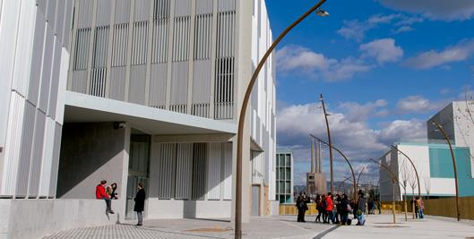
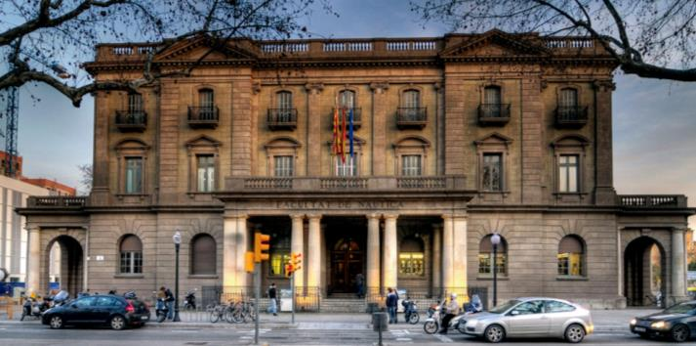
^{UPC Schools}
DIAGONAL-BESÒS CAMPUS
. Barcelona East School of Engineering. EEBE
(Barcelona / Sant Adrià de Besòs)
NAUTICAL STUDIES CAMPUS
. Barcelona School of Nautical Studies. FNB

Slide 22
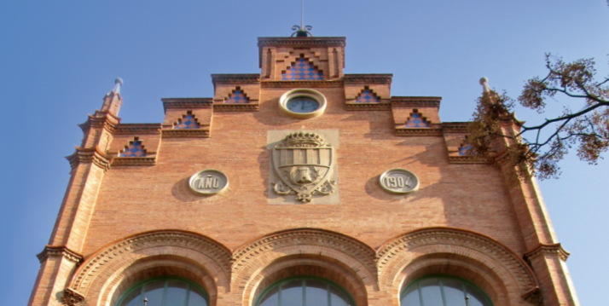
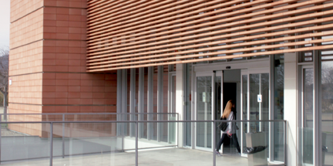
^{UPC Schools}
TERRASSA CAMPUS
. Terrassa School of Industrial, Aerospace and Audiovisual Engineering. ESEIAAT
. Terrassa School of Optics and Optometry. FOOT
. Image Processing and Multimedia Technology Centre. CITM
BAIX LLOBREGAT CAMPUS
. Castelldefels School of Telecommunications and Aerospace Engineering. EETAC
. Barcelona School of Agricultural Engineering. ESAB

Slide 23
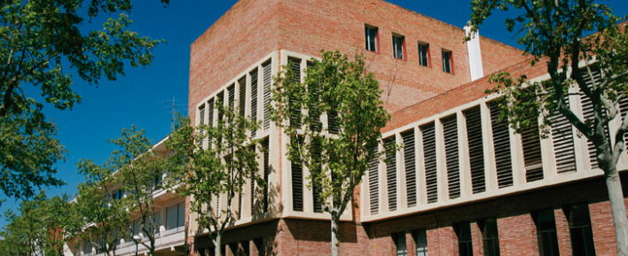
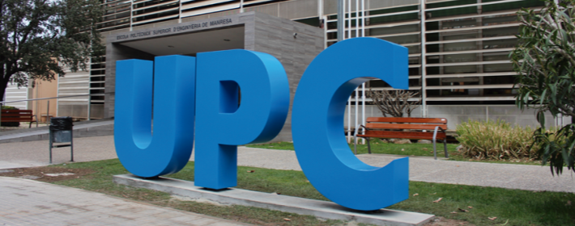
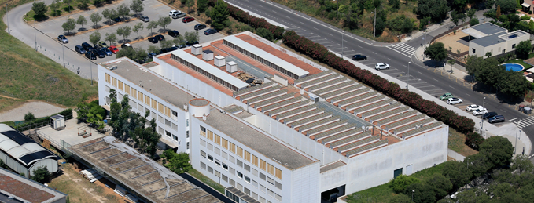
^{UPC Schools}
VILANOVA I LA GELTRÚ
CAMPUS
. Vilanova i la Geltrú School of Engineering. EPSEVG
MANRESA CAMPUS
. Manresa School of Engineering. EPSEM
SANT CUGAT DEL VALLÈS
CAMPUS
. Vallès School of Architecture. ETSAV

Slide 24
^{Structure}
Departments
INSTITUTES
· Agri-Food Engineering and Biotechnology
^{· Architectural Design}
^{· Architectural Representation}
^{· Architectural Technology}
^{· Automatic Control}
^{· Chemical Engineering}
· Civil and Environmental Engineering
^{· Computer Architecture}
^{· Computer Science}
^{· Electrical Engineering}
^{· Electronic Engineering}
^{· Engineering Presentation}
^{· Fluid Mechanics}
^{· Heat Engines}
· History and Theory of Architecture
^{and Communication} ^{Techniques}
^{· Management}
· Materials Science and Metallurgy
^{· Mathematics}
^{· Mechanical Engineering}
· Mining, Industrial and ICT Engineering
· Nautical Science and Engineering
^{· Network Engineering}
^{· Optics and Optometry}
^{· Physics}
· Project and Construction Engineering
· Service and Information System Engineering
· Signal Theory and Communications
· Statistics and Operations Research
· Strength of Materials and Structural Engineering
· Urbanism and Regional Planning
. FLUMEN. River Dynamics and Hydrological Engineering Institute
. IBEI. Barcelona Institute of International Studies (interuniversity)
. ICE. Institute of Education Sciences
. ICFO. Institute of Photonic Sciences (associated entity and affiliated institute)
. IIEDG. Interuniversity Women's and Gender Studies Institute (interuniversity)
. INTE. Institute of Energy Technologies
. INTEXTER. Terrassa Institute of Textile Research and Industrial Cooperation
. IOC. Institute of Industrial and Control Engineering
. IRI. Institute of Robotics and Industrial Informatics (owned by UPC-CSIC)
. ISUPC. University Research Institute for Sustainability Science and Technology
THE UPC GROUP
^{. CIM Foundation}
. Fundació Politècnica de Catalunya
. Innovation and Technology Centre Foundation (CIT UPC)
^{. IThinkUPC}
. Mediterranean Technology Park
^{. UPCnet, SL}

Slide 25
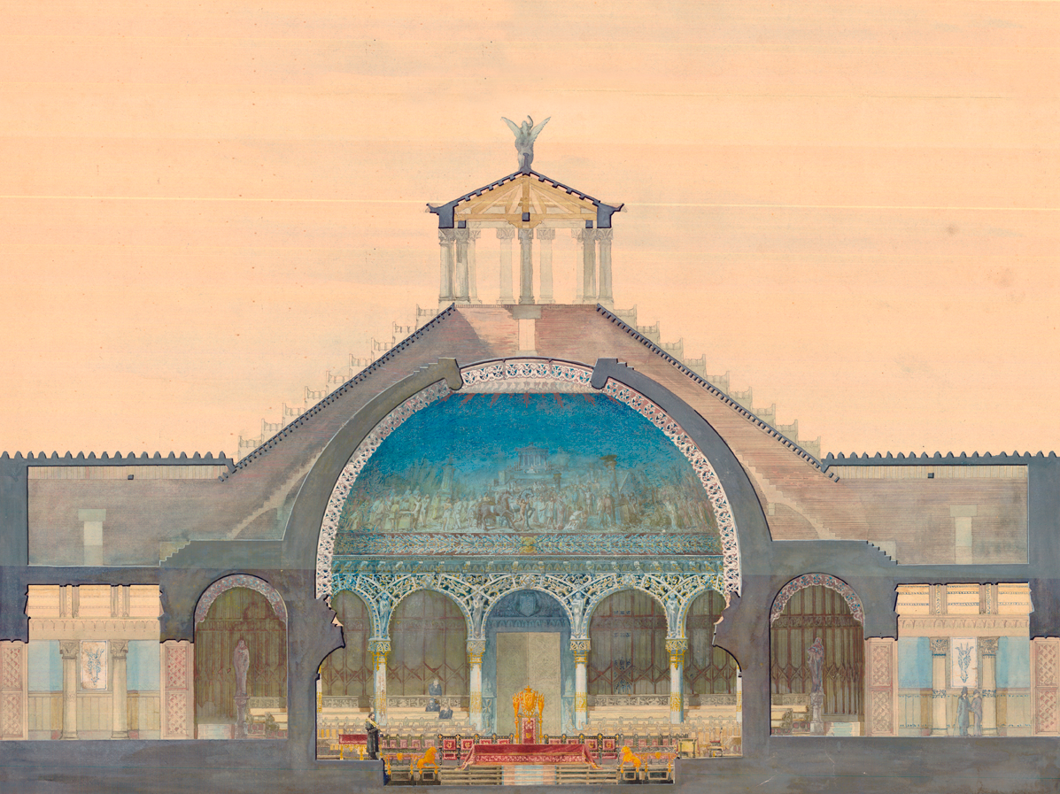
RESEARCH AND KNOWLEDGE TRANSFER
Design of an assembly hall submitted
by Gaudí in 1877 at the Barcelona School
of Architecture (ETSAB)

Slide 26
TECNIO RESEARCH CENTRES*
· CD6. Centre for Sensors, Instruments and Systems Development
· CITCEA. Centre for Technological Innovation in Static Converters and Drives
· CREB. Biomedical Engineering Research Centre
· DAMA-UPC. Data Management Group
· GCEM. Electromagnetic Compatibility Group
^{· INNOTEX. Innotex Center}
· LABSON. Fluid Power Systems Laboratory
· MCIA. Center for Innovation in Electronics, Motion Control and Industrial Applications
· SARTI. Technological Development Centre for Remote Acquisition and Data Processing Systems
· SEER. Renewable Electrical Energy Systems
* Research centres that belong to the Network of Technological Innovation Support Centres (TECNIO)

Slide 27
SPECIFIC RESEARCH CENTRES
· CCABA. Advanced Broadband Communications Centre
· CD6. Centre for Sensors, Instruments and Systems Development
· CDPAC. Architectural Design Documentation Centre of Catalonia
· CEBIM. Molecular Biotechnology Centre
· CERpIE. Research and Development Centre for Business Improvement and Innovation
· CETpD. Technical Research Centre for Dependency Care and Autonomous Living
· CPSV. Centre for Land Valuation Policy
· CRAL. Centre for Research and Services for the Local Administration
· CREB. Biomedical Engineering Research Centre
· CREMIT. Engines and Heat Installations Centre
· CRnE. Barcelona Research Center in Multiscale Science and Engineering
· CS2AC-UPC. Supervision, Safety and Automatic Control
· IDEAI-UPC. Intelligent Data Science and Artificial Intelligence
· LaCàN. Numerical Methods for Applied Sciences and Engineering
· LIM/UPC. Maritime Engineering Laboratory
· LITEM. Laboratory for Technological Innovation in Structures and Materials
· (MC2)‐UPC. Continuum and Computational Mechanics
· PERC-UPC. Power Electronics Research Centre
· SSR-UPC - Smart Sustainable Resources
· TALP. Centre for Language and Speech Technologies and Applications

Slide 28
ASSOCIATED RESEARCH ENTITIES
· BSC-CNS. Barcelona Supercomputing Center–Centro Nacional de Supercomputación
^{· CCP. Catalan Plastics Centre}
· CETaqua. Water Technology Centre
· CIIRC. International Centre for Coastal Resources Research
· CIMNE. International Centre for Numerical Methods in Engineering
· CREDA. Centre for Agrifood Economics and Development
· CRM. Mathematical Research Centre
· CTM. Manresa Technology Centre
· CTTC. Telecommunications Technology Centre of Catalonia
· FMA. Miquel Agustí Foundation
^{· i2CAT. i2Cat Foundation}
· IBEC. Institute for Bioengineering of Catalonia
· ICFO. Institute of Photonic Sciences
· IEEC. Space Studies Institute of Catalonia
· IREC. Catalonia Institute for Energy Research

Slide 29
SPONSORING COMPANIES AND ENTITIES
SPONSORS OF EXCELLENCE
SPONSORS
^{· Abertis}
^{· COMEXI Group}
^{· Fundació Cellex}
^{· GIRBAU Group}
^{· ICL Iberia}
^{· Obra Social “la Caixa”}
^{· Banco Santander}
^{· SEAT}
^{· AMES}
^{· Construccions RUBAU}
^{· COPISA Grup}
^{· Endesa}
^{· FCC Construcción}
^{· JG Ingenieros}
^{· Mecalux}
^{· OHL}
· SOADCO (Klockner Implant System)
^{· Telefónica}
COLLABORATORS
^{· Accenture}
^{· Agbar}
· Agrupació Catalana de Tèxtil i Moda
^{· Ajuntament de Castelldefels}
^{· Ajuntament d’Igualada}
^{· ASEMAS}
· Asociación de Investigación de las Industrias del Curtido y Anexas
· Asociación Química Española de la Industria del Cuero
· Bernecker & Rainer Automatización Industrial
^{· BOSCH}
^{· Covestro}
^{· DENSO}
^{· Dow Chemical Ibérica}
^{· dSPACE}
^{· Everis}
^{· FIB Alumni-Cercle Fiber}
^{· Fundació Caixa d’Enginyers}
· Fundació per a la Innovació Tèxtil d’Igualada
^{· Fundació Resa Campus}
^{· Fundación ONCE}
^{· Gestamp}
^{· HNA}
^{· HP}
^{· Ibertrac}
^{· La Mútua dels Enginyers}
^{· La Vanguardia}
^{· Lear Corporation}
^{· Mapro}
^{· Naturgy}
^{· PILZ}

Slide 30
PREMIUM ENTERPRISE CHAIRS
· Abertis-UPC Chair in Transport Infrastructure Management and Road Safety
· Infrastructure Circle-UPC Chair (COPISA, FCC, OHL, Construccions Rubau)
· Girbau Group-UPC Chair of Research and Innovation in Industrial Laundry Technology
· ICL-UPC Chair in Sustainable Mining
· Manel Xifra Boada Chair of Research and Innovation in Flexible Packaging Production Technology
· SEAT-UPC Chair of Excellence and Innovation in the Automotive Industry for Sustainable Mobility
ENTERPRISE CHAIRS
· A³-UPC Chair in Leather, Fashion and Textile Innovation
· AMES Group-UPC Chair in Design and Innovation of New Biomaterials
· Endesa Red-UPC Chair in Energy Innovation
· JG Ingenieros-UPC Chair for the Study of Sustainability in Buildings
· Klockner-UPC Chair in Dental Implants and Prostheses
· Mecalux-UPC Chair in Automatisms and Innovation for Logistics
· Telefónica-UPC Chair on the Evolution and Future Trends of the Information Society
UNESCO CHAIRS
·UNESCO Chair of Higher Education Management (CUDU)
· UNESCO Chair of Numerical Methods in Engineering
^{· UNESCO Sustainability Chair}
· UNESCO Chair of Technology and Culture

