Slide 1
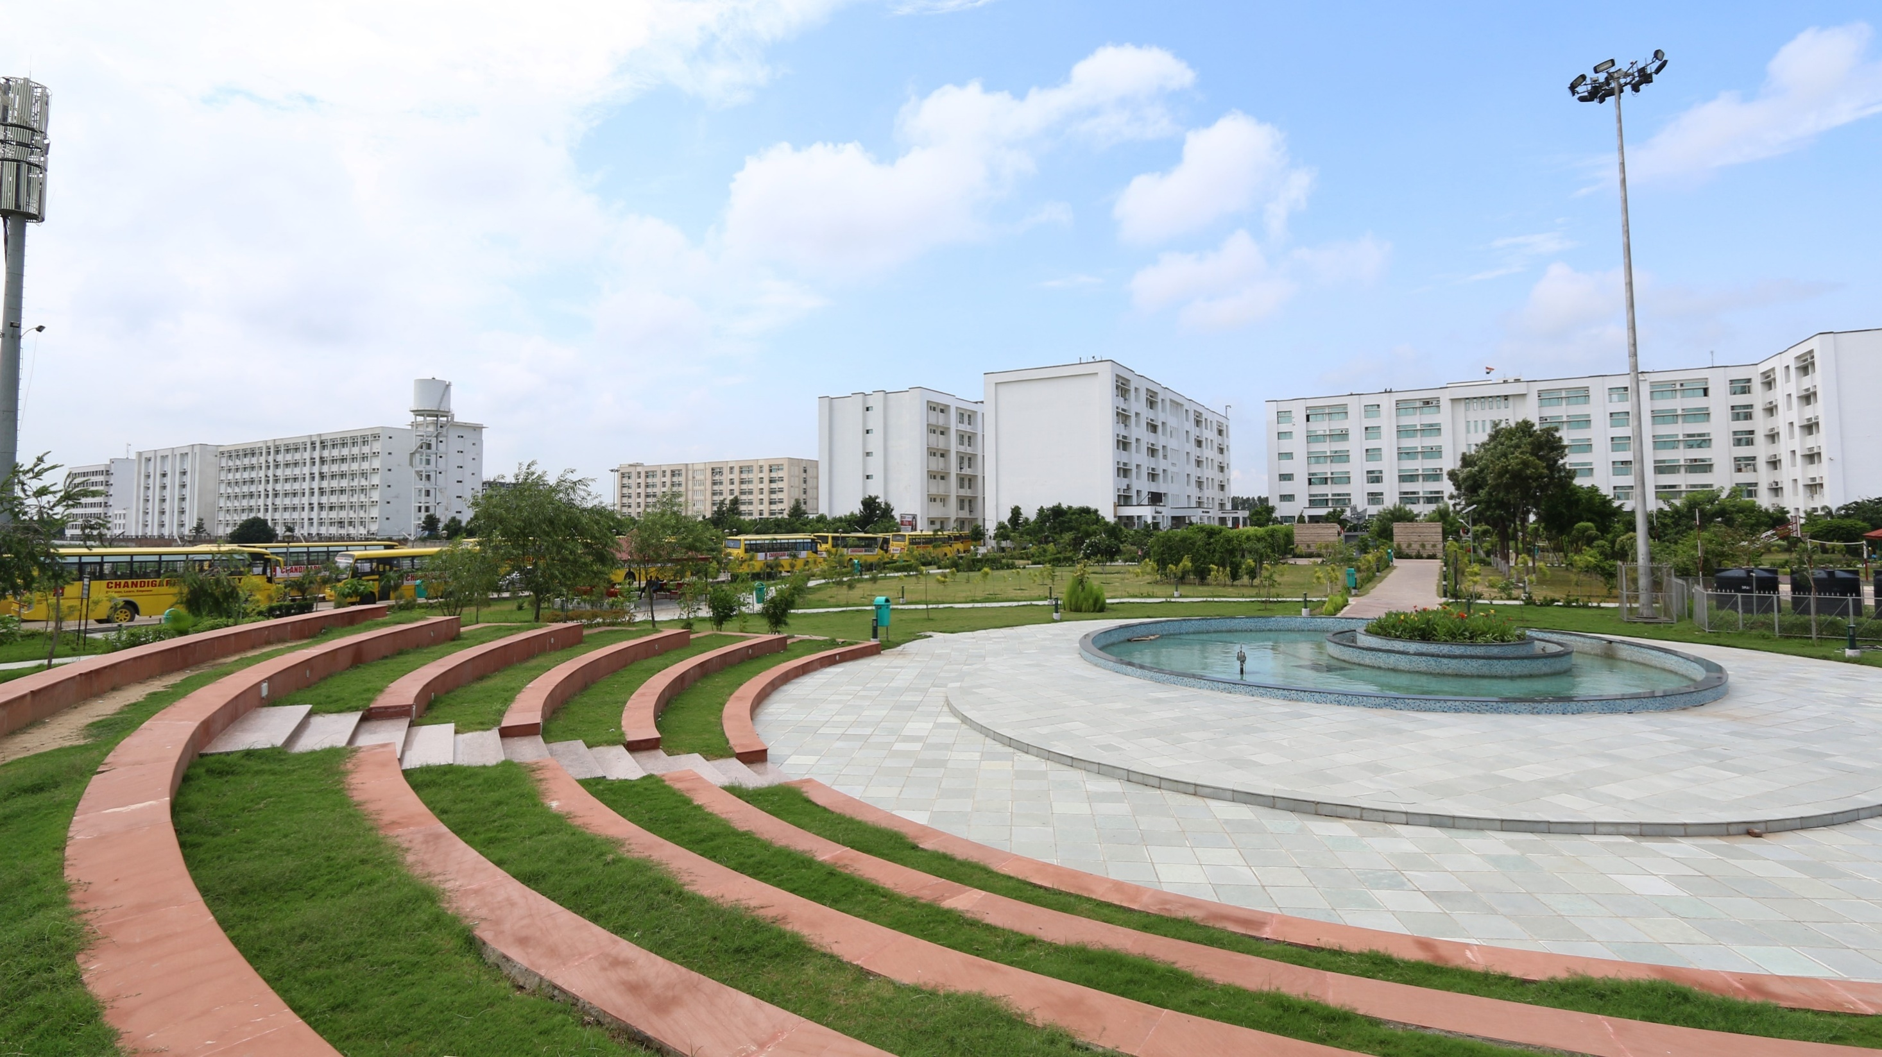


www.cuchd.in
‘ASIA’S BEST & FASTEST GROWING PRIVATE UNIVERSITY’
- BY WCRC
Research Profile
Campus - Gharuan, Mohali

Slide 2
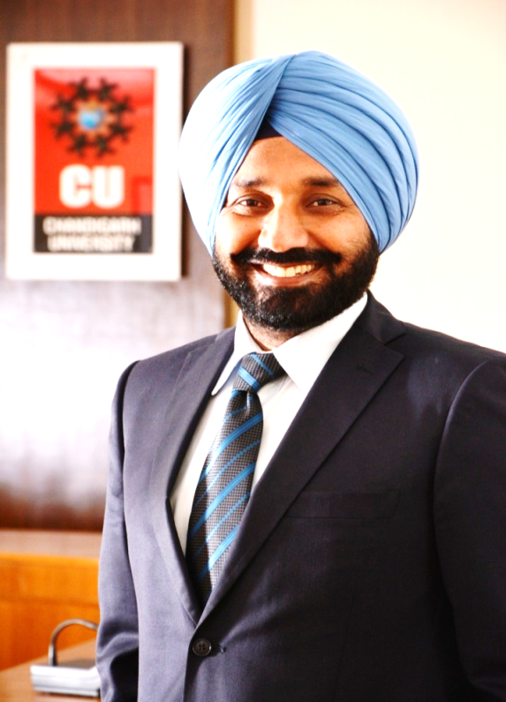
FOUNDER
Founder Chairman, Chandigarh Group of Colleges (CGC)Established in 2001.
Chairman, Education Promotion Society for India (EPSI), North West Region.
Chairman, ASSOCHAM, Education Committee- Regional Council
Hails from Remote Village of Punjab with Farming Family Background.
First Graduate of his village who made it big with great vision and will to achieve.
Constantly working towards mission to for an excellence driven professional university that leads to the betterment of the society.
Adopted a number of rural schools which are being provided regular academic, infrastructural and financial support.
Honored with International Leadership Award in the field of education by Rome University.
Decorated with top Edupreneurs of the country award Presented by Minister of State, MHRD.
S. Satnam Singh Sandhu
Chancellor

Slide 3
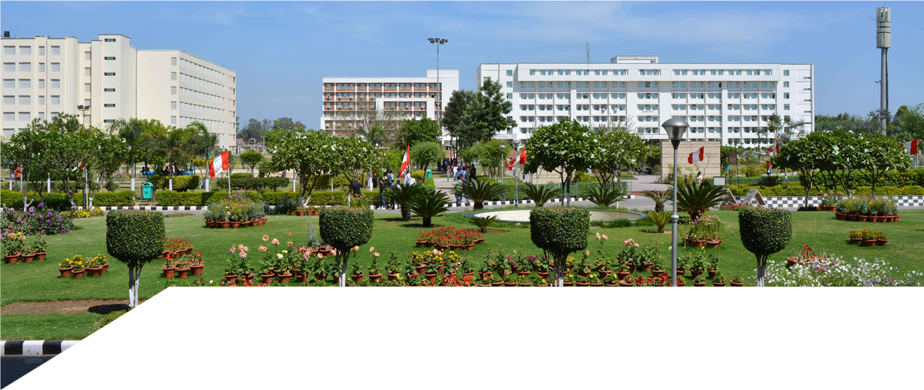
University Grants Commission (UGC)
All India Council for Technical Education (AICTE)
Council of Architecture (CoA)
Pharmacy Council of India (PCI)
Bar Council of India (BCI)
National Council for Teacher Education(NCTE)
Association of Indian Universities (AIU)
Association of Commonwealth Universities (ACU)
International Association of Universities (IAU)
Indo US Collaboration for Engineering Education (IUCEE)
Institute of Electrical and Electronics Engineers (IEEE)
American Chemical Society (ACS)
RECOGNITIONS
AND
APPROVALS
| Accredited by Large number of Prestigious Corporate Houses |

Slide 4
VISION
“To be globally recognized as a Centre of Excellence for Research, Innovation, Entrepreneurship and disseminating knowledge by providing inspirational learning to produce professional leaders for serving the society”.

Slide 5


UNIVERSITY AWARDS
University with Best Placements by WCRC. Asia's Best & Fastest Growing University awarded by WCRC. Ranked 7th among Top 25 Socioversities of India by Careers 360. Awarded “A” Credit Rating by “FITCH” in 2015 Engineering Ranked 5th Among Top Private Engineering Institutes of India – THE WEEK Ranked Among India’s Top 5 Engineering Institutes by Times Engineering. Ranked 22nd Among Top 100 Engineering Colleges in India- Outlook 2016
NON ACADEMIC AWARDS
ACADEMIC AWARDS

Slide 6

UNIVERSITY AWARDS
Management
AAA Ranking by Careers 360.
AA+ Ranking by Digital Learning Top 5 Women Friendly B-School- Apex Institute of Technology by Outlook Money
Hotel Management
Best Hotel Management Institute 2014-2015. (Awarded for consecutive 2 years by Indian Restaurant Congress) Ranked 25 Among top Pvt. Hotel Management Institutes of India – The Week
ACADEMIC AWARDS

Slide 7
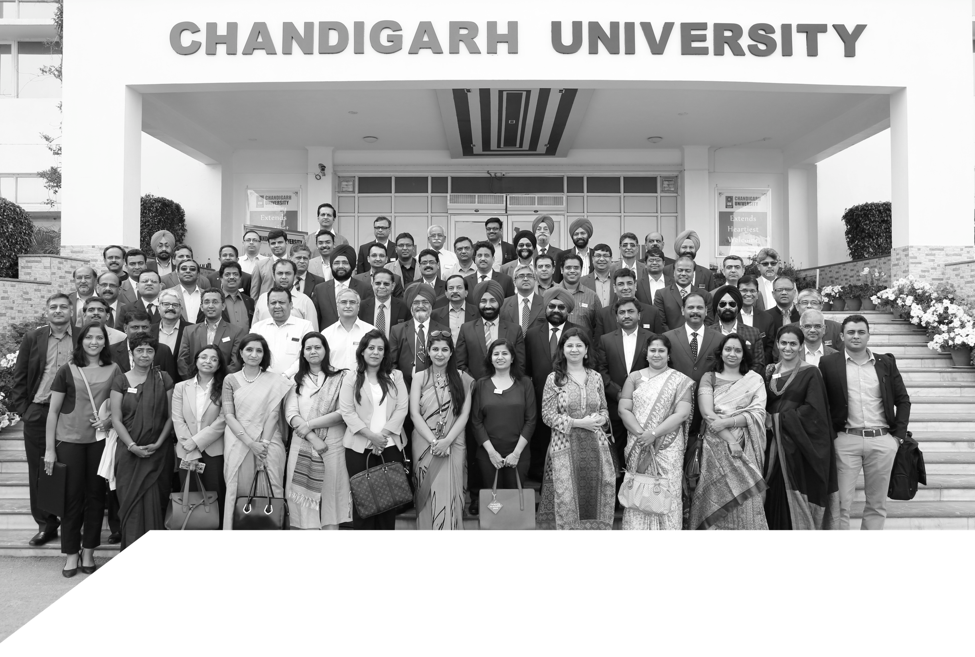
CORPORATE ADVISORY BOARD
Corporate Advisory Board (CAB) of Chandigarh University has more than 150 Senior Functionaries Like Chairmen, VP’s, CEO’s and Directors of Top Multinational Companies.

Slide 8






CORPORATE ADVISORY BOARD
ABG Shipyard Ltd | Asia Motors Works Ltd (AMW) | CK Birla Group
Ashok Leyland Ltd. | Ballarpur Industries Ltd (BILT) | Coffee Day
Aditya Birla Group | Birla Soft India Ltd. | CSC (P) Ltd.
Adventz Group | Caterpillar India Pvt. Ltd. | Cinda Engg. & Construction Pvt. Ltd.
Anand Automotive Systems Ltd. | CGI India | Cybage Software Pvt. Ltd.
Apollo Tyres Ltd. | CHEP India (Brambles Ltd.) | Cypress Semiconductor Technology India

Slide 9






CORPORATE ADVISORY BOARD
GMR Group | Microsoft | Go Daddy
Deepak Nitrite Limited | Reliance | Force Motors Ltd.
D. E. Shaw India Software Private Limited | Rio Tinto India | Grail Research
ERA Infra Engineering Ltd. | Fino Paytech Ltd. | GVK Power and Infrastructure Ltd.
Dalmia Group | Finolex Cables Ltd. | Gwynnie Bee India Pvt. Ltd.
Eveready Industries India Ltd. | FMC Technologies India Pvt Ltd. | HD Motor Company India Pvt Ltd

Slide 10






CORPORATE ADVISORY BOARD
Indo National Limited (Nippo Battery) | Infogain India Pvt Ltd. | JK Tyre
Vedanta Group | Infosys BPO | Juniper Networks India Pvt. Ltd.
HT Media Ltd. | InMobi Technology Services Pvt. Ltd. | Kirloskar Pneumatic Co. Ltd.
Hyundai Construction Equipment India Pvt | Polaris Group | HDFC Bank
Hindustan Petroleum Corpn Ltd. | Jabong, AquaBrim Pvt. Ltd. | L&T Hydrocarbon Engineering Limited
IMRB International India Pvt Ltd. | Jet Airways | L&T Infotech Limited

Slide 11






CORPORATE ADVISORY BOARD
Linkedin Technology Information Pvt Ltd. | Mindtree Ltd. | Lava International Ltd.
Mahindra & Mahindra Ltd. | Misy Financial Software | ONIDA
MakeMyTrip (India) Pvt. Ltd. | Onicra Credit Rating Agency of India Ltd. | Paypal India Pvt. Ltd.
Marico Ltd. | NEC Technologies India Ltd | Hero Group
Max India Ltd. | NI Systems (India) Private Limited | Piramal Group
Meru Cab | Nomura Services India Private Ltd. | Planet Ganges Consulting Private Limited

Slide 12






CORPORATE ADVISORY BOARD
Praxair India Private Limited | Shapoorji and Pallonji Co Ltd. | TAFE
Quark India | Shopclues.com | Tally Solutions Pvt Ltd
Praj Industries Ltd. | Shopper's Stop Ltd. | Tata Communications Limited
Reliance Jio Infocom Ltd. | SMLIsuzu | TCG Hamilton Group
Royal Enfield | Steria India Ltd. | Tech Mahindra Ltd.
Praj Industries Ltd. | Sterlite Technologies Ltd. | Sanmar Group

Slide 13




CORPORATE ADVISORY BOARD
Thought Works Technologies | Thermax Ltd.
TVS Auto Assist India Limited | United Health Group (UHG)
Ultratech Cement Ltd. | Zee Entertainment Enterprises
VE Commercial Vehicles Limited | Zensar Technologies Ltd.
Welspun Group | ZS Associates India Pvt Ltd.
Virtusa India (Pvt.) Ltd.

Slide 14
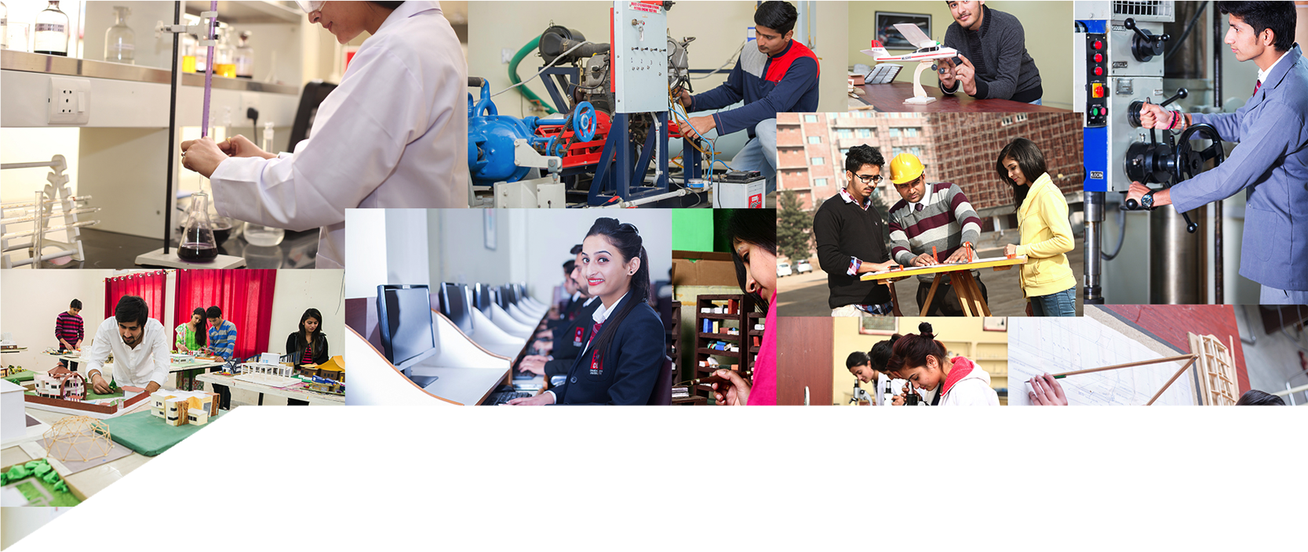
PROGRAMS OFFERED
Engineering
Management
Commerce
Computer Application
Architecture
Pharmacy
Bio-Technology
Forensic Sciences
Tourism & Hospitality
Medical Lab Technology
Basic Sciences I Humanities
Agriculture
Legal Studies (Law)
Animation, Film & Visual Arts
Journalism & Mass Communication
Doctoral Programs
University Institutes | 17
Faculties | 16
Departments | 39
Courses/ Programmes | 100
UG Courses | 58
PG Courses | 42

Slide 15

INDUSTRY COLLABORATIVE PROGRAMS
ENGINEERING (Honours)
IN ASSOCIATION WITH IBM
CSE- CLOUD COMPUTING
CSE- INFORMATION SECURITY
CSE- BIG DATA & ANALYTICS
BUSINESS MANAGEMENT
MBA- BUSINESS ANALYTICS
IN ASSOCIATION WITH IBM
MBA- BANKING & FINANCIAL ENGINEERING
IN ASSOCIATION WITH ICICI DIRECT, TALLY EDUCATION & FLIP

Slide 16
ACADEMIC FRATERNITY
The University has presently around 150 doctorates
More than 250 faculty members pursuing PhD
Faculties from institutions like IIT’s, NIT’s, IIM’s and reputed universities
Faculty has more than 1200 publications to their credit
Faculty is encouraged to do research, participate in seminars, conferences at both National & International levels
International Visiting Faculty, Corporate Faculty and Adjunct Faculty for better exposure

Slide 17







RESEARCH COLLABORATIONS WITH INDUSTRY
HEWLETT PACKARD ENTERPRISE -
CENTER OF EXCELLENCE
TECH MAHINDRA – IMS
ACADEMY
(1st in North India)
MICROSOFT INNOVATION CENTER
(1st In North India)
MICROSOFT GLOBAL TECHNICAL
SUPPORT CENTER (Only 3 In India)
CONNECT – VIDEOCON ADVANCE COMMUNICATION LAB
IBM SOFTWARE LAB FOR EMERGING
TECHNOLOGIES (1st In India)
VOLVO EICHER T-SCHOOL
(1st in India)

Slide 18
OTHER PROMINENT COLLABORATIONS
MENTOR GRAPHICS UNIVERSITY SCHEME
WIPRO MISSION 10x TECHNOLOGY LEARNING CENTER
ORACLE ACADEMY
MSC CENTER OF EXCELLENCE
INFOGAIN- LEARNING PARTNER
UNISYS ACADEMIC COLLABORATION
HOLIDAY INN (INTERCONTINENTAL HOTEL GROUP)
LIGARE VOYAGES
HYUNDIA PROFESSIONAL DEVELOPMENT CENTRE
Official Partner of
NASSCOMM FOUNDATION
for:
NATIONAL DIGITAL LITERACY MISSION

Slide 19
Research Committees
The University has constituted a three-level committee for monitoring the research progress of the University.
The University Research Degree Board (RDB), headed by the Dean of Academic Affairs, Dean of Research, All Deans of faculties, All HoDs and all other Professors of the University.
Research Degree Board has the powers to approve and administer research degree registrations, examination arrangements, monitor student progress and make recommendations for the award of research degrees.
RDB oversee the managements of research degrees across all University departments, schools and institutes, and foster the development of postgraduate research community.
(b) There is a Research Degree Committee (RDC) in each subject within the faculty.
RDC is the recommending body. The Chairperson of the RDC is the Dean of that faculty. RDC proposes programs of course work to register for the degree of Ph.D and appoint first and second supervisor for the candidate’s program of work and approve the appointment of any additional supervisor(s) and/or advisor(s) as appropriate.

Slide 20
Research Committees
At the School/ Department level, a set of senior faculty members form Department Research Committee (DRC), which is headed by the School Dean/HoD and coordinated by the respective faculty members.
The DRC monitors the progress of the scholars and ensures the proper conduct of the meetings related to school research activities. DRC also monitors the working of the Centres of Research established in various departments of the University
In addition to this in Ph.D program a Doctoral Committee (DC) is constituted to suggest and monitor the progress of the individual scholars.
To coordinate with industries, administer the policies related to research & consultancy services, and maintain the relevant documents, Chandigarh University has set up University Centre for Research & Development (UCRD).
The activities related to sponsored research (of faculty) are taken care and monitored by the Dean of Research.

Slide 21
Research Collaborations
In order to promote collaborative research with other institutes / industries, the University has created platforms on a number of occasions in which discussions have been held between the faculty members and the personnel from industry.
Fly Wings Simulators Glass Academy Foundation Hyundai Motor India LTD. ValeurHR E-Solutions Pvt.LTD Oniosome Healthcare Pvt.Ltd Quadrant Televentures LTD.(Videocon) Helio Pharmaceuticals Baddi National Small Scale Industry Corporation Nasscom Foundation Microsoft GTSC Tally Education Pvt. LTD. Wipro MTLC EMC2 Academic Alliance Oracle Academy IBM India Pvt LTD. Unisys innovation Labs | Finitiatives Learning India Pvt. LTD. Ligare Voyages Ltd. ICICI Securities LTD. Pharma Instinct (p) LTD. Cox & Kings Chandigarh Agritech Pvt LTD. ALLELE Life Sciences (P) Ltd. Volvo Eicher Commercial Vehicle TAJ Chandigarh IHG Academy Aspiring Minds ITC InfoTech India LTD. Infogain Tech Mahindra LTD. Microsoft Innovation Centre

Slide 22
UNIVERSITY CENTRE FOR RESEARCH & DEVELOPMENT
Provision of Rs. 50 Million annually, for promotion of Research, Innovations & Entrepreneurship
Chandigarh University has set up University Centre for Research & Development (UCRD) for industrial alliances and administer the policies related to research & consultancy services
University has filed 57 Patents, 04 Design Registration and 02 Trademarks. In the current year 03 Centre of Excellence (COE) are been created in Mechanical Engineering, Electronics & Communication Engineering and Computer Science & Engineering.
The various departments of the University has published around 700 papers in National journals and 815 papers in International journals , has attended 316 National and 198 International conferences/seminars and had published 25 books.

Slide 23
UNIVERSITY CENTRE FOR RESEARCH & DEVELOPMENT
The following are the established research centres within the campus, which focusing on multi-disciplinary research:
Centre for Research in Flexible Manufacturing Systems
Centre for Research in Thermal Engineering
Centre for Research in Material Science
Centre for Research in Computational Nuclear Physics
Centre for Research in Soft Computing
Centre for Research in Rural Marketing and Business Enhancement
Centre for Research in Pharmaceutical Sciences
Centre for Research in Punjab Cooking Heritage

Slide 24
UNIVERSITY CENTRE FOR RESEARCH & DEVELOPMENT
The following Research Groups are actively involved various departments :
Computer Science Engineering & Computer and Communication Engineering
Predicting and Preventing Epidemics (PPE) Analysis
Game Theory based Decision Making (GTDM).
Primordial Earthquake Damage Analytics (PEDA).
Dynamic Loop Scheduling (DLS) for meta-schedulers in intercloud.
Multimedia Content Distribution by VANETS
Security and Video Surveillance
Data Security and Privacy Issues
Electrical Engineering
Engineering Education
Optical Fiber Communication
Power Electronics
Power System
Renewable Energy
Physics
Nano Materials
Nuclear Physics
Radiation Physics
Chemistry
Synthetic Organic Chemistry
Polymer Science
Inorganic Chemistry
Nano Chemistry
Environmental Science
Mathematics
Fixed Point Theory
Fuzzy Mathematics
Operational Research
Dynamics
Fuzzy Reliability
Wavelet Analysis
Plasticity & Creep
Mechanical Engineering
Manufacturing and Industrial Engineering
Design Engineering
Thermal Engineering
CAD/CAM

Slide 25
UNIVERSITY CENTRE FOR RESEARCH & DEVELOPMENT
The following Research Groups are actively involved various departments :
Chemical Engineering
Chemical Process Optimization
Alternative Energy Systems
Photo-Assisted Oxidative Detoxification of Pollutants
Decolorization of Synthetic Textile Dyes
Waste Water Treatment Using Argo-Waste
Piping Designing
Research Surface Methodology
Aerobic / Anaerobic Treatment of Waste Water
Civil Engineering
Geotech. Engg.
Construction Technology and Management
Environment
Structures
Transportation
Water Resource
Petroleum Engineering
Drilling Technology
Reservoir Engineering
Geotechnology
Reservoir Geophysics
Polymer Processing
Biodegradation of Polymer Materials
Piping
Fluid Dynamics
Electronics & Communication Engineering
Wireless & Mobile Communication
Image Processing
Robotics
Digital Signal Processing
VLSI System Design
Automobile Engineering
Hydrogen fuel cell technology
Alternative Fuels for Automobiles
Bio-Pharma
Herbs and Phytochemical.
Transdermal Drug Delivery System
Cognitive Studies.

Slide 26
UNIVERSITY CENTRE FOR RESEARCH & DEVELOPMENT
CONSULTANCY
The University has an Industrial-Institutional-Interaction Cell.
The cell serves as the link between the industry and the institution for updating the academic curriculum, arranging guest lectures by the industrial experts and placement arrangements.
University publishes a Consultancy Brochure
Consultancy services are publicized through the University website and through industrial contacts.
Updated literature about the institution is periodically sent to the prospective companies to highlight the latest achievements/ advancements made by the faculty including the addition of facilities.
University is also member of CII, PHD Chamber of Commerce.

Slide 27
UNIVERSITY CENTRE FOR RESEARCH & DEVELOPMENT
CONSULTANCY
Some of the Prominent Industrial Consultancy Projects of 2015-16
S No | DEPARTMENT | NAME OF THE INDUSTRY | PROJECT TITLE | AMOUNT (Rs)
1 | PHARMACY | Chandigarh Agritech Pvt. Ltd. | Development of Quality Assurance Laboratory for Neutraceuticals | 100,000
2 | CIVIL | M/s Aqua Tech Solutions Pvt. Ltd JV Sh. Kuldeep Singh Client : Punjab Water Supply and Sewerage Board | Third Party Quality Assurance Work for “Construction of Sewage Treatment Plant at Shahkot, Jalandhar” | 162,500
3 | CIVIL | Jai Bhushan Malik Engineers and Contractors | Quality Control of “Providing and laying of sewerage scheme of Barnala City | 126,000
4 | CSE | JSSM Enterprises | Consultancy for bulk digitizing and scanning process | 400,000

Slide 28
UNIVERSITY CENTRE FOR RESEARCH & DEVELOPMENT
CONSULTANCY
Some of the Prominent Industrial Consultancy Projects of 2015-16
S No | DEPARTMENT | NAME OF THE INDUSTRY | PROJECT TITLE | AMOUNT (Rs)
5 | ELECTRICAL | BN Concast Pvt.Ltd. | Designing of Power House | 30,000
6 | ELECTRICAL | Hero Metal Casts | Improvement of Power factor and Designing of Timer Circuits of PLC | 30,000
7 | MECHANICAL | Aqua Systems Pvt. Ltd. | Reduction in rejection rate in the gravity die casting process | 50,000
8 | MECHANICAL | Elite Industries | Design of Special Purpose Machine for Bore Machining of Cylinder Block | 30,000
9 | MECHANICAL | Elite Industries | Design of Fixture for machining of Cylinder Block | 20,000
10 | MECHANICAL | Hytech Engineers | Design and Development of Automated Rail Guided Vehicle for Flexible Manufacturing System | 200,000
11 | Mechanical | Essel Bath Fittings | Grading of sand and reduction in Casting rejections | 50,000

Slide 29
UNIVERSITY CENTRE FOR RESEARCH & DEVELOPMENT
CONSULTANCY
Some of the Prominent Industrial Consultancy Projects of 2015-16
S No | DEPARTMENT | NAME OF THE INDUSTRY | PROJECT TITLE | AMOUNT (Rs)
12 | UIHM | Ekant Hotels and Resorts | Designing of Menu, determining prices, creating and testing of new recipes | 100,000
13 | UIHM | Hotel Supreme | Interior decoration of rooms | 150,000
14 | UIHM | Dev Snack Industries Dev Food Products | Development of new products and enhancement of present products, nutrient value and maintaining hygiene | 200,000
15 | USB | Punjab Roadways Punbus, Chandigarh | Punjab Roadways Passenger Satisfaction Survey (9th & 10th September, 2015) | 25,000
16 | UCRD | Punjab Survey | Pre poll study for Punjab from VSKM | 4,000,000

Slide 30
UNIVERSITY CENTRE FOR RESEARCH & DEVELOPMENT
Some of the Prominent Ongoing Projects
Sr. No. | Title | Researcher
1 | Influence of mass asymmetry on nuclear stopping and scaling among the different components of anisotropic flow | Dr. Suneel Kumar
2 | Solitary wave solution of generalized non-linear Schrodinger equation in presence of external source | Dr. Vivek Sharma
3 | Preparation and Characterization of Surfactant-free Aqueous Emulsions for medical applications | Dr. Raminder Kaur
4 | Synthesis and Characterization of NA2O-B2O3-P2O5 based glasses as solid electrolyte for batteries applications | Dr. Paramjyot Jha
5 | Design and Simulation of radiation Hard Si detector types for High luminosity collider Experiments and other applications | Dr. Ajay K. Srivastava
6 | Experimental Investigation on the use of MR fluids for Bio-Medical Applications | Dr. Satbir S Sehgal Harjot Singh Gill

Slide 31
UNIVERSITY CENTRE FOR RESEARCH & DEVELOPMENT
Some of the Prominent Ongoing Projects
Sr. No. | Title | Researcher
7 | Plasmon Enhanced Upconversion Luminescene of NaYF4: Er, Tb Nanocomposites Core Shell for Solar Cell Application | Dr. Vijay Sharma
8 | Use of Nanofillers in Hybrid Composites for Advanced Barrier Layers and Medical Applications | Dr. Kartik
9 | Development of Earth Powered Light | Dr. Vinod
10 | Compact Modeling of Graphene based Hetero-Structures for Electronic Circuit Design | Dr. Tripti
11 | Development of effective membranes, utilizing electrospinning techniques, for removal of micro-pollutants from the waste water | Dr. Bharat Bajaj
12 | Molecular characterization and variability studies on fungus associated with gummy stem blight of cucurbits | Dr. Abhishek Katoch

Slide 32
UNIVERSITY CENTRE FOR RESEARCH & DEVELOPMENT
Some of the Prominent Ongoing Projects
Sr. No. | Title | Researcher
13 | Phytochemical studies and evaluations of some Indian medicinal plants for antianxiety activities | Dr. Pardeep Goyal
14 | Small Scale Wind Turbine Generator Optimized for Low Wind Speeds | Dr. Harjot Singh
15 | Enhancement of soil fertility and crop yield in organic farming by phosphate solubilising rhizobacteria | Dr. Gurdeep Kaur
16 | Green Synthesis Of Chiral 1, 2-amino Alcohols and Their Activity Study As Antimicrobial And Anticancer Agents | Dr. Debarati Chakraborty Dr. Tulika Mishra
17 | Synthesis and Characterization studies of new Pyrimidine based Heterocyclics | Dr. Harvinder Singh Sohal
18 | Synthesis of Imine linked Urea / Thiourea based receptors for Cation Recognition; Search for biological applications | Dr.Renu Sharma

Slide 33
UNIVERSITY CENTRE FOR RESEARCH & DEVELOPMENT
Some of the Prominent Ongoing Projects
Sr. No. | Title | Researcher
19 | “Synthesis of Glyconanomaterials to amplify the glycan mediated Interactions” | Dr. Ritu Mahajan
20 | Development of Novel Materials from Lignocellulosic Waste Biomass by various Chemical Modifications for the Removal of Heavy metal ions from Industrial Effluents | Dr. Raj kumar Rana
21 | “Cancer drug synergy based on computational intelligence techniques” | Dr. Lohit Kapoor
22 | “Utilization of Bio-mass ash in concrete for sustainable development” | Dr. Aradhana Mehta
23 | Utilization of lignocellulosic biomass for production of industrially important value-added products: Non enzymatic Pretreatment strategy | Dr. Gunjan Mukherjee
24 | Molecular and Functional Characterisation of Oxidoreductases from Aspergillus sp for its potential Industrial Applications | Dr. Mitun Chakraborty

Slide 34
UNIVERSITY CENTRE FOR RESEARCH & DEVELOPMENT
Some of the Prominent Ongoing Projects
Sr. No. | Title | Researcher
25 | Bioformulation of Hand sanitizer from flora collected from lower Shivalik hills and its fringes | Dr. Tulika Mishra Dr. Gunjan Mukherjee
26 | Herbal preparation of medicinal plants of mid-high altitude of northern regions of India and synergistic effect with B-Complex for hepatic cells repair during liver disorders | Dr. Vipasha Sharma
27 | Isolation And Screening Of Plastic Degrading Microbes From Environment With Potential Application In Promoting Ecofriendly | Dr. Nancy George
28 | Synthesis, Design and Evolution of pro-drugs and its formulations in the form of transdermal drug delivery systems for treatment of depression, schizophrenia and related disorder | Dr. Manish Goswami Dr. Rajwinder Kaur
29 | Portable Electronics Workbench for Learning and Prototyping | Prof. Divneet Singh

Slide 35
UNIVERSITY CENTRE FOR RESEARCH & DEVELOPMENT
University publishes four journals:
Chandigarh University Journal of Undergraduate Research and Innovation
Chandigarh University Research Bulletin
Chandigarh University Engineering Review
Chandigarh University Business Review

Slide 36
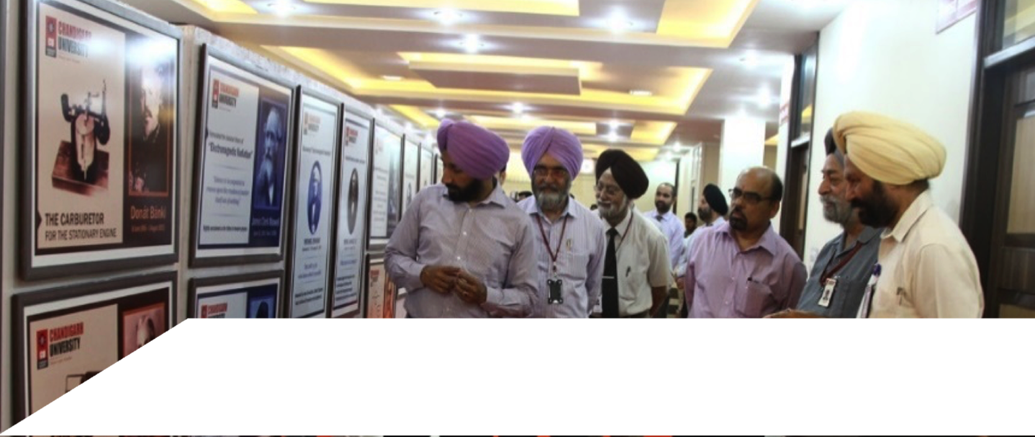
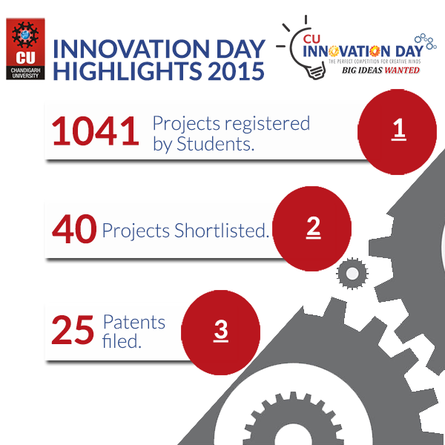
ABDUL KALAM INNOVATION CONCLAVE
To create an environment of innovation through the spirit of
Competition and Freedom to explore
An Annual Event to Promote & Nurture Innovative Ideas:
Registration
Scrutiny
Consolidation
Screening/ Defense
Experimentation
Patent and Presentation
1041
Projects registered by Students
40
Projects Shortlisted
25
Patents filed.

Slide 37
GRANTS RECEIVED
In a short span of 3 years Chandigarh University got Grants of INR 41.1 Million from various government agencies:
INSPIRE
15 M
UDAAN
8.5 M
DST PROJECTS
9.6 M
GRANTS
IEDC
5 M
CONFERENCES
1.5 M
WORKSHOPS
1.5 M

Slide 38
ENTERPRENUERSHIP & INNOVATION
START- UPS AT TBI
BOOK LAE INDIA (Online Book Exchange Site)
REED CONSULTANCY (Management Consultancy Firm)
7 DAY STUDIO (3D Animation Company)
ENNO-EXCELLENCE (Rural Entrepreneurship Platform)
REVADA (Social NGO)
TECHNOLOGY BUSINESS INCUBATOR (TBI)
INNOVATION and ENTEREPRENUERSHIP DEVELOPMENT CELL (IEDC)
Focus on the practical aspects of entrepreneurship which assists from idea incubation to logical conclusion.
First-hand experience with Entrepreneurs and industry experts for mentoring and execution.
Assistance in Business Plans pitching to investors for further investments and capital growth.
TBI operates on a much lower fee structure as compared to most similar institutions and create a life-time network for participants.
FUNDING AGENCIES:
NABARD, SIDBI
Leading Banks - SBI, PNB, ALLAHABAD etc.
Govt. Organizations : DST, MSME

Slide 39











































INTERNATIONAL COLLABORATIONS
UK
GCU, Scotland
UK
Canada
GCU, Scotland
Canada
Germany
Switzerland
Collaborations with more than 75 reputed and highly ranked International Universities across the globe.
Germany
France
Switzerland
USA
France
USA
Spain
Poland
Spain
Poland
Mongolia
Mongolia
Italy
South Korea
Italy
South Korea
Afghanistan
China
Iraq
Afghanistan
Iraq
Thailand
Mexico
Thailand
Mexico
Singapore
Colombia
Singapore
Colombia
Brazil
Brazil
Australia
Australia
Argentina
Argentina

Slide 40
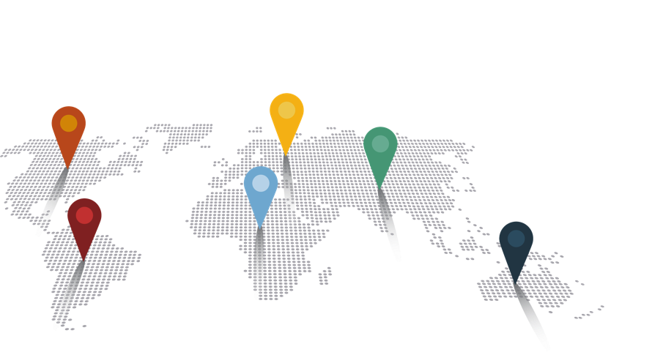




INTERNATIONAL PARTNERSHIPS
Afghanistan
Argentina
Australia
Azerbaijan
Belgium
Brazil
Bangladesh
Canada
China
Colombia
Cameroon
Ethiopia
France
Finland
Georgia
Germany
17. Indonesia
18. Iraq
19. Italy
20. Japan
21. Kenya
22. Liberia
23. Mexico
24. Mongolia
25. Malaysia
26. Macedonia
27. Mauritius
28. Mozambique
29. Netherlands
30. Nepal
31. New Zealand
32. Nigeria
33. Poland
34. Philippines
35. Russia
36. Singapore
37. South Africa
38. South Korea
39. Spain
40. Switzerland
41. Thailand
42. Turkey
43. Taiwan
44. Togo
45. UK
46. USA
47. Vietnam
48. Zambia
150+
Partner
Universities
50+
Countries
600+
International
Students

Slide 41

INTERNATIONAL PARTNERSHIPS
30 Universities Ranked Among Top 200 Universities of the World – By QS Ranking
3 Universities with more than 500 years of legacy
13 Universities with more than 150 years of legacy
11 Universities with more than 100 years of legacy
24 Universities with more than 50 years of legacy
113 Public & 35 Private Universities
DOMAIN WISE TIE-UP’S
Architecture – 19
Hospitality – 20
Management – 67
Media & Animation – 20
Education – 10
Engineering – 60
Health – 24
Legal Studies – 22

Slide 42
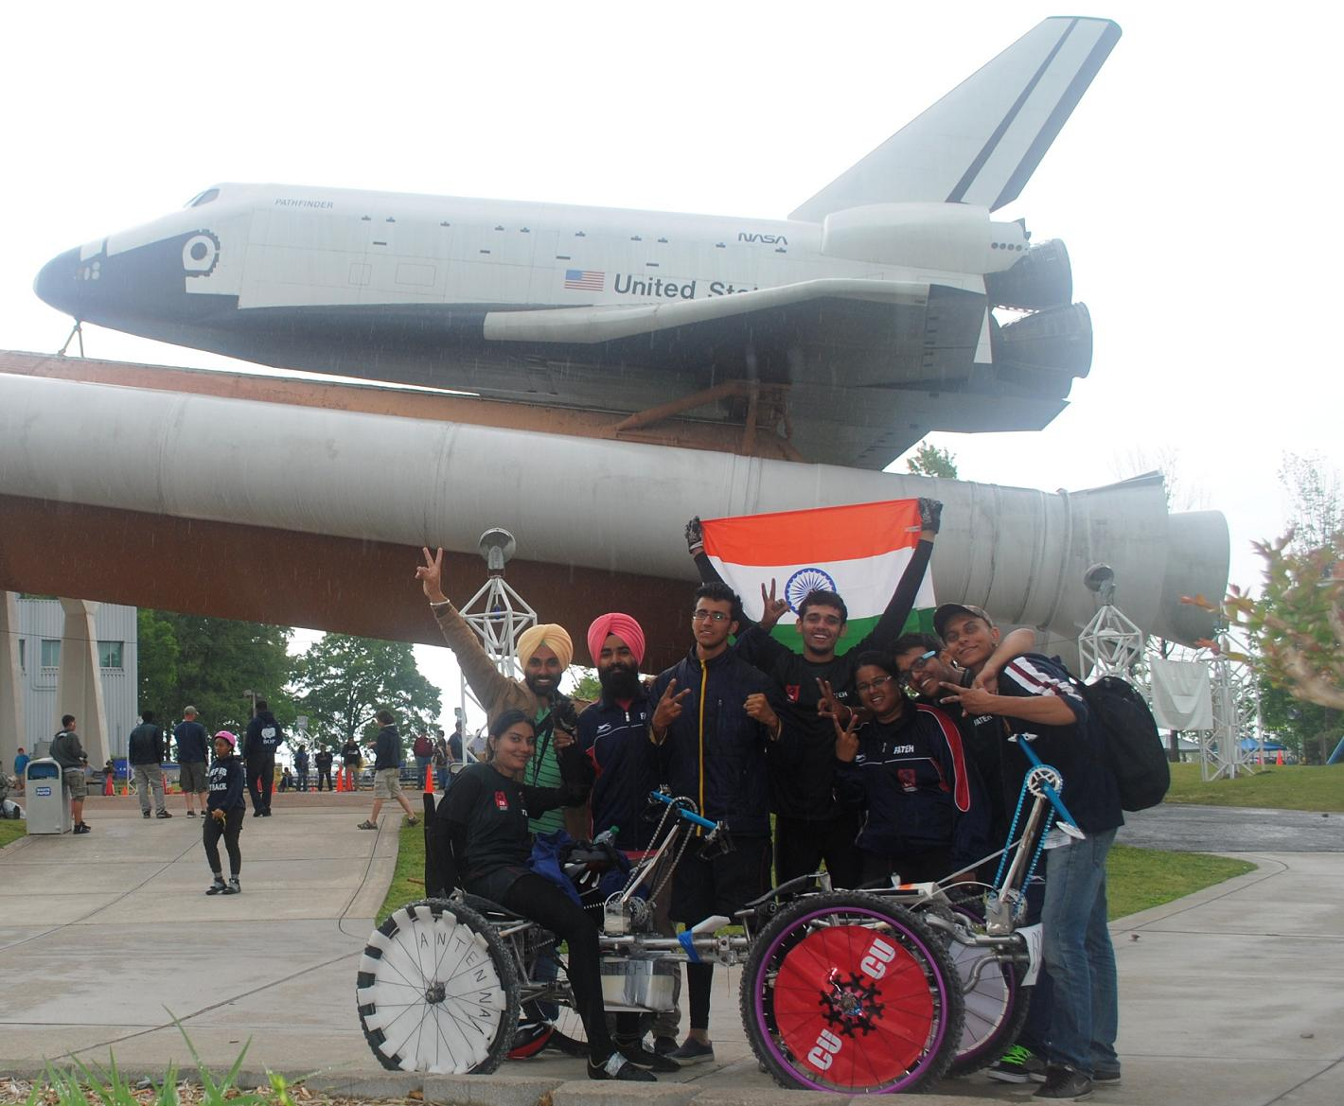
INTERNATIONAL ACHIEVEMENTS BY STUDENTS
Winners of MOONBUGGY Competition organized by NASA, USA - 1st in Asia & 12th in the World
- Ranked 1st in the Design
Winners of HUMAN POWERED VEHICLE (HPVC) an annual event organized by ASME In Colorado, USA

Slide 43
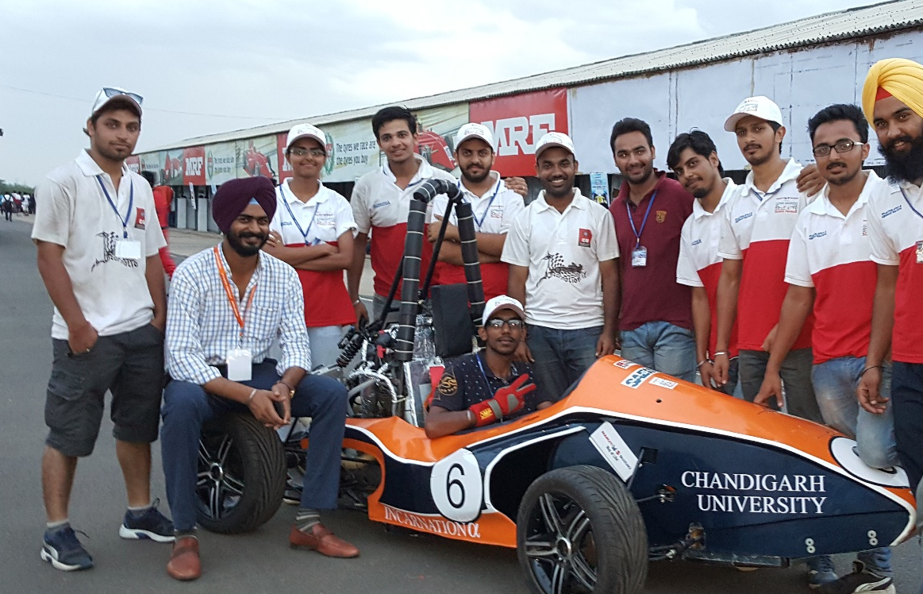
INTERNATIONAL ACHIEVEMENTS BY STUDENTS
Formula One Racing Car Designed by CU Students Booked their position in Top 10 in Technical Round at Chennai in Racing Competition out of 156 Participant from India
Go Cart Designed by Mechanical, Automobile & Electrical students and bagged 5th Position All over India Total 41 teams from PAN India participated including IITs, NITs, SRM & VIT.
Over all 1st Position in ASME HPVC (Human Powered Vehicle Challenge) India Competition

Slide 44
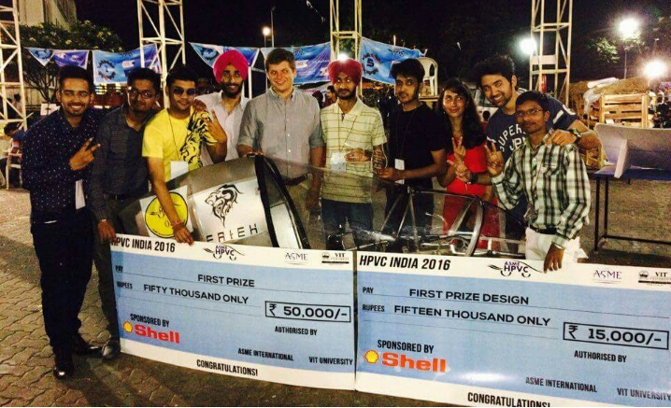
INTERNATIONAL ACHIEVEMENTS BY STUDENTS
Over all 1st Position in ASME HPVC India Competition
Total 41 teams from PAN India participated including IITs, NITs, SRM & VIT.
Team FATEH grabbed 1st Position in Design
2nd Position in Innovation

Slide 45
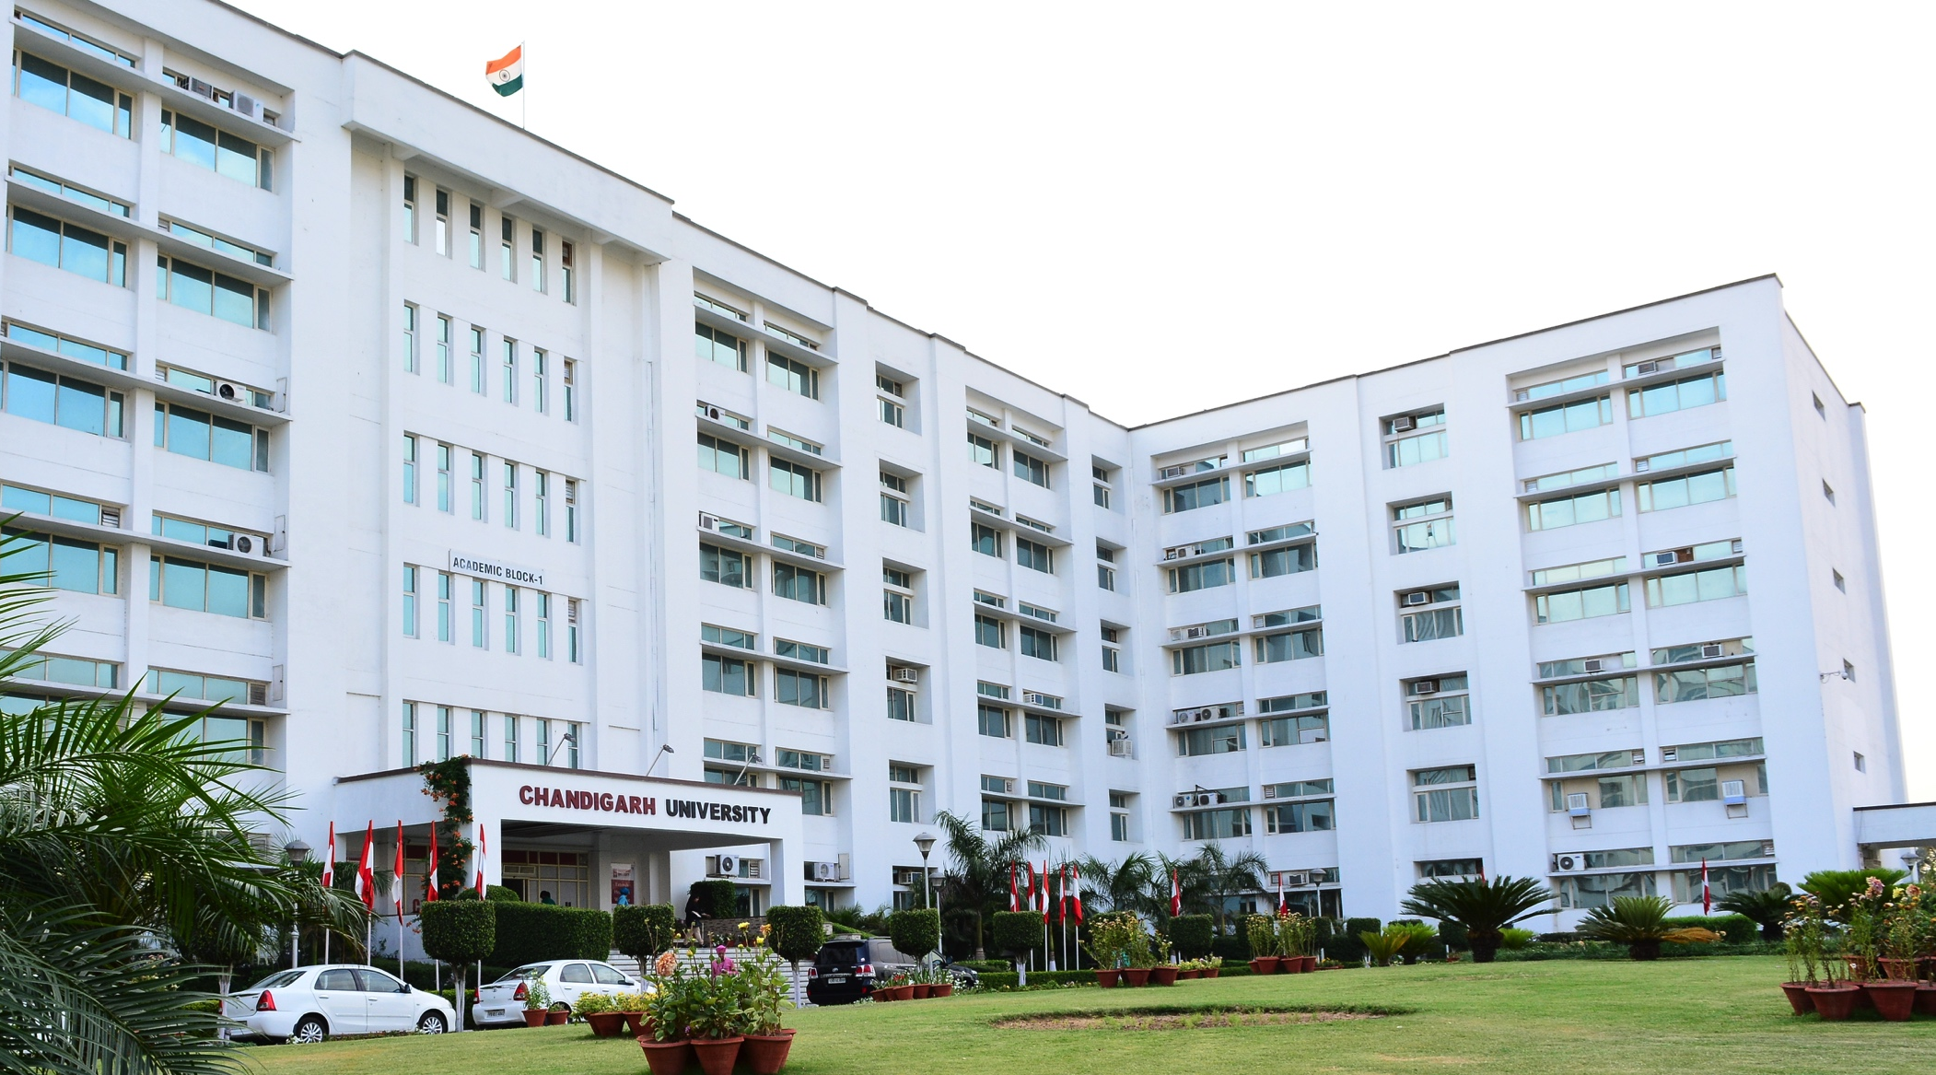


We Solicit Guidance & Suggestions

