Slide 1




Slide 2
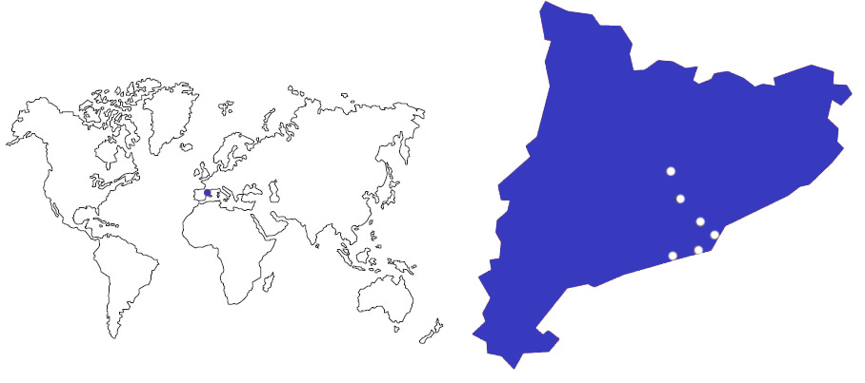
UPC BARCELONATECH
Manresa
Terrassa
Sant Cugat
Barcelona
Vilanova i la Geltrú
Castelldefels
Leading Technology at the south of Europe
南欧科学技术领导者

Slide 3
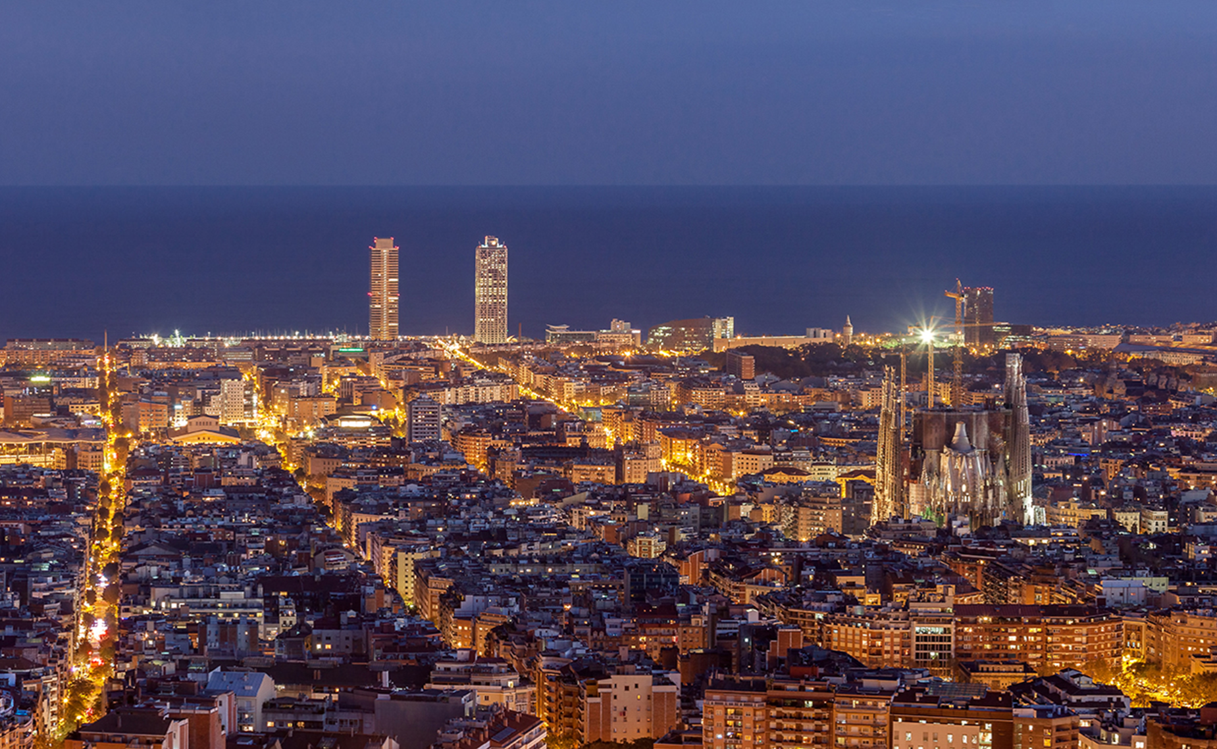
Education, Research, Innovation, Internationalization
教育、科研、创新与国际化
BARCELONA....
The Southern gateway to Europe
Mediterranean Capital
Bridge to the Maghreb
Platform for links to Latin America
1,611.822 Inhabitants
4,788.422 Inh. Metropolitan Area
17,4% foreign population
117 GDP per capita (Index UE=100)
41.391,2 kTn habour total transit
35,210.735 airport passangers
438.385 Companies (province of BCN)
5.602 foreign companies (Catalonia)

Slide 4

Education, Research, Innovation, Internationalization
教育、科研、创新与国际化
The Universitat Politècnica de Catalunya – BarcelonaTech is a public institution of Higher Education and Research, specialised in the areas of Architecture, Engineering, Science and Technology.
加泰罗尼亚理工大学 - 巴塞罗那高科是一个提供高等教育与研究的公共机构，致力于建筑，科学和工程领域。

Slide 5

3,093
207
30,155
^{teaching}
^{and research staff}
^{教职工作人员}
^{research groups}
^{研究小组}
^{Students}
^{学生}
20
^{Schools in 8 campus}
^{学院}
32%
64
45
^{bachelor’s degrees}
^{本科专业}
²⁰¹⁸⁻¹⁹
international master’s degree students
^{国际硕士学生}
46
67
^{doctoral programmes}
^{博士专业}
²⁰¹⁸⁻¹⁹
international doctoral degree students
^{(77% of them non EU)}
^{国际博士学生}
^{master’s degrees}
^{硕士专业}
²⁰¹⁸⁻¹⁹
708
higher education institutions with Student Exchange agreements
^{有学生的高等院校}
^{交换协议}

Slide 6
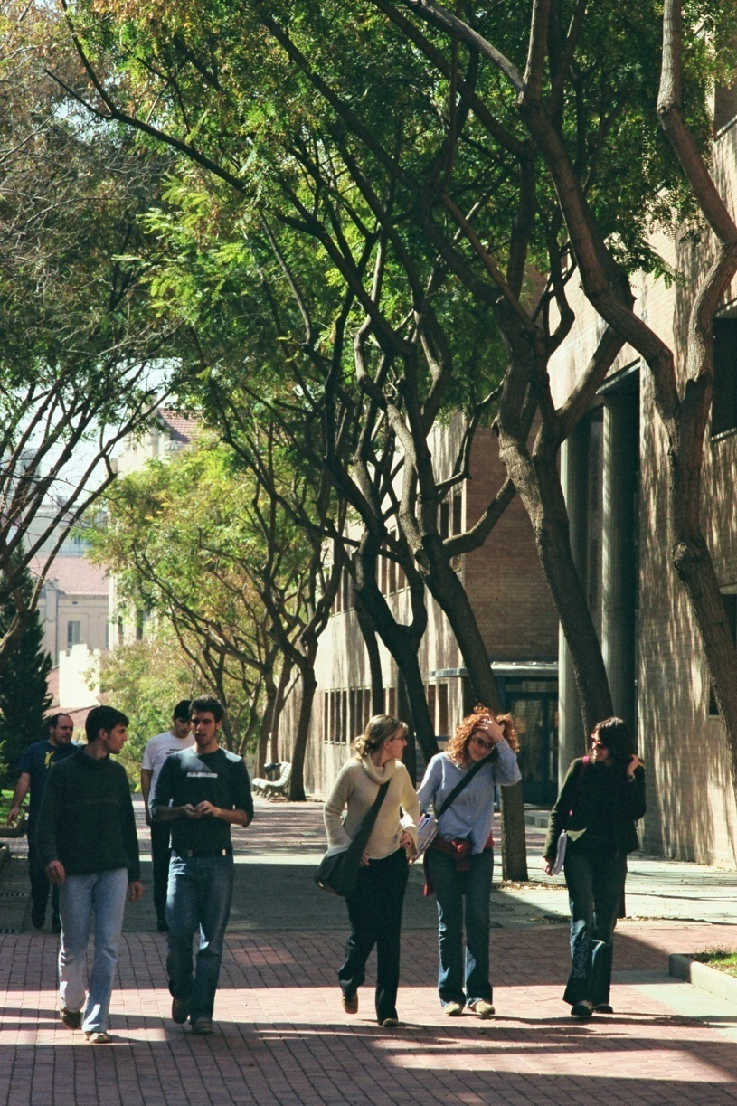
Fields
农业和生物系统工程
Architecture and Urban Planning
建筑学、城市规划和建筑工程
Aerospace Engineering 航天航空
Agricultural and Biosystems Engineering
农业和生物系统工程
Civil, Environmental and Geological Engineering
土木工程、环境和地质工程
Computer Science 信息学
Engineering for Industry: Energy, Biomedical, Chemical, Electrical, Materials and Mechanical
工业工程：能源、工业设计、生物、化学、电气和机械
Naval, Maritime and Nautical Engineering
海洋与航海工程
Telecommunications and Electronic Systems Engineering 电信和电子系统工程
Applied Sciences: Mathematics, Statistics, Physics, Optics and Photonics应用科学：数学、统计学、物理、 光学和光子学

Slide 7
Education
27,966 Undergraduate and master students,
27,966 名硕士毕业生
2,189
PhD students
2,189 名博士生
64 Undergraduate degrees, 64个本科毕业生
2018-2019
46
PhD programs
46个博士项目
2 Erasmus Mundus
2 个伊拉斯谟奖学金项目
2018-2019
65 Master’s programs 65 硕士项目
5 Erasmus Mundus
27 fully in English
5个伊拉斯谟奖学金项目
27个全英授课项目
2018-2019
58,200 members registered in UPCAlumni
58,200 名UPC校友会成员
3,080
Continuing education students: Life-Long Learning Program, corporate training, and other courses
3,080 继续教育学生：终身学习课程项目，培训及其他课程
4,678
Students Internships
4,678 名交换生

Slide 8
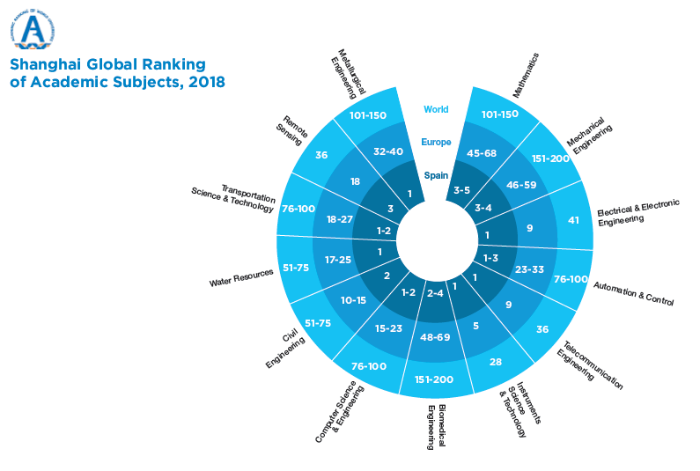
Reputation

Slide 9
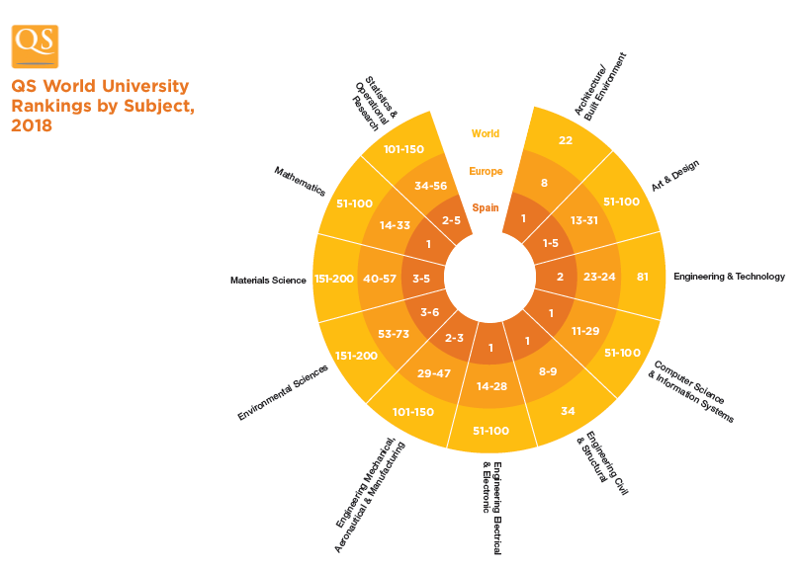
Reputation

Slide 10
Research to Innovate
创新研究
3,093
Researchers grouped in
207 Research groups
3,093名科研人员
207个科研小组
1,923
Papers in scientific journals
每年科学期刊发表学术论文1,923 份
807
new research projects
807 新的研究项目
356
PhD theses presented
每年博士毕业论文356份
130
Technical and scientific awards
130 科学技术奖项

Slide 11
Innovation
创新
From 1998:
313 spin-off and start-up
313 分拆和创业项目成立
10 start-up (2017)
586 Patent licenses
(from 2009 to 2017)
586 专利
52 patent licenses
(2017)
61,4 MEUR
Research income 欧元科研经费收入19,500,000 € of wich comming from contracts with companyies
其中19，500，000来自合作企业
ESA (European Space Agency)
Business Incubation Center
Located in the UPC and supported by the UPC
由UPC支持的欧洲航天局商业孵化中心
2,807
Sponsoring and collaborating companies
2,807 赞助企业和合作伙伴

Slide 12

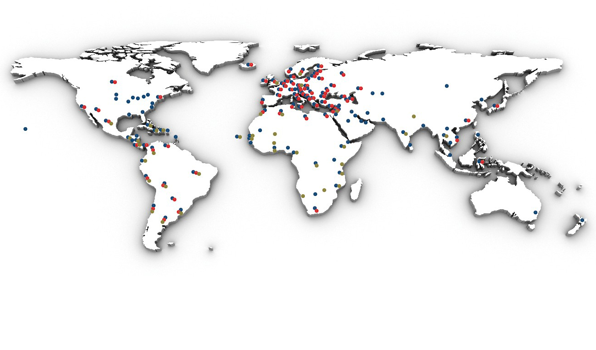

教育：人员流动、双学位、战略联盟
科研与创新项目
发展合作

Slide 13
Internationalization
国际化
378
Memoranda of understanding
with international institutions
和国际上各大学达成378份谅解备忘录
49
Double degree agreements
49 个双学位协议
27
Master’s programs fully in English
27个全英语教学的硕士项目
2,997
Students in international exchange programs
2,997 个学生参予国际交流项目
International students:
Doctorate: 44,6%, 77% of them, are from outside the EU
Master: 32,6%, 26,5% of them, are from outside the EU

Slide 14
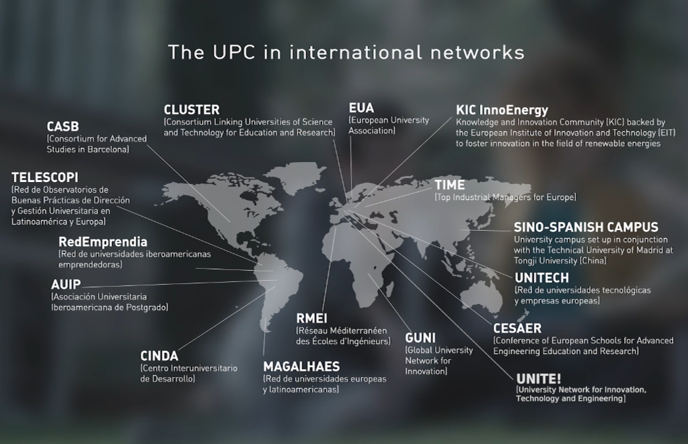
Alliances

Slide 15


















Alliances: CLUSTER

Slide 16
Social Responsibility
社会责任
59 development cooperation projects in 29 countries
与29个国家建立59项合作项目
582 science and technology
Workshop in last academic year
上一学年开展了582个科技Workshop
17,166 primary and secondary school students participate in scientific and technological dissemination activities
17,166名中小学生参加科技
传播活动

Slide 17
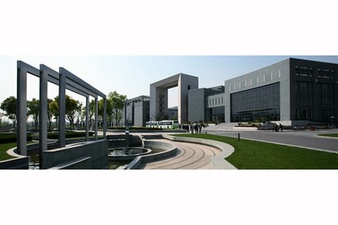
SinoSpanish Campus
at Tongji University
Inaugurated in 2012 together with Universidad Politécnica de Madrid
2012 年与马德里理工大学共同成立
Sino-Spanish Campus UPC-UPM at Tongji University
加泰罗尼亚理工大学-马德里理工大学共同的中西学院在同济大学

Slide 18
SSC at TU: Main Goals
Education
  Student Exchanges 学生交换
  Double Degrees 双学位
  Organization of a Summer School 暑期学校
Research 研究
  Teachers mobility 教师流动
  Joint Projects 联合项目
  Organization of Workshops and scientific Conferences 及学术会议开展
Culture 文化
  Cultural exchanges 文化交流
  Dissemination of Catalan and Spanish culture 加泰罗尼亚和西班牙文化的传播
  Organization of cultural and recreational activities
  文化创新活动

Slide 19
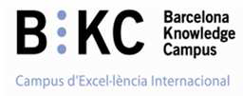
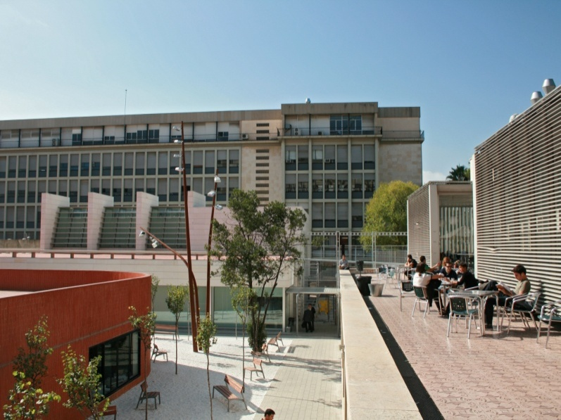
Campus of International Excellence – CEI
BKC establishes a framework for strategic collaboration which is key to providing the local environment with a solid, internationally recognized scientific and technological project, permitting the evolution of the local environment by means of an integrated social model based on innovation and sustainable development.
BKC建立了一个战略合作框架，为当地环境提供一个坚实的国际公认科学与技术项目的基础，通过创新和可持续发展的综合社会模式来改变当地环境

Slide 20

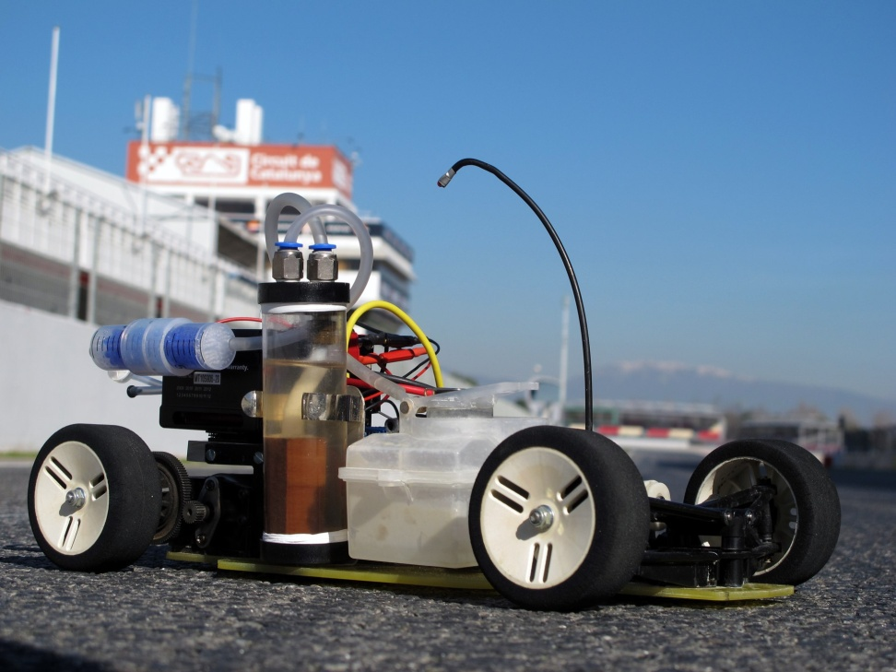
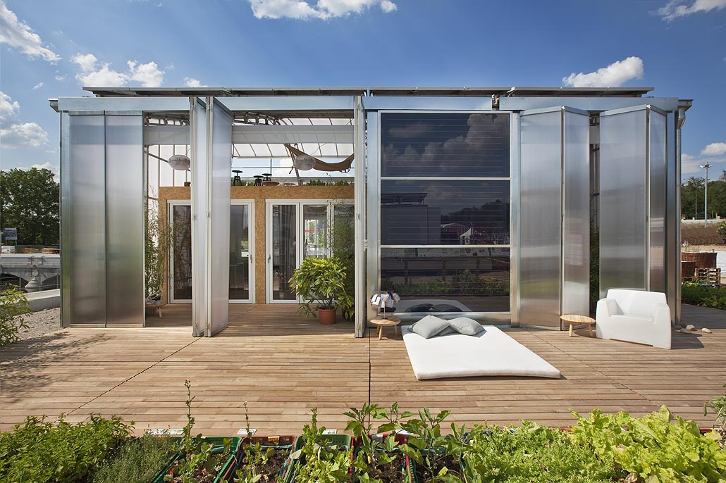
Energy Campus
The Energy Campus is a strategic consortium of several agents working together in the international arena to harness the potential of changes to the energy model while endorsing principles of social responsibility.
校园能源是多个国际级代理商的合作战略联盟，旨在利用潜在的能源模式变化来支持社会责任原则

Slide 21
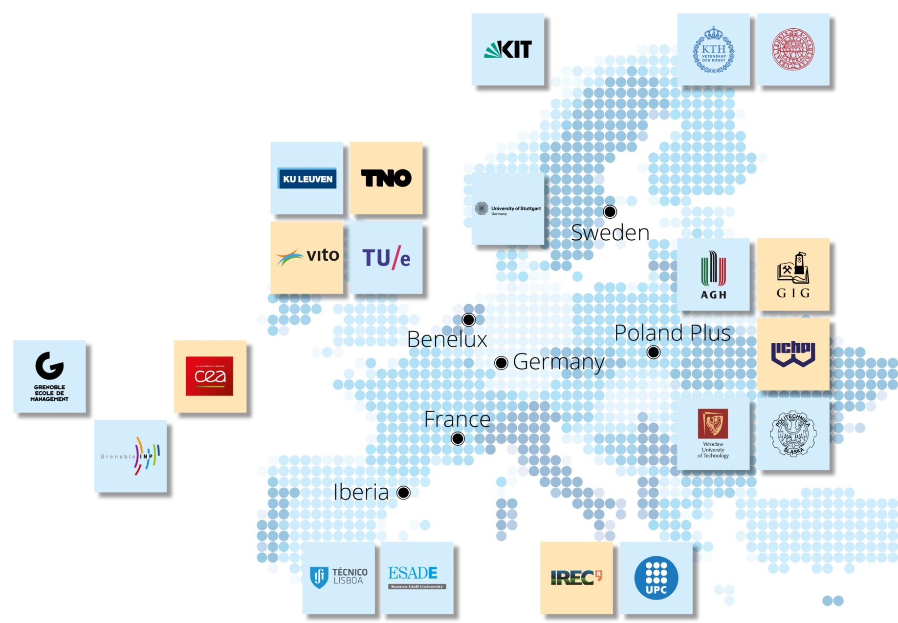
KIC Innoenergy
Making connections:
the power of the network
6 co-location centres
27 shareholders
160 additional partners
Activities in 17 countries
Our Shareholders
Research Institutes
Universities
Co-location Centres

Slide 22
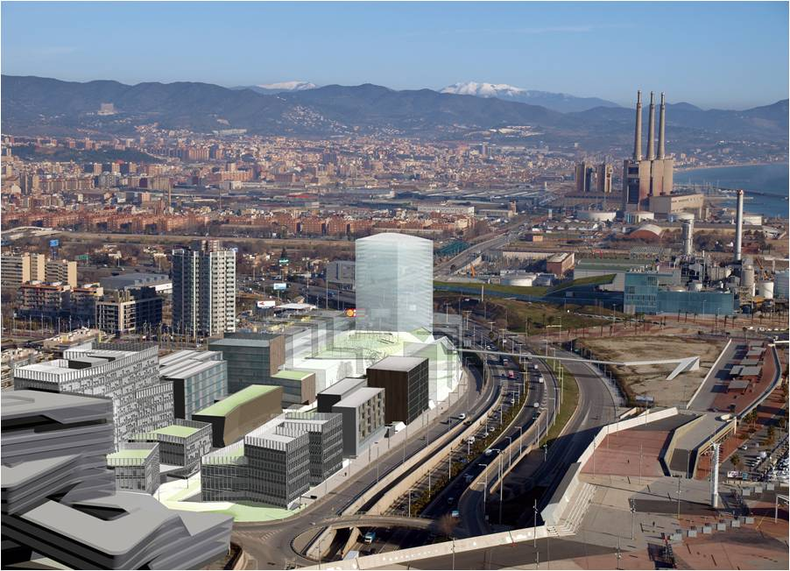






KIC Innoenergy - Iberia
Formal partners:主要合作伙伴
ESADE
Gas Natural FENOSA
Institut de Recerca de l’Energia de Catalunya-IREC
Instituto Superior de Lisboa
Universitat Politècnica de Catalunya
Associate partners:合作伙伴
Ciemat
Energías de Portugal
Iberdrola
Tecnalia Research and Innovation

Slide 23
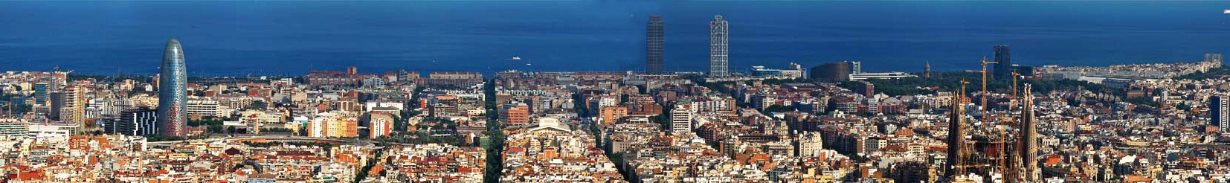
Global Technology Leading Innovation
Barcelona, amongst the 12 best student cities in Europe!*
* According to QS Best Student Cities 2018 Ranking

