Slide 1



Academic year 2022-2023

Slide 2
We are
The Universitat Politècnica de Catalunya · BarcelonaTech
is a public institution of Higher Education and Research, specialised in the areas of Architecture, Engineering, Science and Technology

Slide 3
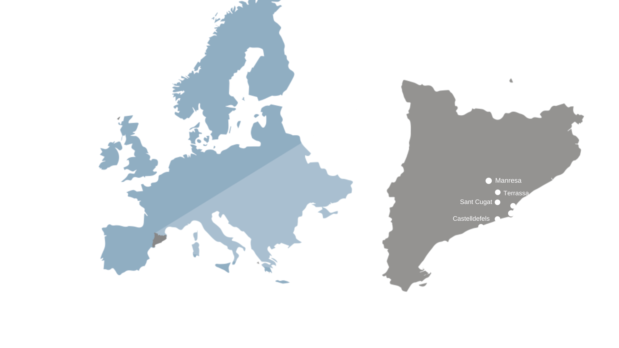
We are a leading technological university at the south of Europe

Slide 4
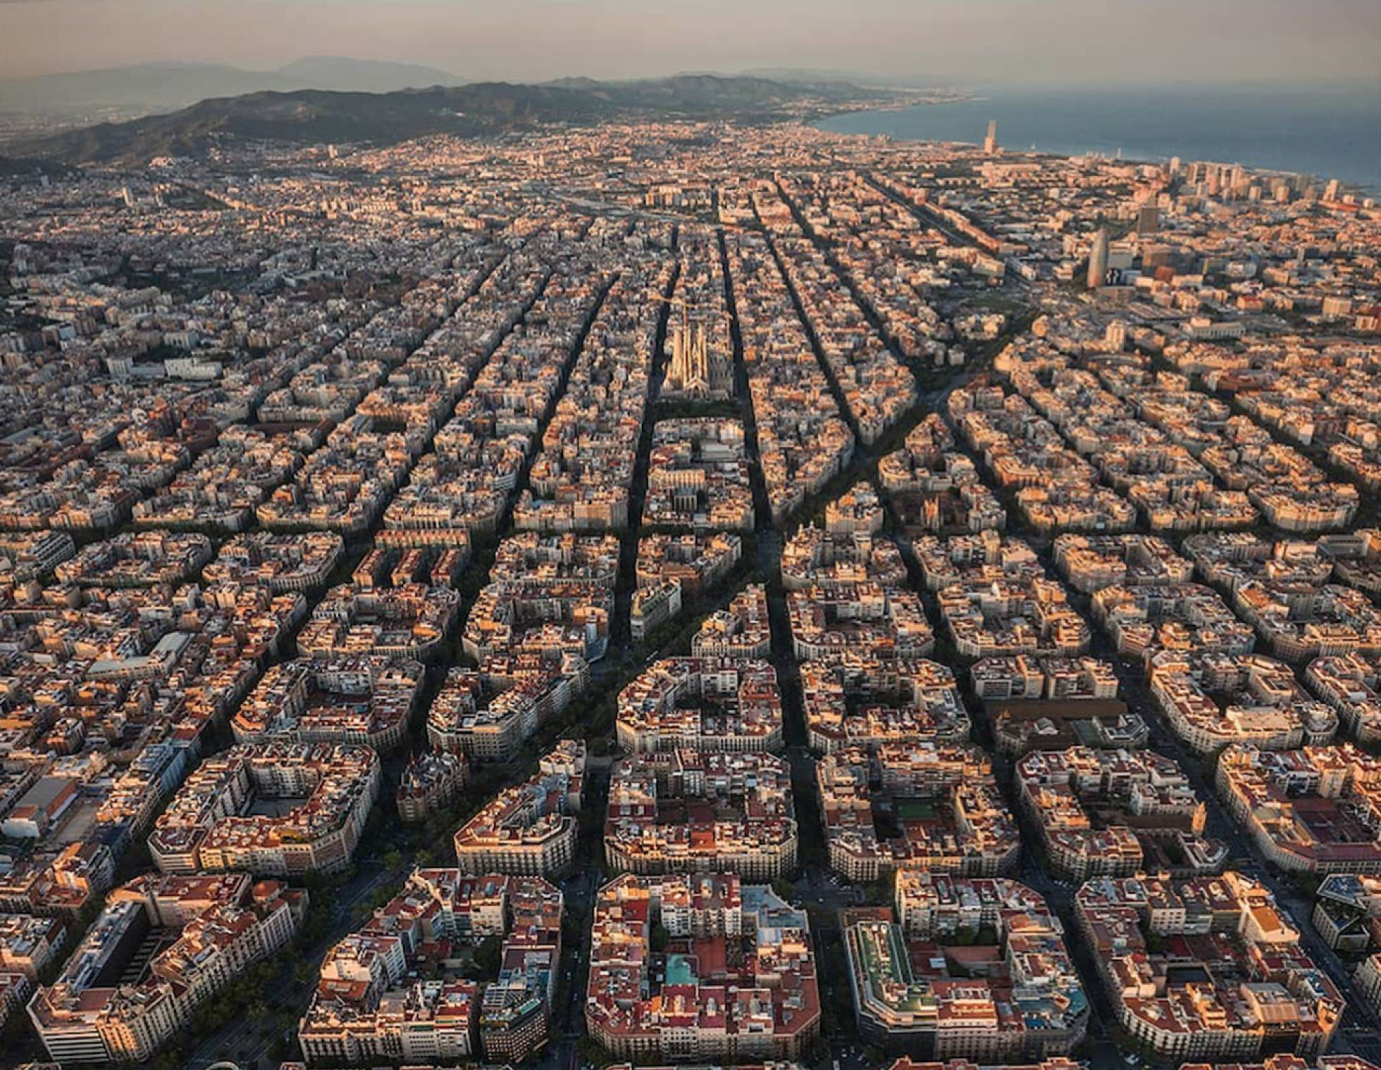
A hub for Education, Research, Innovation and Internationalisation.
… The Southern gateway to Europe
… Mediterranean Capital
… Bridge to the Maghreb
… Platform for links to Latin America
1 636 732 Inhabitants
3 719 096 Inh. Metropolitan Area
112,4 GDP per capita (Index EU27=100)
66 436 346 kTn harbour total transit (2021)
52 657 600 Airport passengers (2019)
471 885 Companies (BCN region)
8 908 Foreign companies (Catalonia)
Barcelona

Slide 5
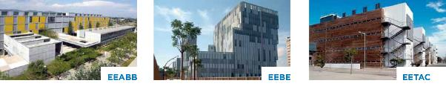

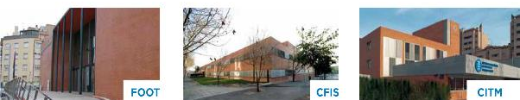
30
Departments
209
Research groups
18
Schools

Slide 6
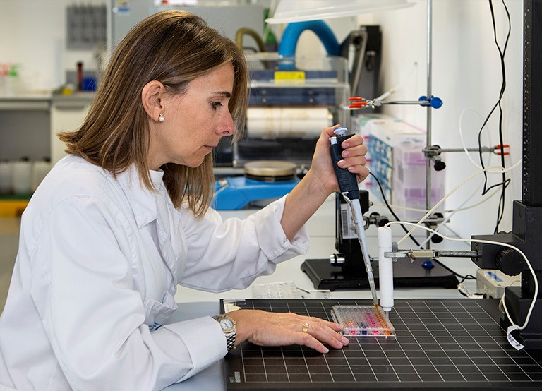
Fields
Architecture and Urban Planning.
Aerospace Engineering
Agricultural and Biosystems Engineering
Civil, Environmental and Geological Engineering
Computer Science
Engineering for Industry: Energy, Biomedical, Chemical, Electrical, Materials and Mechanical, Naval, Maritime and Nautical Engineering, Telecommunications and Electronic Systems Engineering
Applied Sciences: Mathematics, Statistics, Physics, Optics and Photonics

Slide 7
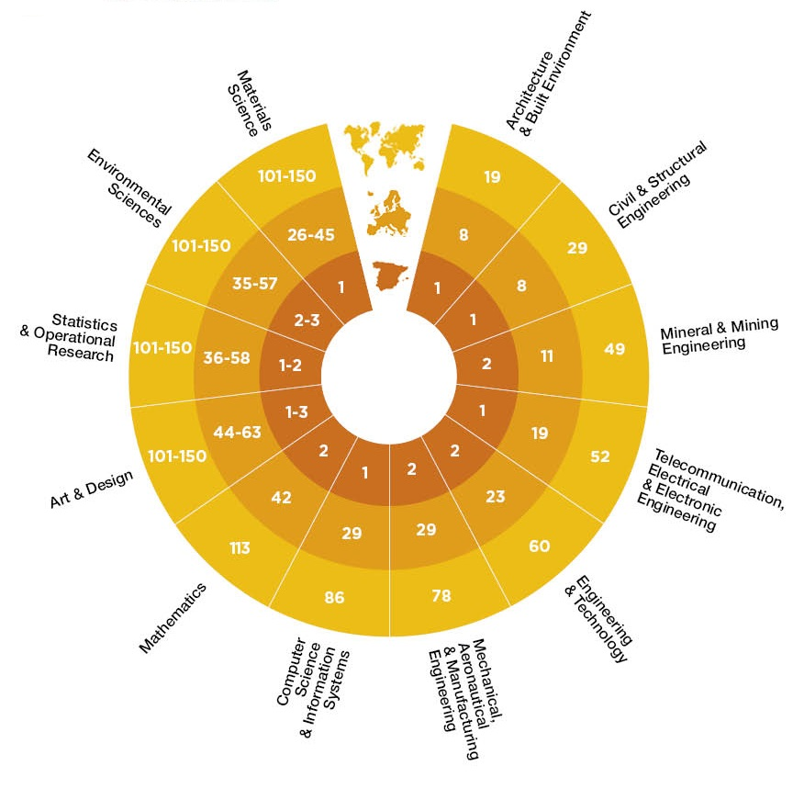

Reputation
      QS World University
  Rankings by Subject, 2022

Slide 8

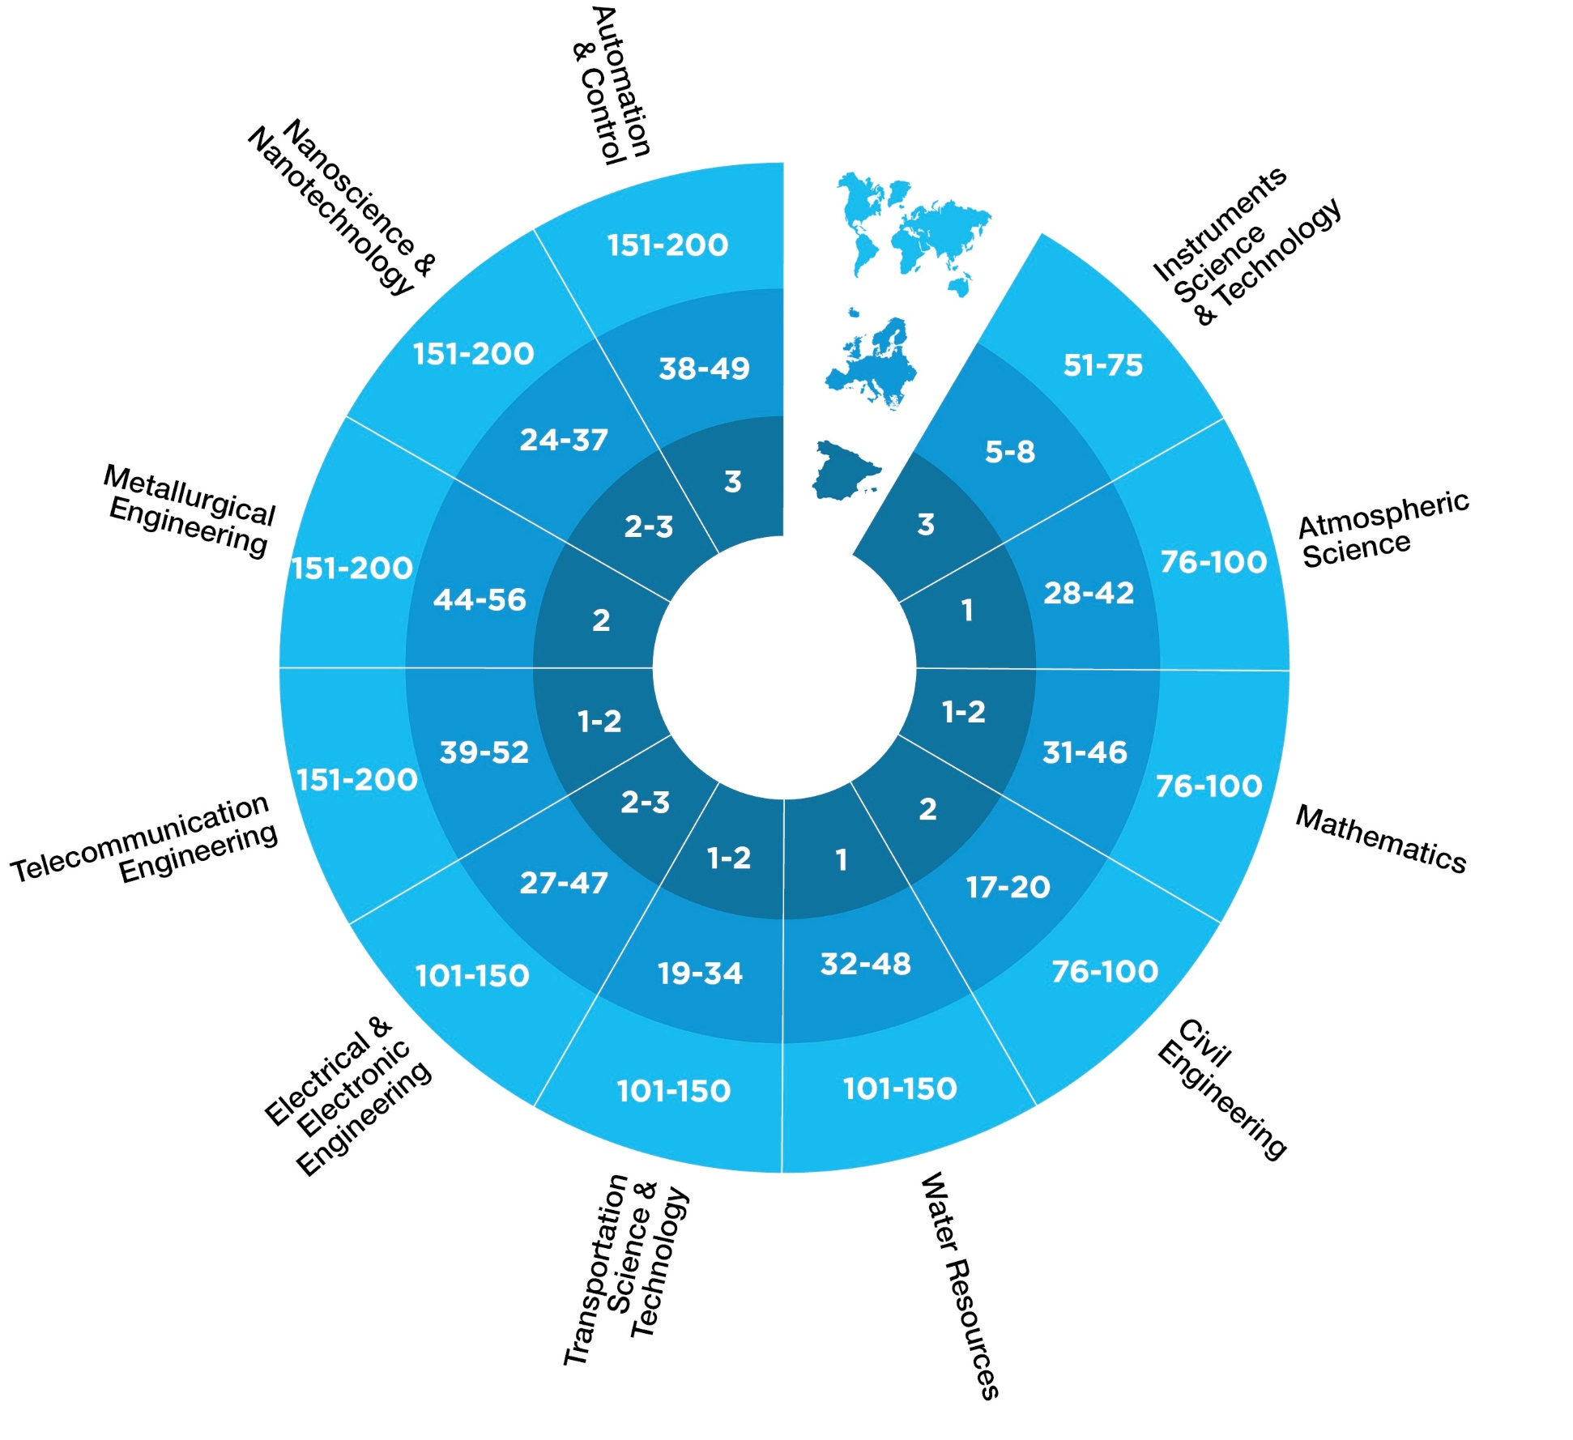
Reputation
      Shanghai Global Ranking
      of Academic Subjects, 2022

Slide 9
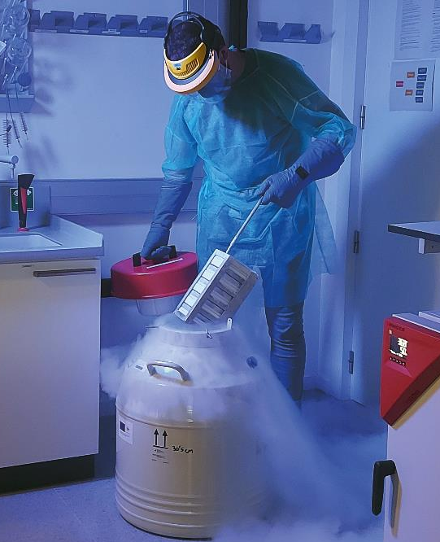
317.3 M€
UPC budget
(2022)
72.7 M€
Projects income
R+D+I (2021)

Slide 10

A university committed to its environment and society

Slide 11
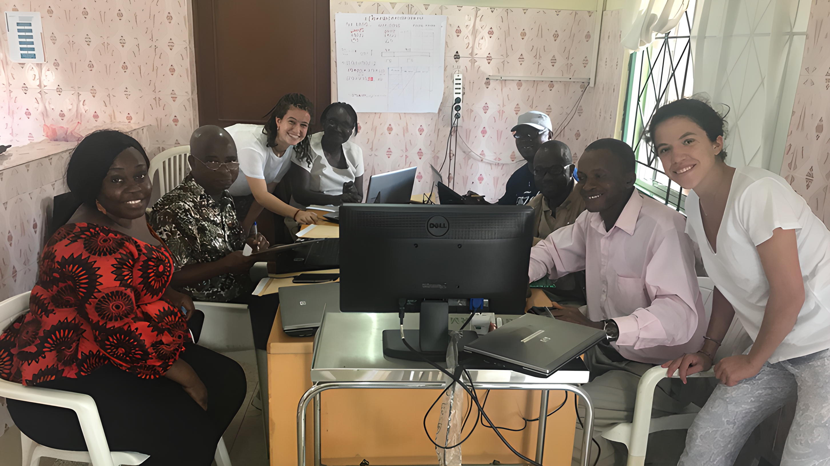


53
development cooperation projects in 21 countries

Slide 12
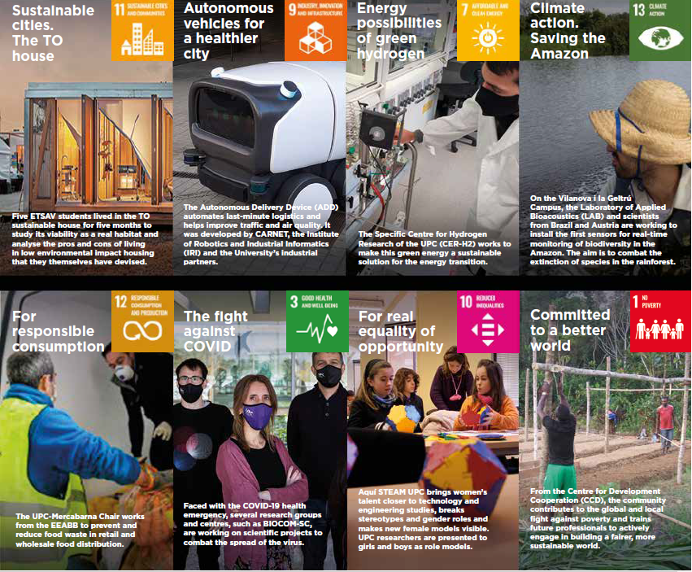

A university aligned with the Sustainable Development Goals (SDG)

Slide 13
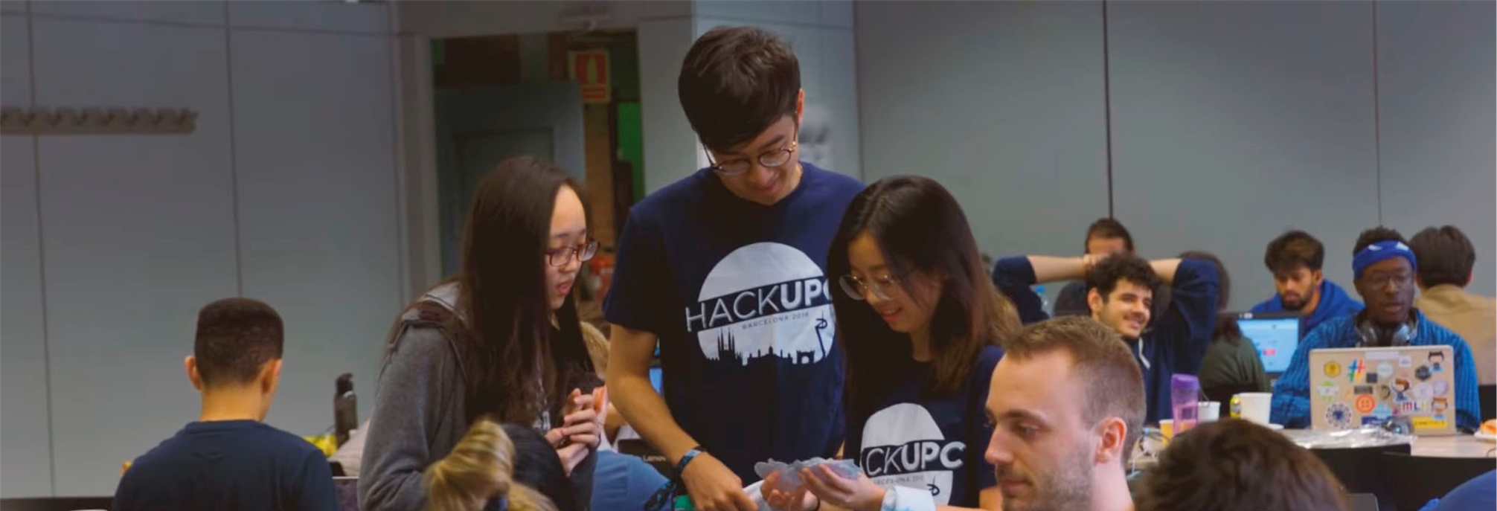
UPC Community

Slide 14

29 812
undergraduate and master students
2 107
PhD students
31 %
of women in the new intake of students

Slide 15
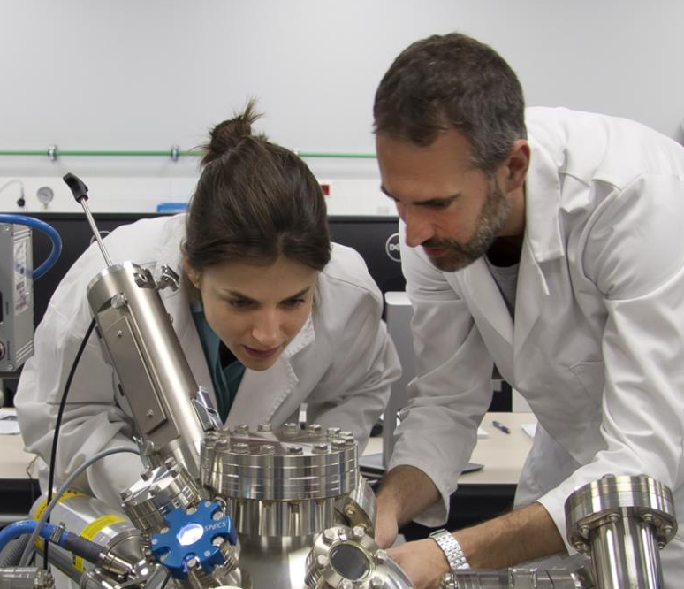
3 523
teaching
and research staff
2 074
Administration and services staff

Slide 16
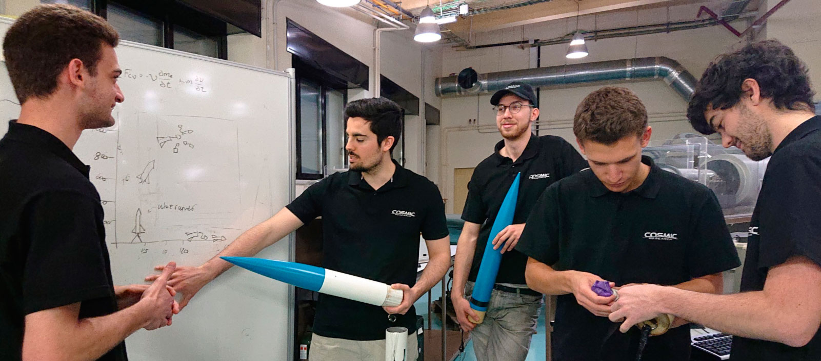
Training the professionals of the future

Slide 17

65
bachelor’s
degrees
84
master’s
degrees
45
PhD programmes

Slide 18
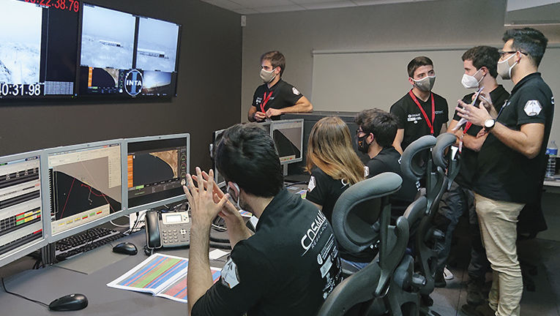
275
Life-long learning programmes

Slide 19
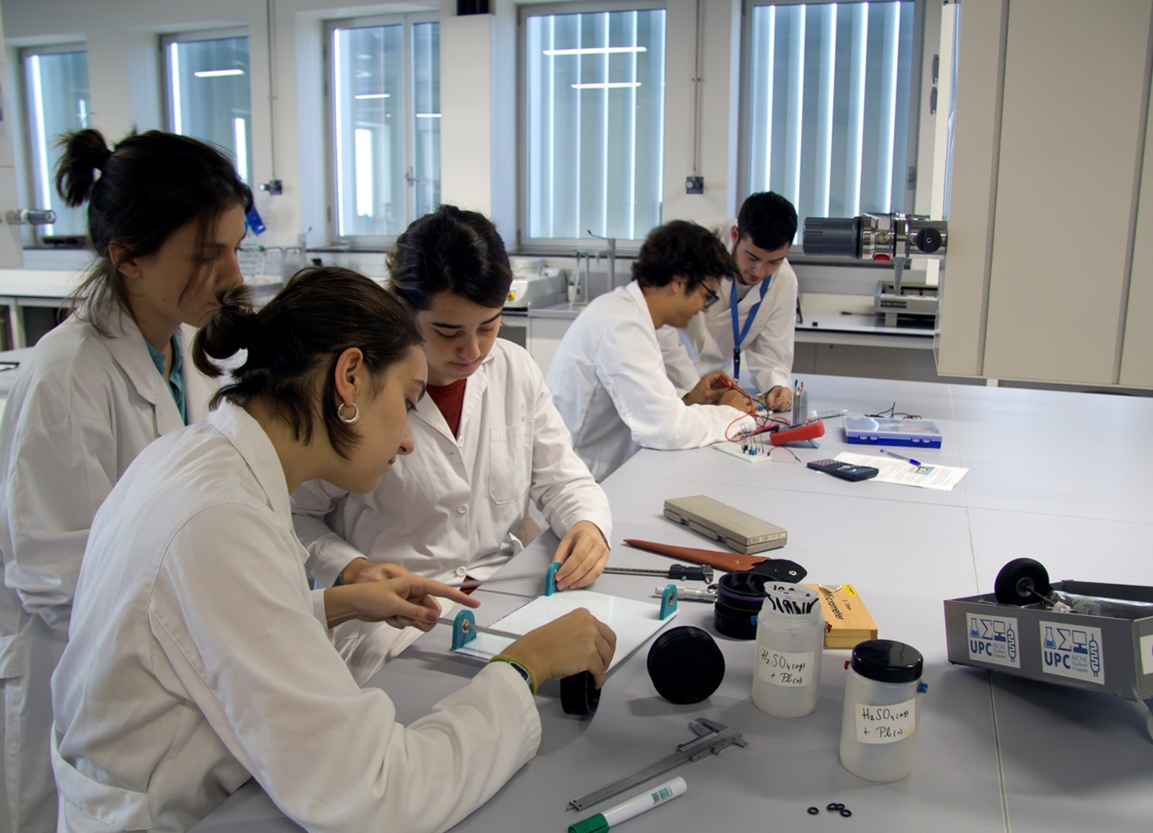
90%
of graduates work in less than 6 months

Slide 20

Internationalisation, a dimension that permeates all activities

Slide 21

UPC abroad
  Education: mobility, double degrees, strategic alliances
  Research and innovation projects
  Development Cooperation

Slide 22
Working in alliances
The UPC in international networks
EUA
(European University Association)
Cluster
(Consortium Linking Universities of Sience and Technology for Education an Research)
TIME
(Top Industrial Managers for Europe)
CASB
(Consortium for Advanced Studies in Barcelona)
UNITE!
(University Network for Innovation, Technology and Engineering)
SINO-SPANISH CAMPUS
A campus at Tongji University (China) composed of the UPC, the Universidad Politécnica de Madrid, the Tecnológico de Monterrey and the Universidad de Sevilla.
TELESCOPI
(Red de Observatorios de Buenas Prácticas de Dirección y Gestión Universitaria en Latinoamérica y Europa)
RedEmprendia
(Red de universidades iberoamericanas emprendedoras)
RMEI
(Réseau Méditerranéen des Écoles d’Ingénieurs)
HERITAGE Network
UNITECH
(Network of technological universities and European companies)
AUIP
(Associación Universitaria
Iberoamericana de Postgrado)
CINDA
(Centro Interuniversitario de Desarrollo)
GUNI
(Global University Network for innovation)
CESAER
(Conference of European Schools for Advanced Engineering Education and Research)
MAGALHAES
(Red de universidades europeas y latinoamericanas)

Slide 23
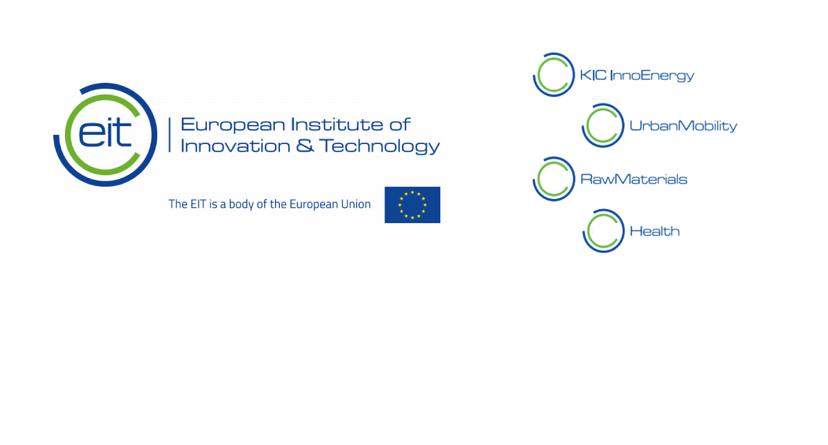
Knowledge and Innovation Community (KIC) supported by the European Institute of Innovation and Technology (EIT)

Slide 24

1 640
Student exchange agreements with
767
Higher Education Institutions
34
International Double Degree programmes with 26 universities

Slide 25
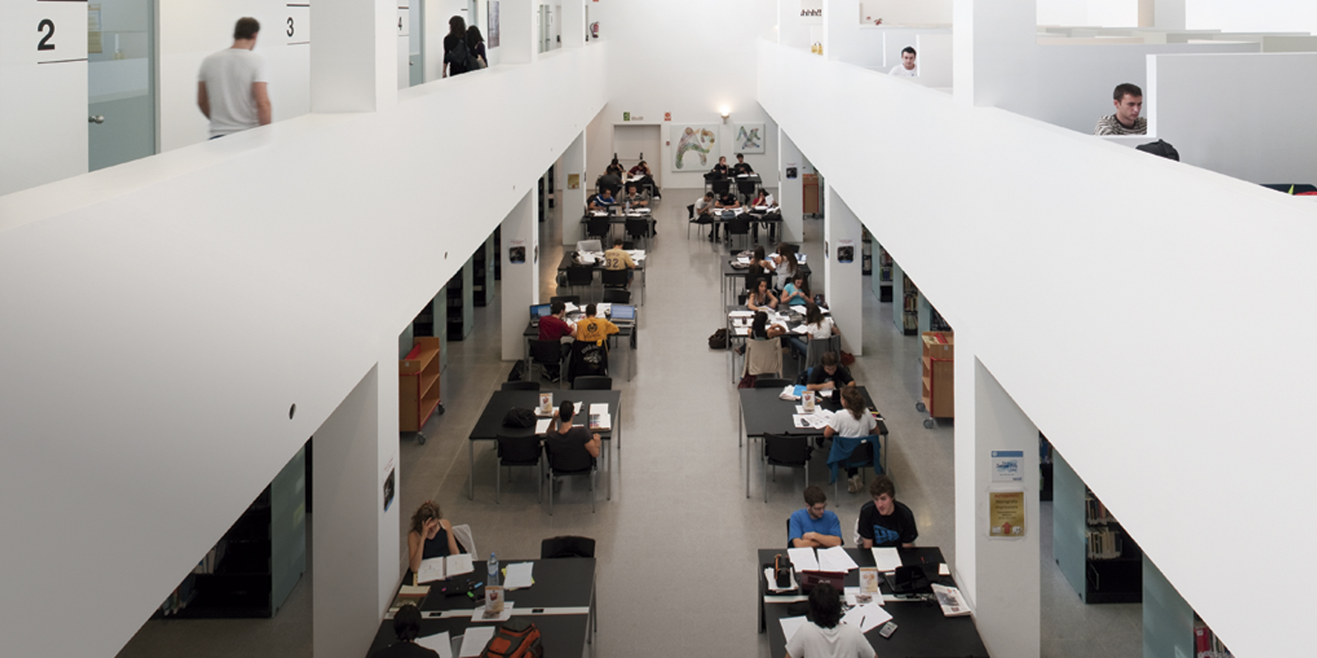
2 756
30%
55%
students in international exchange programmes
of master’s students are international, 79% of them are from outside the EU
of PhD students are international, 82.5% of them are from outside the EU

Slide 26
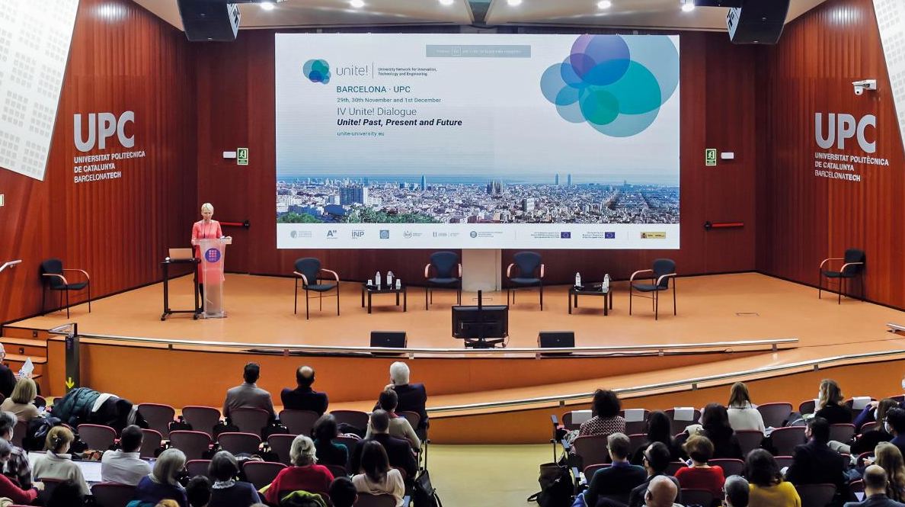
Unite!,
the creation of the future European university

Slide 27

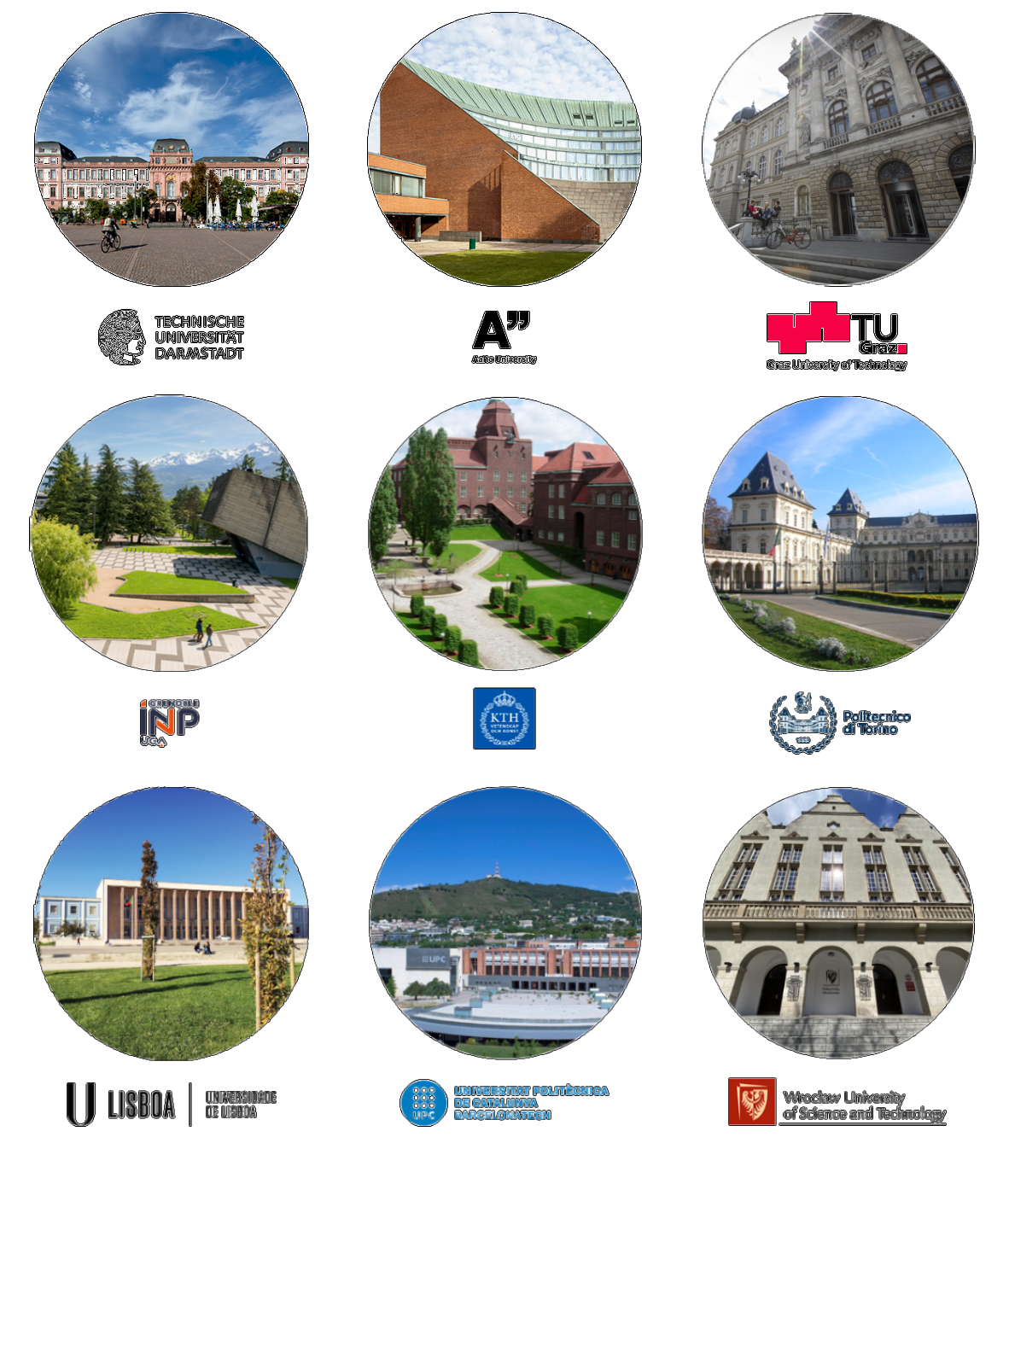
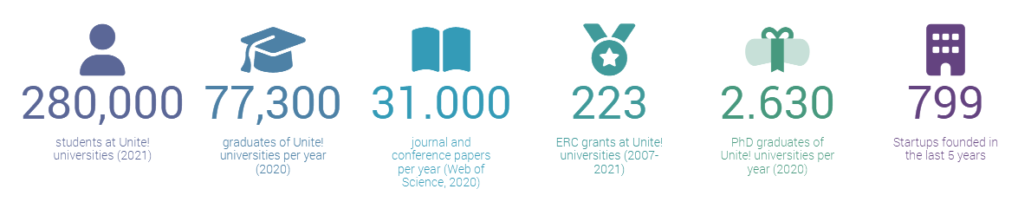
A model of European University of innovation, technology and engineering.
A strategic alliance of universities.
An inclusive community linked to the territory and its stakeholders.

Slide 28
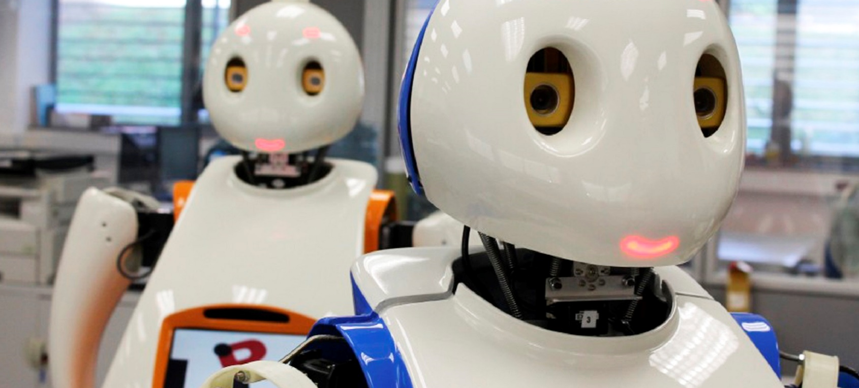
Research to innovate

Slide 29
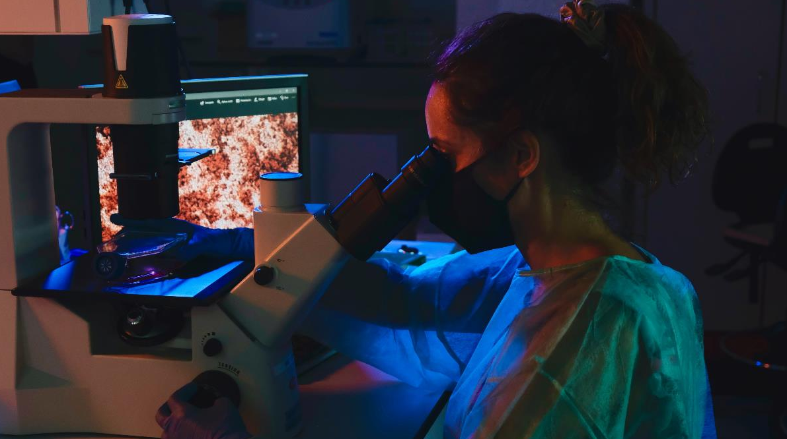
691
active agreements
767
research projects
2 588
papers in scientific journals

Slide 30
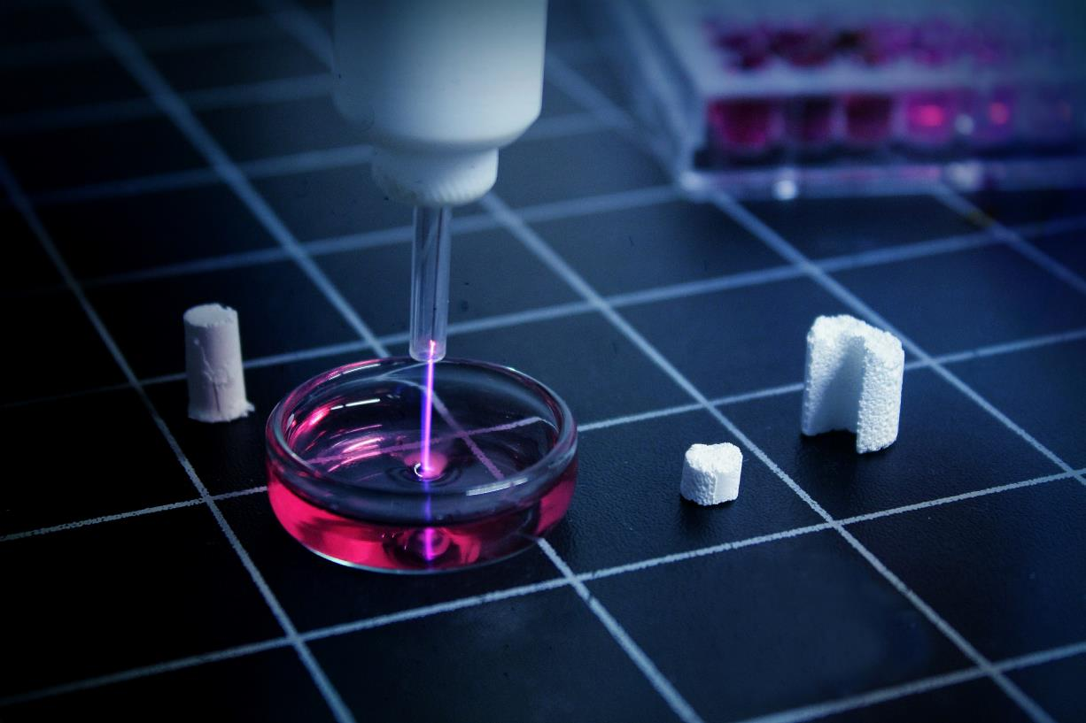
The UPC, first
State University
in projects
funded through the Horizon 2020 programme

Slide 31
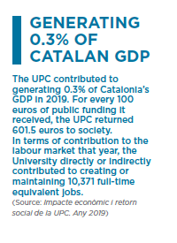
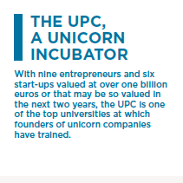
Offering answers to companies
R+D+i
Innovation hubs
Talent (internships in companies)
UPC innovation ecosystem
Industrial Doctorates
https://www.upc.edu/ca/empresa

Slide 32
2 998
companies
and entities
with collaboration agreements

Slide 33
19
patents registered last year
587
international patents and licences in the last 10 years
38
technology-based companies
investee

Slide 34
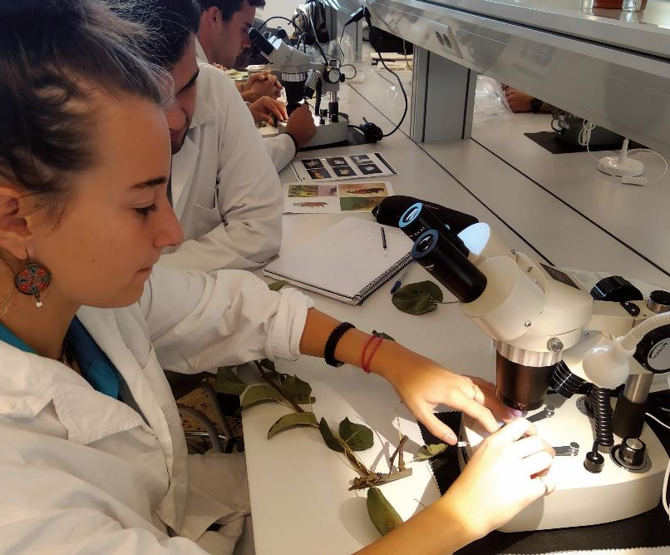
103
industrial doctorate
thesis
28.7% of industrial doctorates in Catalonia since 2007 have been developed at the UPC

Slide 35
UPC,
the university of Engineering, Architecture, Sciences and Technology

