Slide 1




Slide 2
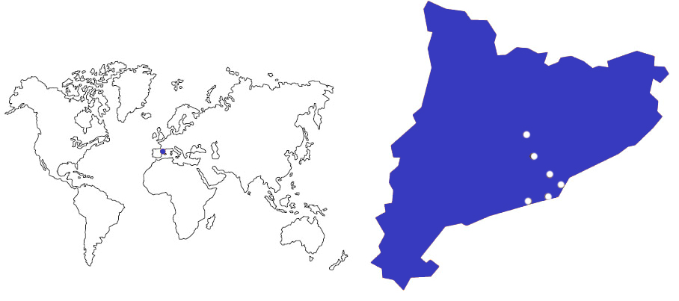
UPC Barcelona Tech
Manresa
Terrassa
Sant Cugat
Barcelona
Vilanova i la Geltrú
Castelldefels
Leading Technology at the south of Europe

Slide 3

Education, Research, Innovation, Internationalization
教育、科研、创新和国际化

Slide 4
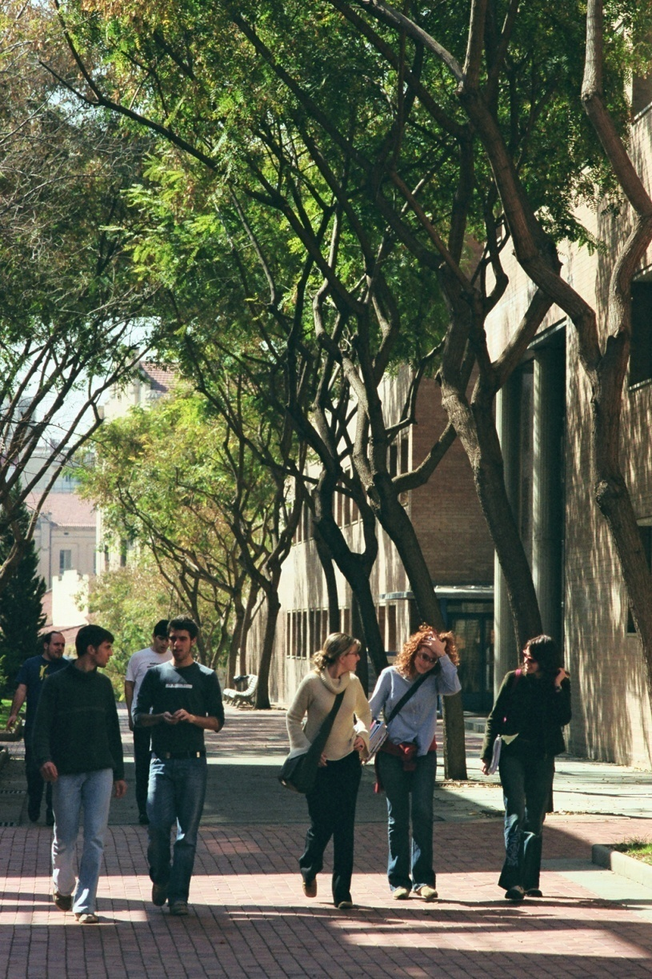
Areas 领域
Aerospace Engineering 航天航空
Agricultural Engineering 农业工程
Applied Sciences: Mathematics, Statistics, Physics, Optics and Photonics 应用科学：数学、统计学、物理、光学和光子学
Architecture and Urban Planning 建筑学、城市规划和建筑工程
Civil, Environmental and Geological Engineering土木工程、环境和地质工程
Computer Science 信息学
Industrial Engineering: Energy, Biomedical, Chemical, Electrical, Materials and Mechanical 工业工程：能源、工业设计、生物、化学、电气和机械
Naval, Maritime and Nautical Engineering 海洋与航海工程
Telecommunications and Electronic Systems Engineering 电信和电子系统工程

Slide 5
Training 教育
50
PhD programs博士项目
5 Erasmus Mundus
5 奖学金项目
25 Programs with excellence label of the Spanish Ministry of Education
25个被西班牙教育部认可的重点学科
Teaching:
72
Master’s programs 硕士项目
13个Erasmus Mundus奖学金项目
26 fully in English个全英语授课项目
(2014-2015)
68
Undergraduate degrees
68个本科学位
(2014-2015)
3,160
Students Internships
名学生在实习
2,198
Students Continuing education 2,198名接受继续教育的学生:
Life-Long Learning Program, corporate training, and other courses
长期项目、企业培训，以及其他课程
2013-2014

Slide 6
Shangai Ranking (ARWU)世界大学学术排名 （ARWU）
Among the top 500 universities in the world, the top 150 in the field of Engineering, Technology and Computer Sciences and the top 200 in Mathematics.
位列全球大学500强，工程、科技和信息领域进入全球 150强，数学进入全球200强
Ranking Times Higher Education
泰晤士高等教育排名
Amongst the hundred best universities under the age of 50.
位列全球建校50年以下大学100强
2014

Slide 7
Quacquarelli Symonds World University (QS)
世界大学排名
UPC is the 1st Spanish university in Engineering and Technology and amongst the 100 best universities in the fields of Civil Engineering, Electrical and Electronic Engineering and Computer Sciences.
西班牙排名第一，其中土木工程、结构工程、电子电气工程及信息专业跻身全球100强。
Ranking of Spanish Universities (I-UGR)
西班牙大学排名 （I-UGR）
UPC is the top Spanish university in the fields of Engineering and Mathematics and in disciplines Automatic Control and Robotics, Civil Engineering, Electrical and Electronic Engineering, Telecommunications and Architecture.
在工程、数学、建筑、自动化、机器人、土木工程、电子电气工程、及电信专业均位列西班牙大学首位。
2014

Slide 8
Research to Innovate
2,385
Papers in scientific journals
2,835 篇学术期刊文章
332
PhD theses presented
332博士论文已经递交
201
Research groups
201 科研团队
160
Technical and scientific awards
160 项科技荣誉
17
Specific research centers
17所专业研究中心
1,126
Research projects started in 2012
1,126的科研项目于2012年开始启动
1,698
Research projects in progress
1,698 项现有研究项目
2013-2014

Slide 9
Creating Future 创新
From 1998 to 2012:
自1998年至2012年：
257 spin-off and start-up
257 分拆和创业项目成立
577
Patent licenses专利
(2000/14)
49,003,263 €
Research income
科研经费收入
(2014)
20
UPC members of the catalan research network of excellence
20 个科研网络TECNIO中心
2,164
Sponsoring and collaborating companies
2,164 赞助企业和合作伙伴
2013-2014

Slide 10

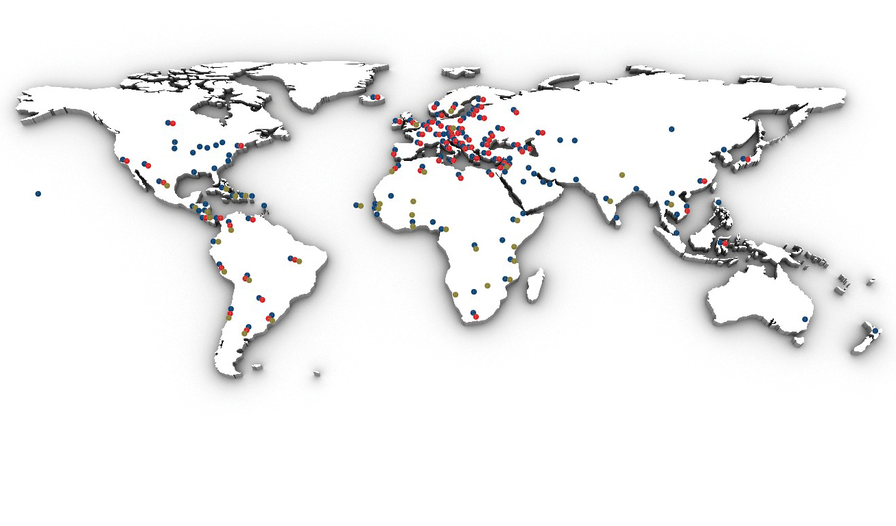

海外UPC
教育：人员流动、双学位、战略联盟
科研与创新项目
发展合作

Slide 11
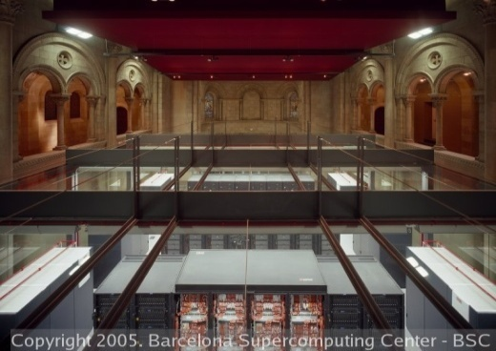
Internationalization国际化
BARCELONATECH is the Spanish university with the
highest number of international university students of PhD and Master’s.
BARCELONATECH是拥有国际生源博士与硕士项目的西班牙大学。

Slide 12
Internationalization 国际化
363
Memoranda of understanding
with international universities
和国际上各大学达成363份谅解备忘录
100
Double degree agreements
with 90 universities and HEI’s
和各大学以及高等教育机构达成100个双学位协议
2,713
Students in international exchange programs
2,713个学生参予国际交流项目
1.628 OUT 名学生在海外留学
1.085 IN 名外籍学生在UPC就读
26
Master’s programs fully in English
26个全英语教学的硕士项目
(2014-15)
International students:国际学生：
Doctorate: 52%博士生占
Master: 36,6%研究生占
78% are from outside the EU其中有78％是非欧盟学生
2013-2014

Slide 13
Internationalization国际化
UPC - BARCELONATECH academic and research networks
研究和学术网络
    AUIP
    CASB
    CESAER
    CINDA
    CLUSTER
    EUA
    GUNI
    MAGALHAES
    RMEI
    TIME
    REDEMPRENDIA

Slide 14


















International Networking: CLUSTER
CLUSTER university network
Belgium
Finland
France
Germany
Germany
Ireland
Italy
Netherlands
Portugal
Sweden
Switzerland
Associate Members
战略合作伙伴
Brazil
Brazil
Canada
China
Moscow
USA

Slide 15

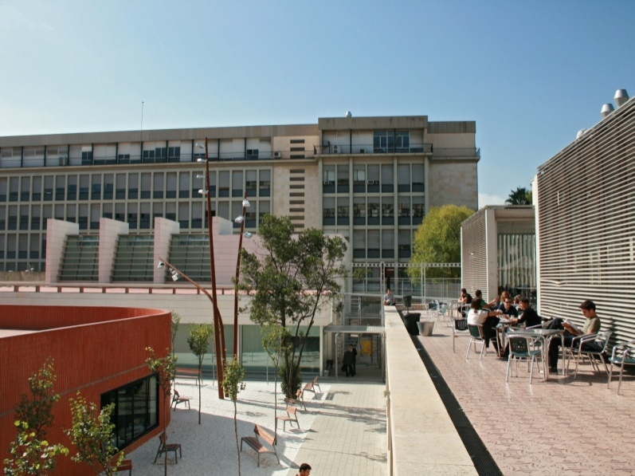
Internationalization国际卓越校园
Campus of International Excellence – CEI I
BKC establishes a framework for strategic collaboration which is key to providing the local environment with a solid, internationally recognized scientific and technological project, permitting the evolution of the local environment by means of an integrated social model based on innovation and sustainable development

Slide 16

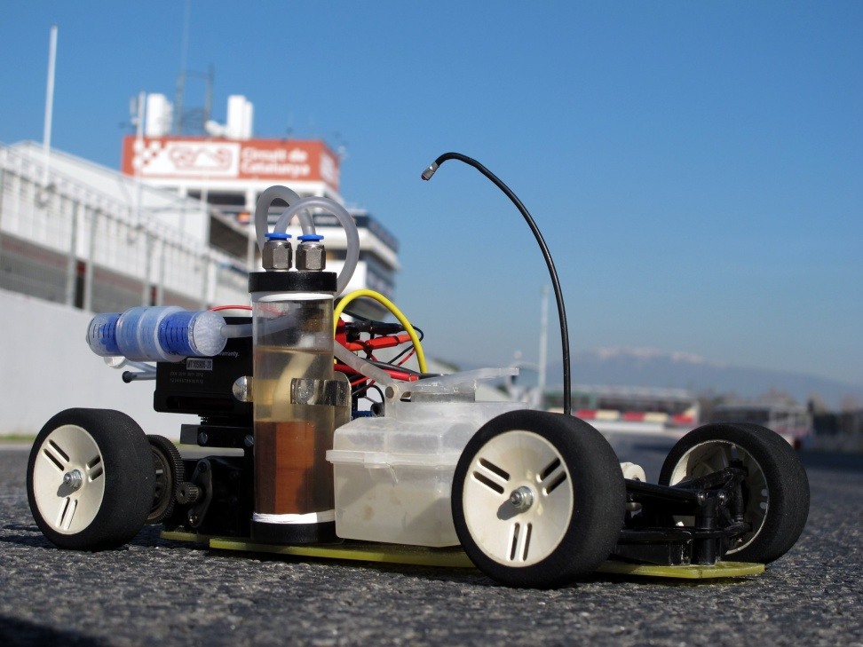
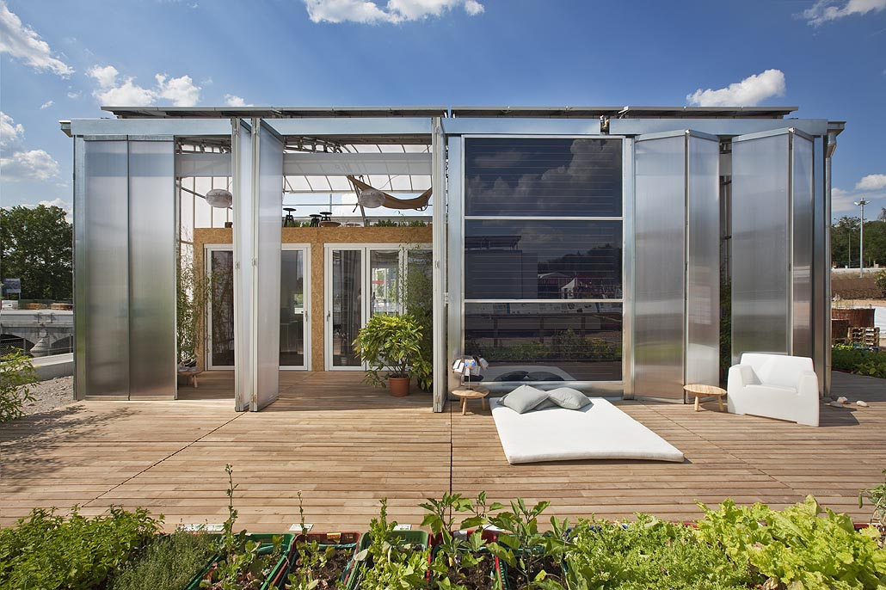
Internationalization
Campus Energia 校园能源
CAMPUS ENERGIA:
ENERGY TO EXCELL
Campus Energía is a strategic consortium of several agents working together in the international arena to harness the potential of changes to the energy model while endorsing principles of social responsibility.
校园能源是多个国际级代理商的合作战略联盟，旨在利用潜在的能源模式变化来支持社会责任原则。

Slide 17
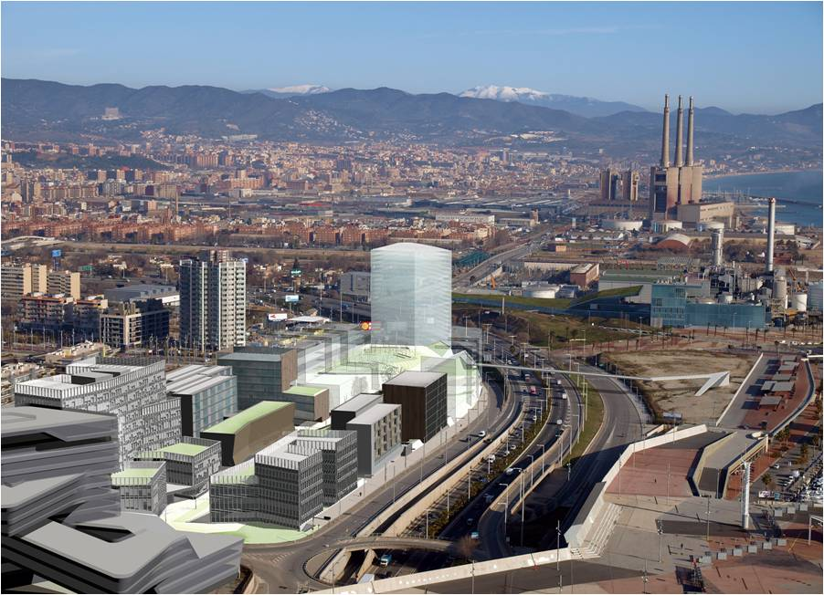






Internationalization
KIC Innoenergy
Formal partners:主要合作伙伴
ESADE
Gas Natural FENOSA
Institut de Recerca de l’Energia de Catalunya-IREC
Instituto Superior de Lisboa
Universitat Politècnica de Catalunya
Associate partners:合作伙伴
Ciemat
Energías de Portugal
Iberdrola
Tecnalia Research and Innovation

Slide 18
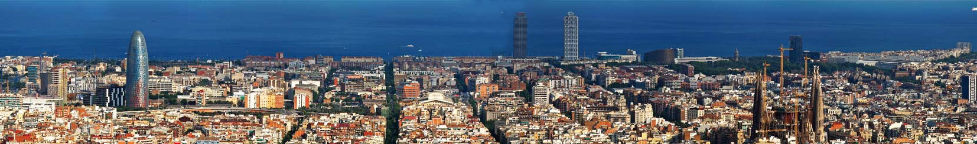
Global Technology Leading Innovation
Barcelona, among the 10 best student cities in the world!*
巴塞罗那，全世界学生最喜欢留学的十大城市之一
* According to QS Best Student Cities 2014 Ranking

Slide 19
http://www.upc.edu

