Slide 2
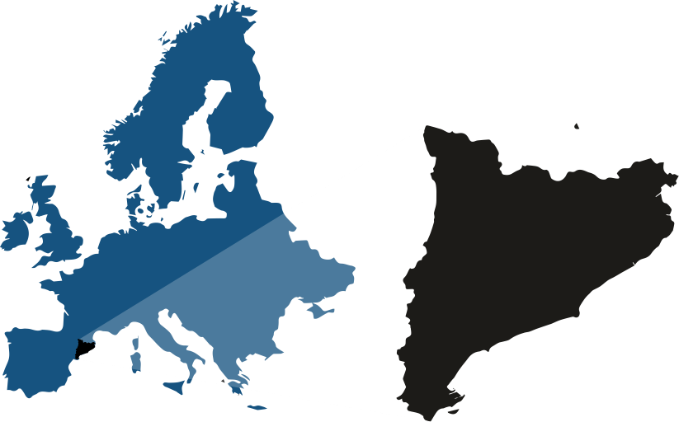
We’re a leading technological university at the south of Europe
•
Manresa
•
Terrassa
•
Sant Cugat
•
•
Sant Adrià del Besos
•
•
Barcelona
Castelldefels
Vilanova i la Geltrú

Slide 3
The Universitat Politècnica
de Catalunya · BarcelonaTech is a public institution of Higher Education and Research, specialized in the areas of Architecture, Engineering, Science and Technology.

Slide 4
Barcelona
A hub for Education, Research, Innovation and Internationalisation
… the Southern gateway to Europe … Mediterranean Capital … Bridge to the Maghreb … platform for links to Latin America
1 636 732 Inhabitants
3 719 096 Inh. Metropolitan Area
112.4 GDP per capita (Index UE=100)
66 436 346 kTn harbour total transit
52 657 600 airport passengers (2019)
471 885 companies (BCN region)
8 908 foreign companies (Catalonia)

Slide 5
31 919
students
3 523
teaching and research staff
65
bachelor’s degrees
84
master’s degrees
45
doctoral programmes
30%
international master’s degree students
55%
international doctoral degree students (79% of them non EU)
18
schools in 9 campuses
210
research groups
767
higher education institutions with student exchange agreements

Slide 6
Fields
Architecture and Urban Planning
Aerospace Engineering
Agricultural and Biosystems Engineering
Civil, Environmental and Geological Engineering
Computer Science
Engineering for Industry: Energy, Biomedical, Chemical, Electrical, Materials and Mechanical
Naval, Maritime and Nautical Engineering
Telecommunications and Electronic Systems Engineering
Applied Sciences: Mathematics, Statistics, Physics, Optics and Photonics

Slide 7
Education
29 812
Undergraduate and master
students
2 107
PhD students
45
PhD programs
1 Erasmus Mundus 2022-2023
70 151
UPC Alumni
3 595
Continuing education students:
Life-Long Learning Program,
corporate training,
and other courses
5 283
Students Internships
84
Master’s programs
9 Erasmus Mundus
40 fully in English
2022-2023
65
Undergraduate
degrees

Slide 8
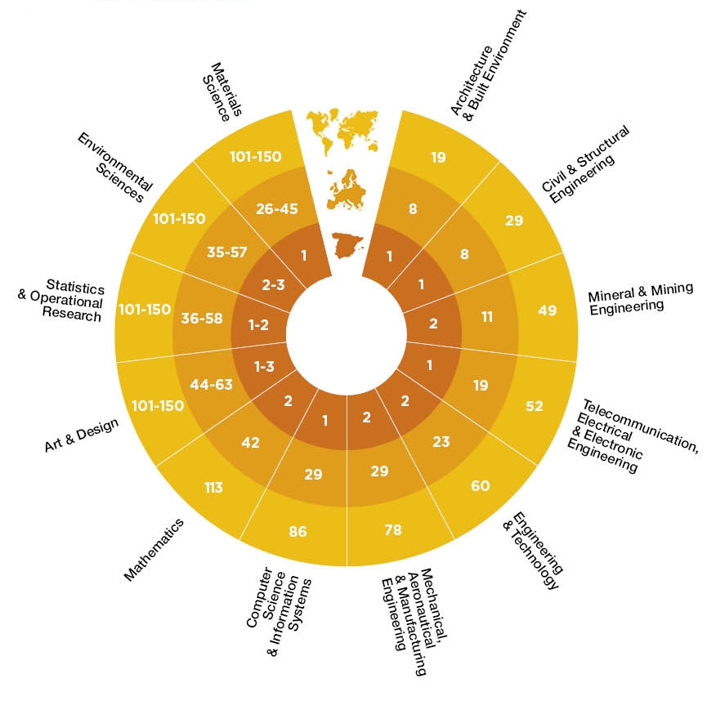
Reputation
QS World University
Rankings by Subject, 2022

Slide 9
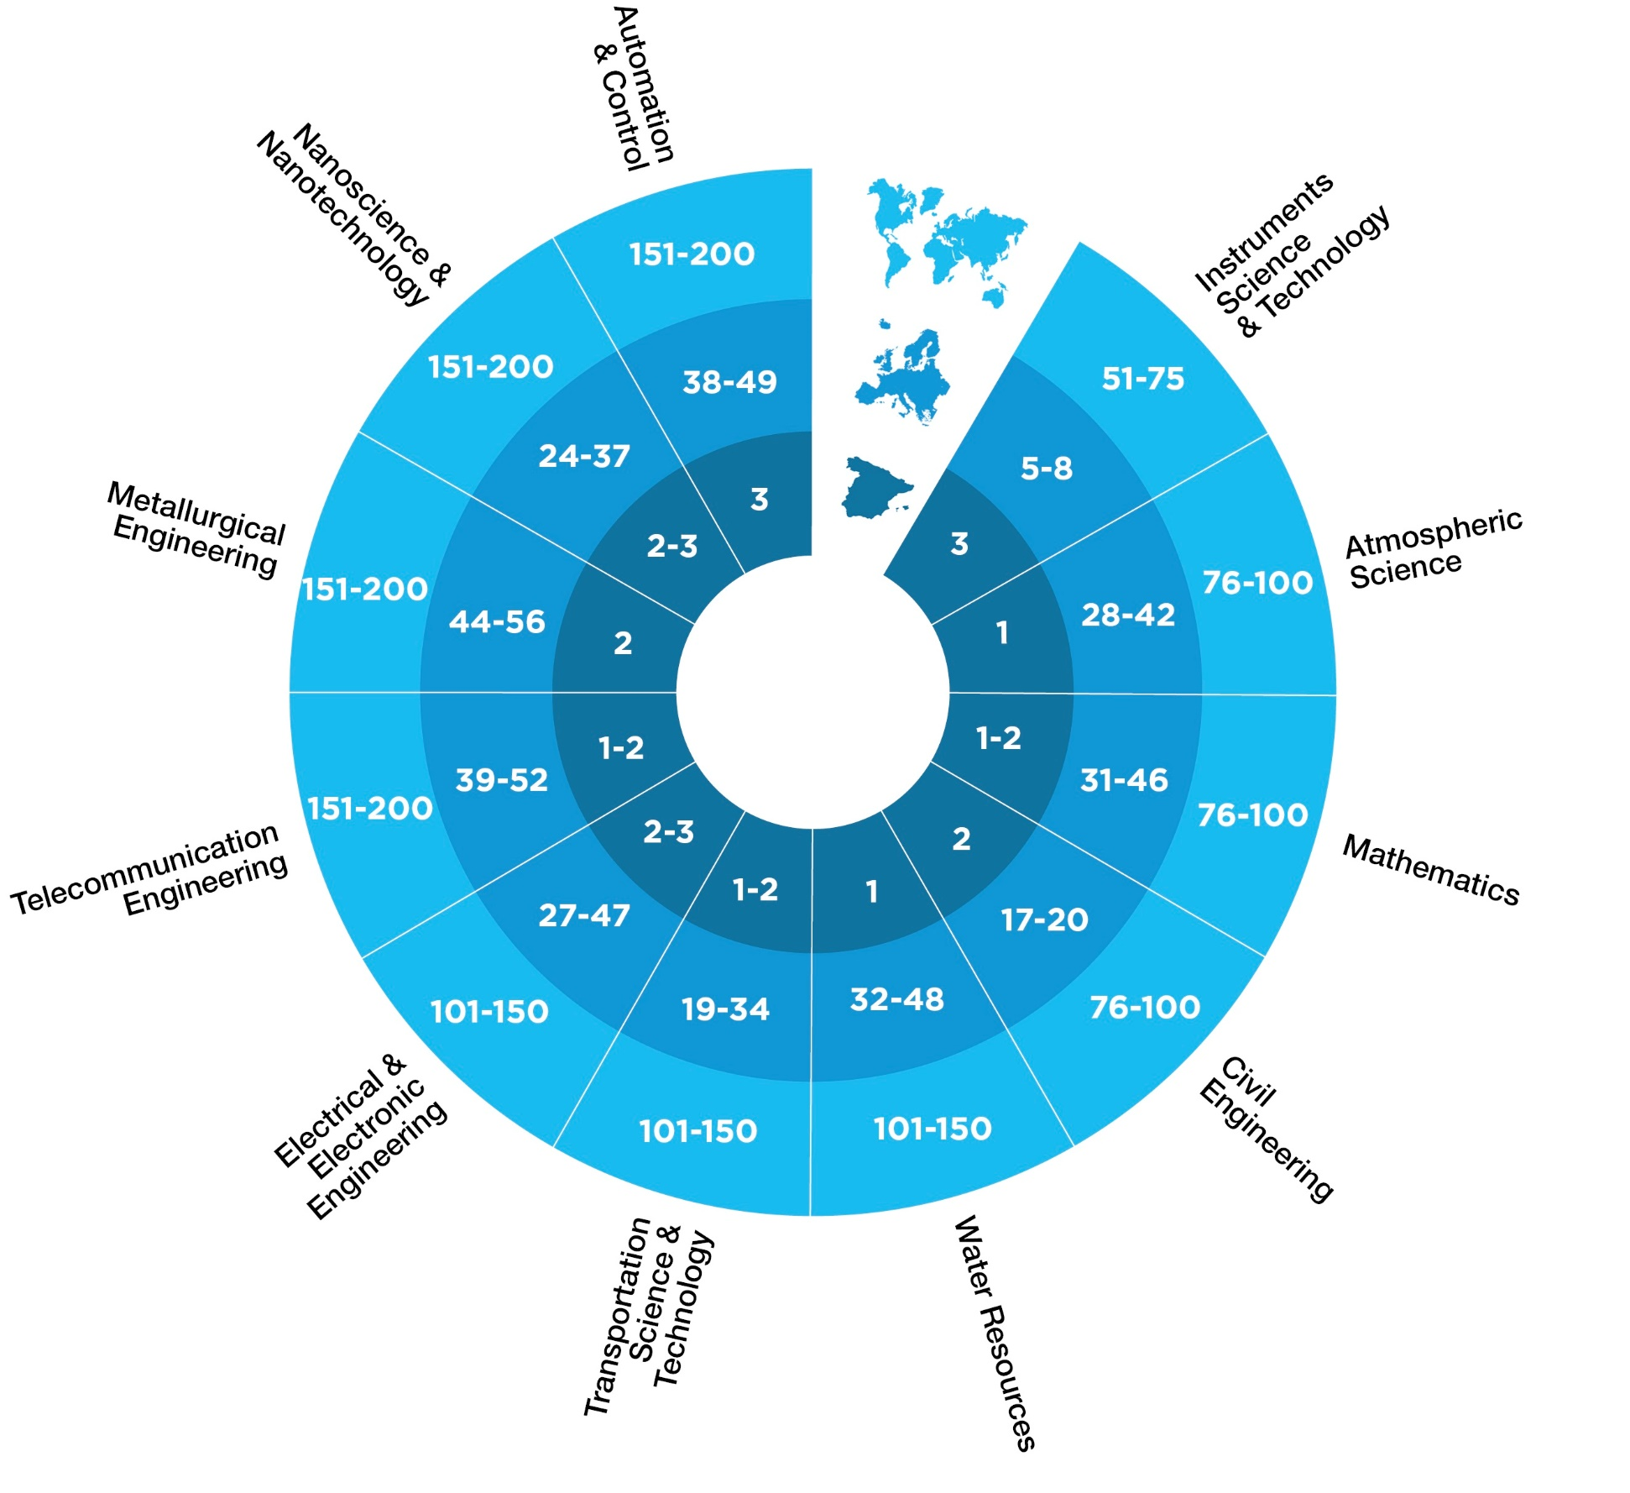
Reputation
Shanghai Global Ranking
of Academic Subjects, 2022

Slide 10
Research to innovate
3 523
Researchers
2 588
Papers in scientific journals
231
PhD theses presented
99
Technical and scientific
awards (2022)
1 854
ongoing research projects

Slide 11
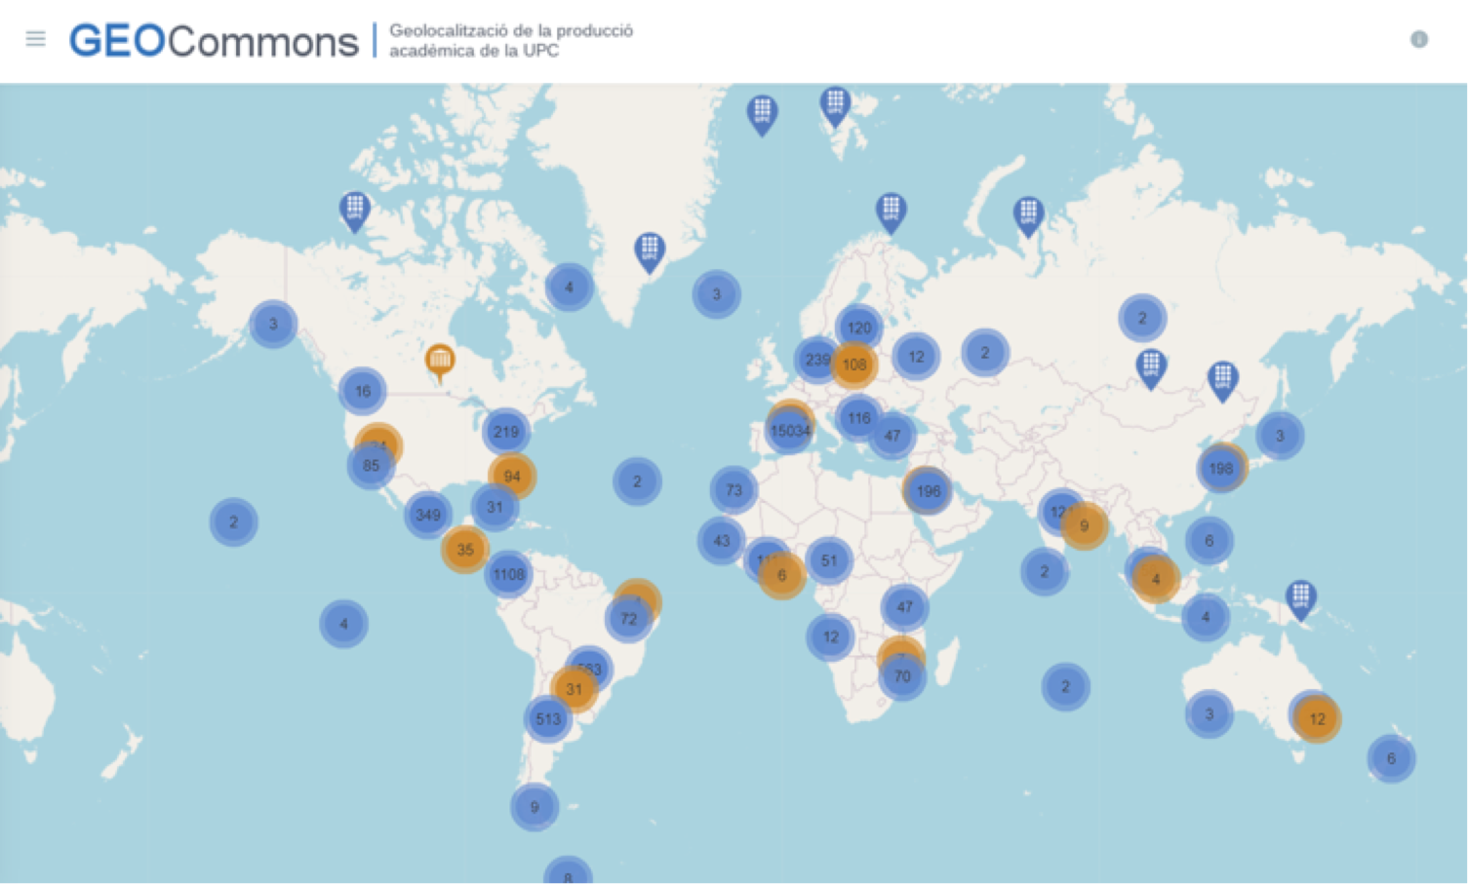
Education
https://geocommons.upc.edu/

Slide 12
Innovation
587 International Patents and licenses (last 10 years)
19 Patent licenses (2022)
ESA (European Space Agency)
Business Incubation Center
Located and supported by the UPC
72.7 MEUR
Research income
Since 1998:
353 spin-off and start-up
2 998
Sponsoring and collaborating companies

Slide 13
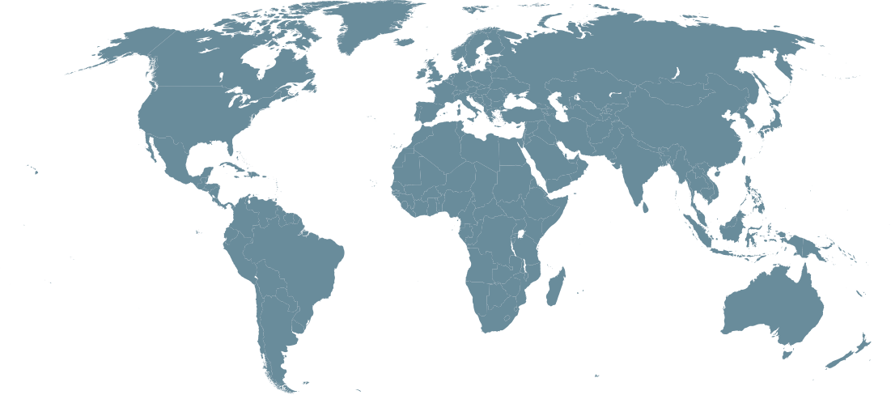
UPC ABROAD
Education: mobility, double degrees, strategic alliances
Research and innovation projects
Development Cooperation

Slide 14
Internationalisation
219
MoU
with international institutions
2 756
Students in international exchange programmes
34
Double degree
agreements
International students:
Doctorate: 55%, 79% of them, are from outside the EU
Master: 30%, 82.5%
of them, are from
outside the EU
53
development cooperation projects (2022)
40
Master’s programmes fully in English

Slide 15
Alliances
The UPC in international networks
KIC InnoEnergy
Knowledge and Innovation Community (KIC) backed by the European Institute of Innovation and Technology (EIT) to foster innovation in the field of renewable energies
EUA
(European University Association)
Cluster
(Consortium Linking Universities of Sience and Technology for Education an Research)
CASB
(Consortium for Advanced Studies in Barcelona)
TIME
(Top Industrial Managers for Europe)
UNITE!
(University Network for Innovation, Technology and Engineering)
TELESCOPI
(Red de Observatorios de Buenas Prácticas de Dirección y Gestión Universitaria en Latinoamérica y Europa)
SINO-SPANISH CAMPUS
University campus set un in conjunction with the Technical University of Madrid at Tongji University (China)
RedEmprendia
(Red de universidades iberoamericanas emprendedoras)
HERITAGE Network
UNITECH
(Red de universidades tecnológicas y empresas europeas)
AUIP
(Associación Universitaria
Iberoamericana de Postgrado)
RMEI
(Réseau Méditerranéen des Écoles d’Ingénieurs)
CESAER
(Conference of European Schools for Advanced Engineering Education and Recearch)
CINDA
(Centro Interuniversitario de Desarrollo)
MAGALHAES
(Red de universidades europeas y latinoamericanas)
GUNI
(Global University Network for innovation)

Slide 16
Barcelona, the sixth best city of the world to live, work and invest.
•According to the "World's Best Cities 2023" ranking.

Slide 17
Welcome to UPC!

