Slide 1



加泰罗尼亚理工大学

Slide 2
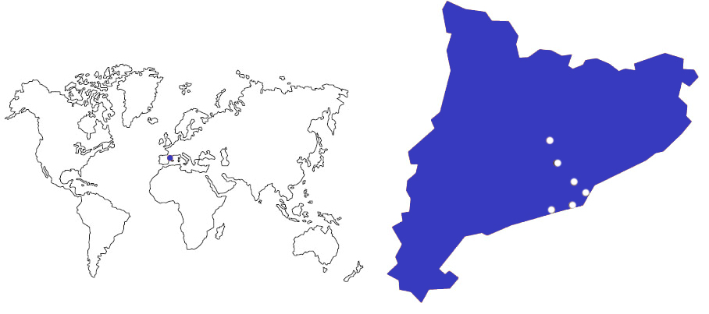
UPC · BarcelonaTech
Manresa
Terrassa
Sant Cugat
Barcelona
Vilanova i la Geltrú
Castelldefels
Leading Technology at the south of Europe
南欧科学技术领导者

Slide 3
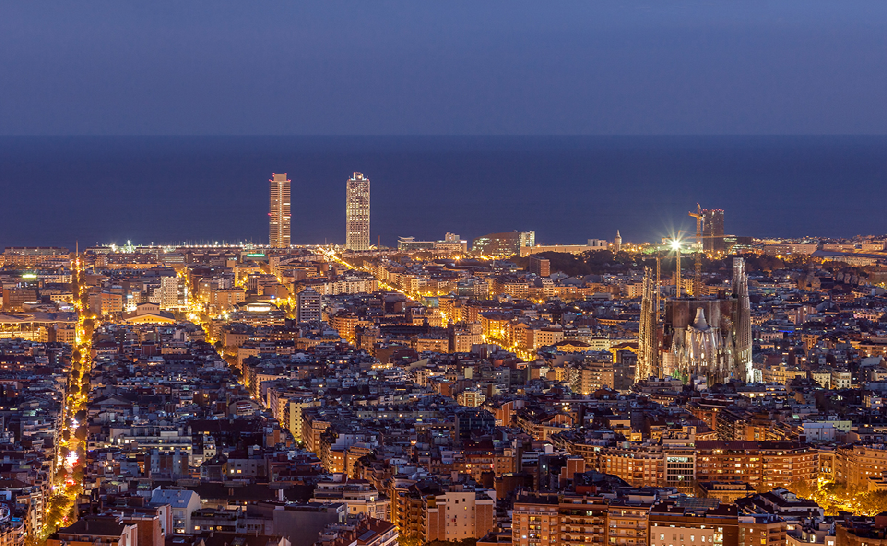
Education, Research, Innovation, Internationalisation
教育、科研、创新和国际化
BARCELONA....巴塞罗那
The Southern gateway to Europe 南欧门户城市
Mediterranean Capital 地中海之都
Bridge to the Maghreb 马格里布联盟桥梁
Platform for links to Latin America
连接拉美的平台
1,664,182 Inhabitants 人口
3,755,512 Inh. Metropolitan Area 市区人口
21,7% foreign population 移民人口
112,4 GDP per capita (Index UE=100) 国内生产总值
65,958,084 kTn harbour total transit 港口吞吐 (吨）
52,657,600 airport passengers 航空承载量 (2019)
477,734 Companies (province of BCN) 企业(巴塞)
8,908 foreign companies (Catalonia) 外企

Slide 4

Education, Research, Innovation, Internationalization
教育、科研、创新与国际化
The Universitat Politècnica de Catalunya·BarcelonaTech is a public institution of Higher Education and Research, specialised in the areas of Architecture, Engineering, Science and Technology.
加泰罗尼亚理工大学·巴塞罗那高科是一个提供高等教育与研究的公共机构，致力于建筑，科学和工程领域。

Slide 5

3,459
206
30,707
^{teaching}
^{and research staff}
^{教职工作人员}
^{research groups}
^{研究小组}
^{Students}
^{学生}
18
^{Schools in 9 campus}
^{学院}
27%
66
55%
^{bachelor’s degrees}
^{本科专业}
international master’s degree students
^{国际硕士学生}
45
81
^{doctoral programmes}
^{博士专业}
international doctoral degree students
^{(79% of them non EU)}
^{国际博士学生}
^{master’s degrees}
^{硕士专业}
736
higher education institutions with Student Exchange agreements
^{有学生的高等院校}
^{交换协议}

Slide 6
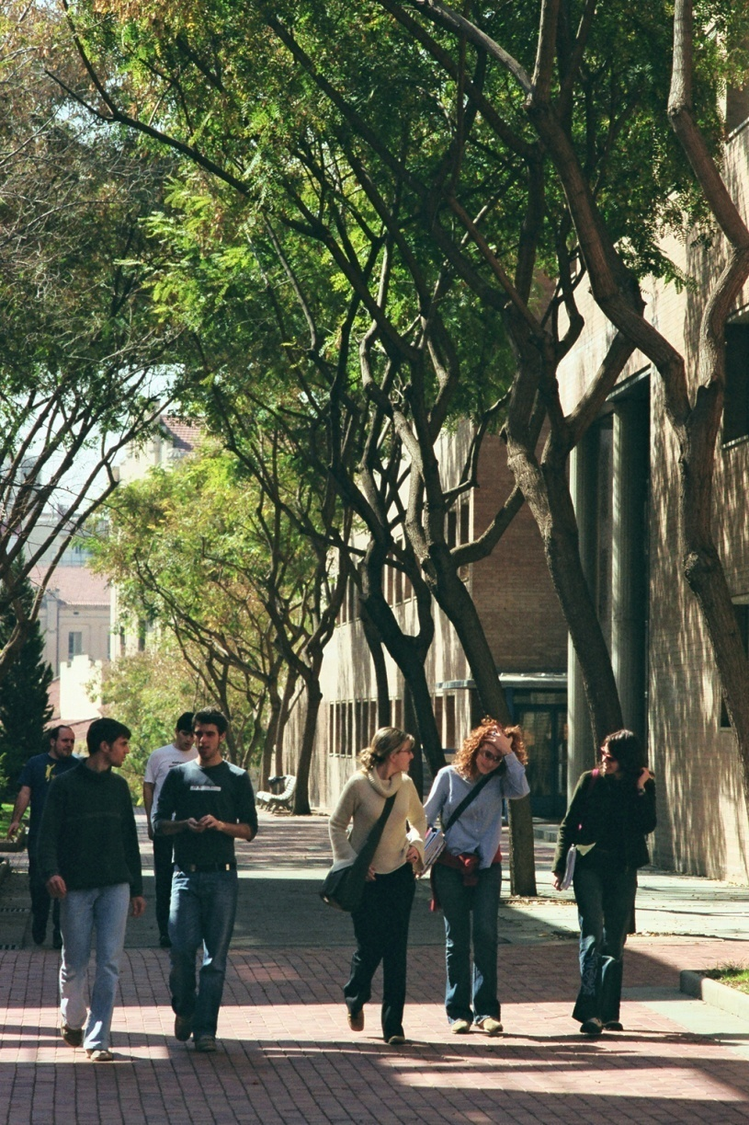
Fields 专业领域
Architecture and Urban Planning
建筑学、城市规划和建筑工程
Aerospace Engineering 航天航空
Agricultural and Biosystems Engineering
农业和生物系统工程
Civil, Environmental and Geological Engineering
土木工程、环境和地质工程
Computer Science 信息学
Engineering for Industry: Energy, Biomedical, Chemical, Electrical, Materials and Mechanical
工业工程：能源、工业设计、生物、化学、电气和机械
Naval, Maritime and Nautical Engineering
海洋与航海工程
Telecommunications and Electronic Systems Engineering
电信和电子系统工程
Applied Sciences: Mathematics, Statistics, Physics, Optics and Photonics 应用科学：数学、统计学、物理、 光学和光子学

Slide 7
Education
28,669 Undergraduate and master students,
28,669 名硕士毕业生
2,038
PhD students
2,038 名博士生
66 Undergraduate degrees, 66个本科毕业生
45
PhD programs
45个博士项目
1 Erasmus Mundus
1 个伊拉斯谟奖学金项目
2020-2021
81 Master’s programs 81 硕士项目
7 Erasmus Mundus
34 fully in English
7个伊拉斯谟奖学金项目
34个全英授课项目
69,442 members registered in UPCAlumni
69,442 名UPC校友会成员
2,929
Continuing education students: Life-Long Learning Program, corporate training, and other courses
2,929 继续教育学生：终身学习课程项目，培训及其他课程
3,823
Students Internships
4,844 名交换生

Slide 8

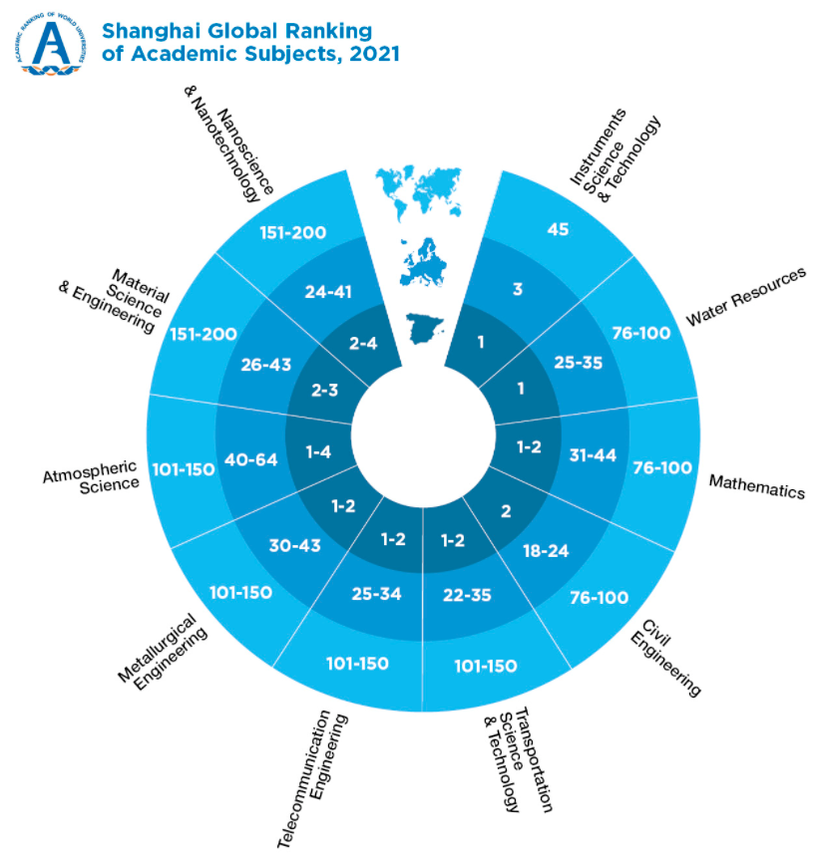
Reputation 荣誉地位

Slide 9
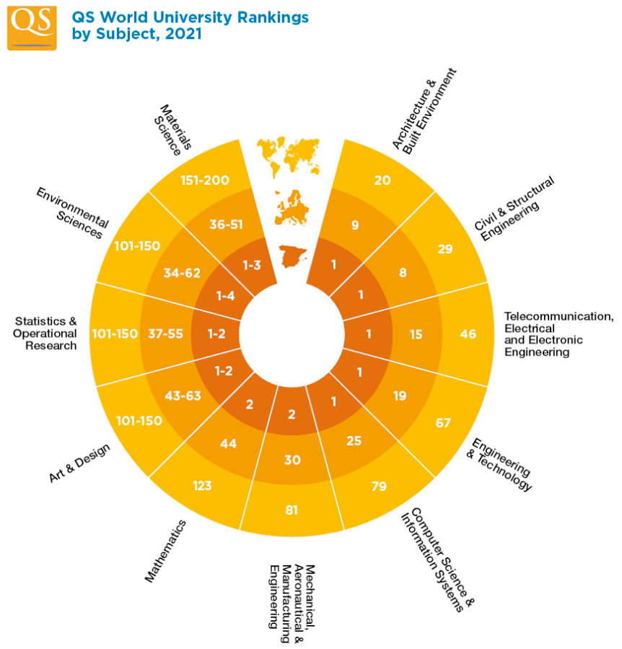
Reputation 荣誉地位

Slide 10
Research to Innovate 创新研究
3,317
Researchers grouped in
206 Research groups
3,317名科研人员
206个科研小组
2,273
Papers in scientific journals
每年科学期刊发表学术论文2,273 份
1,742
ongoing research projects
351
PhD theses presented
每年博士毕业论文315份
159
Technical and scientific awards
159 科学技术奖项

Slide 11
Innovation 创新
From 1998:
340 spin-off and start-up
340 分拆和创业项目成立
642 Patent licenses
(from 2009 to 2020)
642 专利
25 patent licenses
(in the last year)
55 MEUR
Research income 欧元科研经费收入19,500,000 € of which coming from contracts with companyies
其中19，500，000来自合作企业
ESA (European Space Agency)
Business Incubation Center
Located in the UPC and supported by the UPC
由UPC支持的欧洲航天局商业孵化中心
2,456
Sponsoring and collaborating companies
2,456 赞助企业和合作伙伴

Slide 12

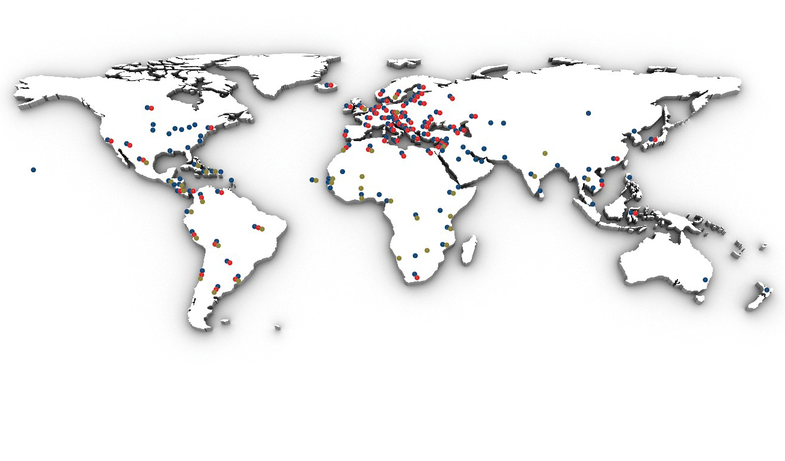
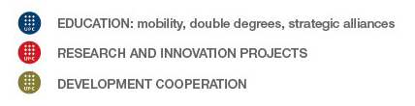
教育：人员流动、双学位、战略联盟
科研与创新项目
发展合作

Slide 13
Internationalisation 国际化
276
Memoranda of understanding
with international institutions
和国际上各大学达成276份谅解备忘录
42
Double degree agreements
42 个双学位协议
2,623
Students in international exchange programmes
2,623 个学生参予国际交流项目
34
Master’s programmes fully in English
34个全英语教学的硕士项目
63 development cooperation projects in 27 countries (2019)
与27个国家建立63项合作项目
(2019)
International students:国际学生
Doctorate: 55%, 79% of them non-EU
博士生：55% 欧盟学生， 其中79％是非欧盟学生
Master: 27%,
研究生：27%是欧盟学生

Slide 14
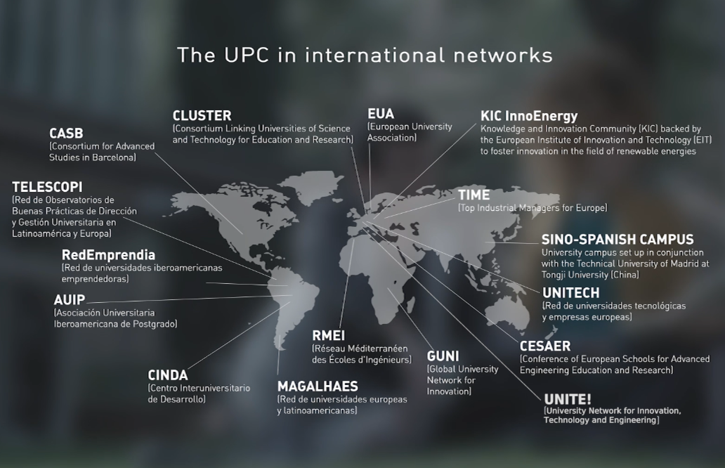
Alliances

Slide 15
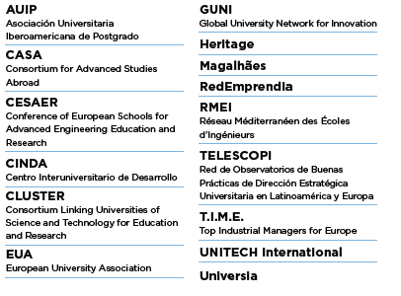
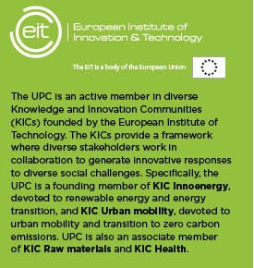
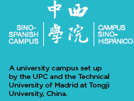
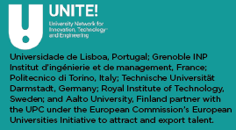
Alliances

Slide 16


















Alliances: CLUSTER

Slide 17
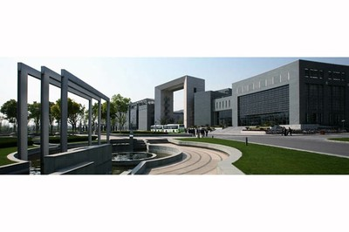
Sino-Spanish Campus at Tongji University
同济大学中西校园
Inaugurated in 2012 together with Universidad Politécnica de Madrid
2012 年与马德里理工大学共同成立
Sino-Spanish Campus UPC-UPM at Tongji University
加泰罗尼亚理工大学-马德里理工大学共同的中西学院在同济大学

Slide 18
SSC at TU: Main Goals
Education
  Student Exchanges 学生交换
  Double Degrees 双学位
  Organization of a Summer School 暑期学校
Research 研究
  Teachers mobility 教师流动
  Joint Projects 联合项目
  Organization of Workshops and scientific Conferences 及学术会议开展
Culture 文化
  Cultural exchanges 文化交流
  Dissemination of Catalan and Spanish culture 加泰罗尼亚和西班牙文化的传播
  Organization of cultural and recreational activities
  文化创新活动

Slide 19

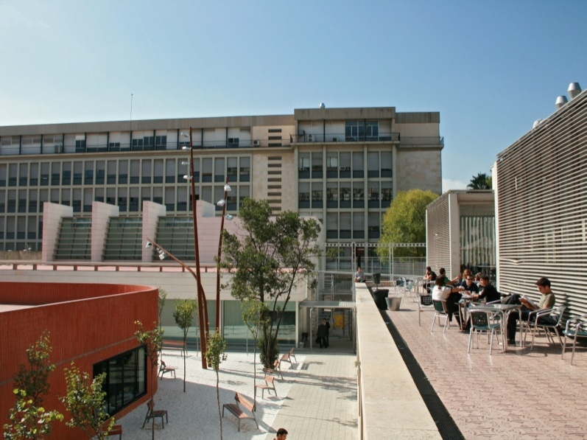
Campus of International Excellence – CEI
BKC establishes a framework for strategic collaboration which is key to providing the local environment with a solid, internationally recognized scientific and technological project, permitting the evolution of the local environment by means of an integrated social model based on innovation and sustainable development.
BKC建立了一个战略合作框架，为当地环境提供一个坚实的国际公认科学与技术项目的基础，通过创新和可持续发展的综合社会模式来改变当地环境

Slide 20

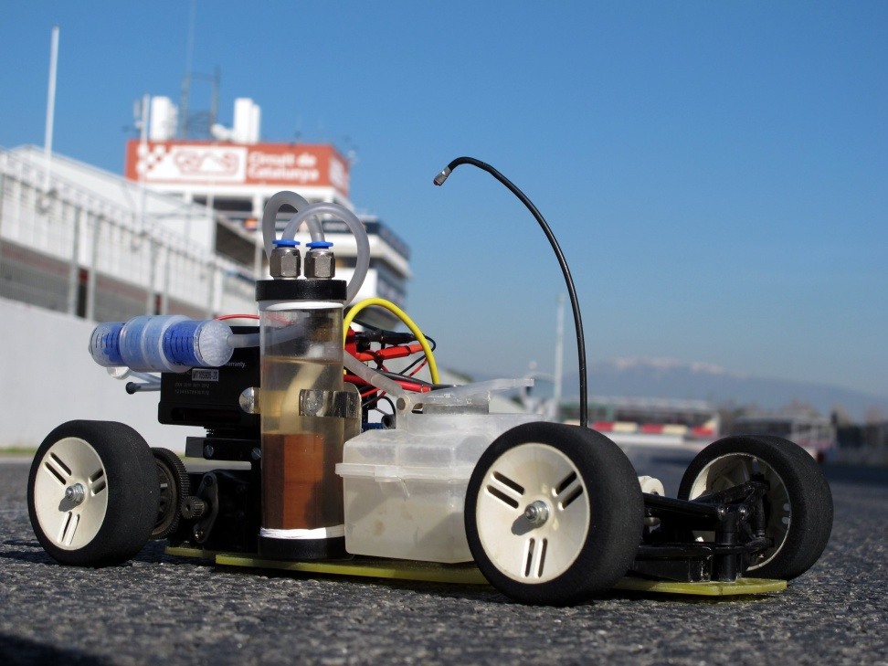
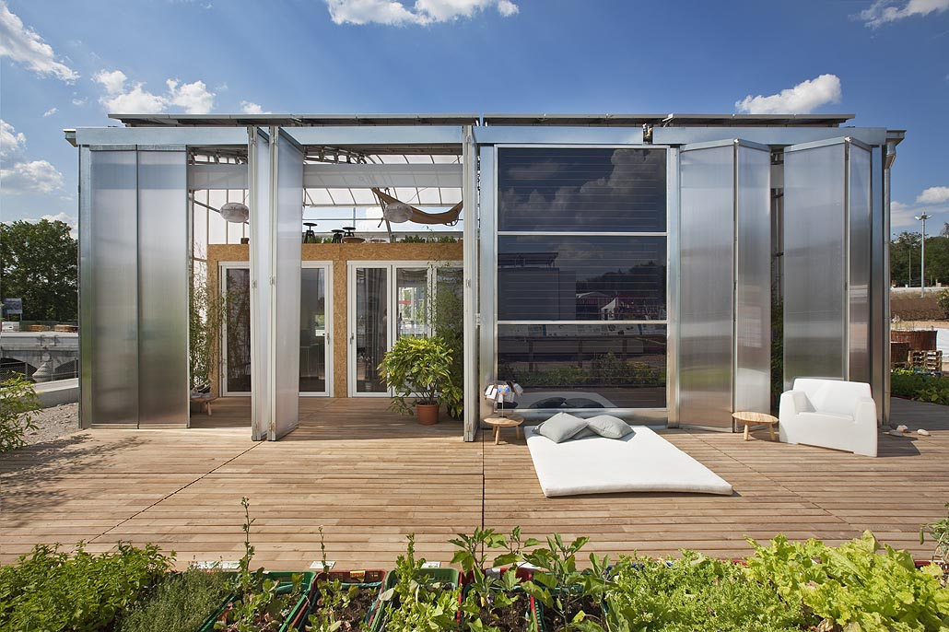
Energy Campus
The Energy Campus is a strategic consortium of several agents working together in the international arena to harness the potential of changes to the energy model while endorsing principles of social responsibility.
校园能源是多个国际级代理商的合作战略联盟，旨在利用潜在的能源模式变化来支持社会责任原则

Slide 21
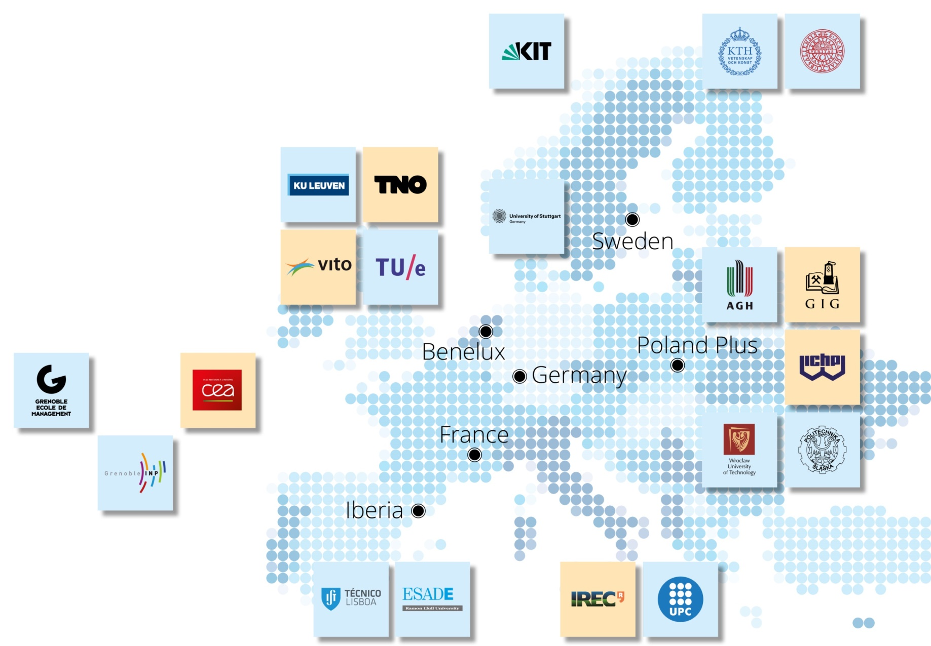
KIC Innoenergy
Making connections:
the power of the network
6 co-location centres
27 shareholders
160 additional partners
Activities in 17 countries
Our Shareholders
Research Institutes
Universities
Co-location Centres

Slide 22
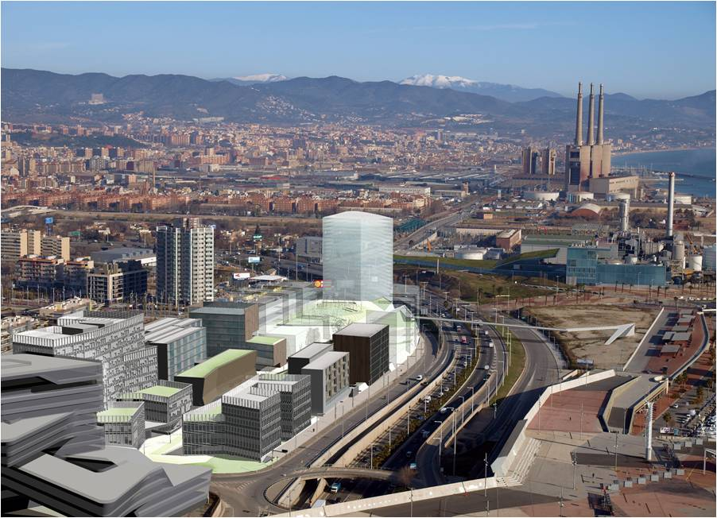






KIC Innoenergy - Iberia
Formal partners:主要合作伙伴
ESADE
Gas Natural FENOSA
Institut de Recerca de l’Energia de Catalunya-IREC
Instituto Superior de Lisboa
Universitat Politècnica de Catalunya
Associate partners:合作伙伴
Ciemat
Energías de Portugal
Iberdrola
Tecnalia Research and Innovation

Slide 23
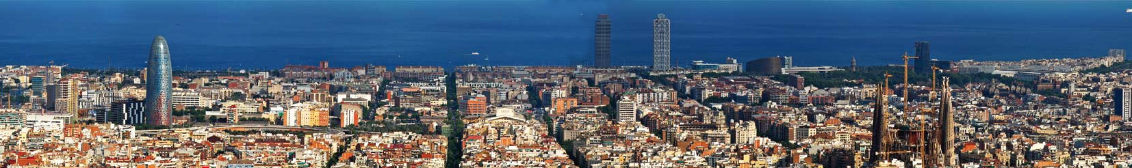
Global Technology Leading Innovation
Barcelona, amongst the 8 best student cities in Europe!*
巴塞罗那，世界学生最喜欢留学的欧洲十二大城市之一
According to QS Best Student Cities 2019 Ranking
评选来源：2019年QS最佳留学城市排名

